Slide 1
Registration process for Crisis Track

Slide 2
Registration Explained
To use Crisis Track you will be required to have both a Crisis Track account and a mySD account. This registration process is only done once.
Your username on Crisis Track and email address on mySD need to match.
Email and Usernames are not case sensitive.

Slide 3
Crisis Track Account Creation
Your Emergency Manager will create your username in Crisis Track and provide that to you after requesting access.
Your request to join Crisis Track needs to come through your County Emergency Manager.
They will need to provide your Email Address, First Name, Last name, Work Phone Number, Role Level and Jurisdiction.

Slide 4
You must create a mySD account
mySD was created by the State of South Dakota to provide a single point of entry and security for eGovernment Services.
mySD will be used to authenticate you as the user of Crisis Track and log you into the system on both mobile and desktop applications.
mySD is managed by South Dakota Bureau of Information and Technology and not by Crisis Track or SDOEM.
To create a mySD account you must go to the website at:
https://sd.gov
Click the Login Button

Slide 5
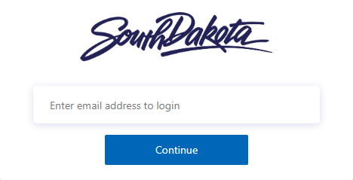
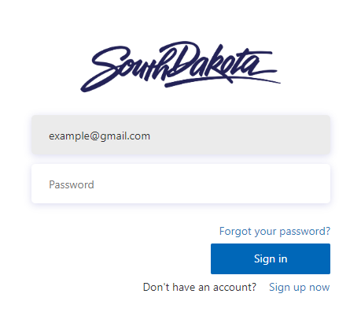
Enter in your username (email address) for Crisis Track and click continue.
The screen will change, and you need to click the lower right “Sign up now”.

Slide 6
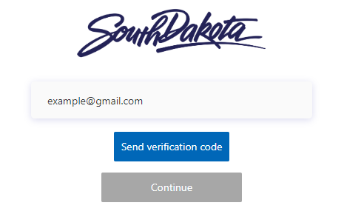
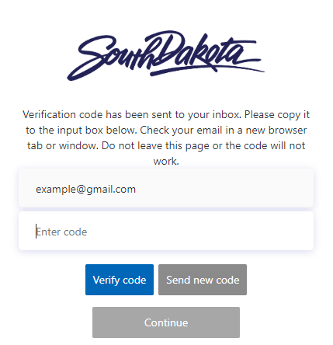
Ensure your email address is correct and click “Send Verification Code”.
Go to your email and enter the verification code sent to you and then select “Verify Code”.

Slide 7
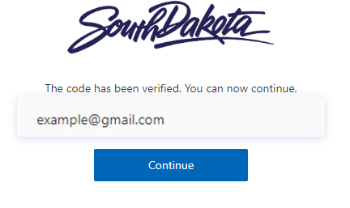
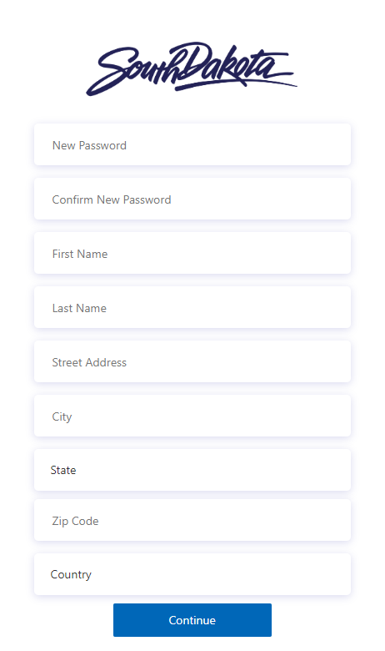
After correct entry of your verification code, you will get confirmation and can continue.
You will then need to complete the registration form with all pertinent information.

Slide 8
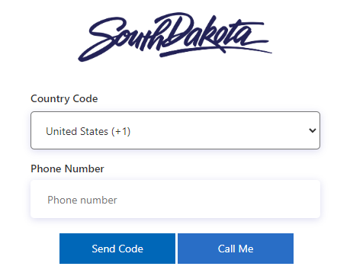
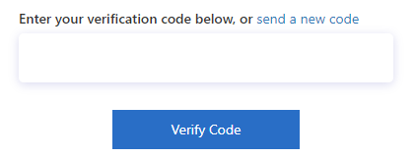
After entering all information, you will be required to enter a valid phone number. You must either have a code sent to you via text or a phone call to verify your information.
If you choose “Send Code” simply enter number sent to you via text and click “Verify Code”. You will be logged into mySD.
If you choose “Call Me” you will receive a phone call and follow the prompts. When complete, you will be logged into mySD.

Slide 9
Have Questions?
If you have any questions or need assistance, contact the South Dakota Office of Emergency Management.
Dustin Hight – Recovery Team Lead
Amanda VanderPlaats – PA Coordinator
Colby Jensen – PA Coordinator
Dale Farmen – PA Coordinator
Phone: (605) 773-3231

Slide 10
Log In process for Crisis Track Desktop Version

Slide 11
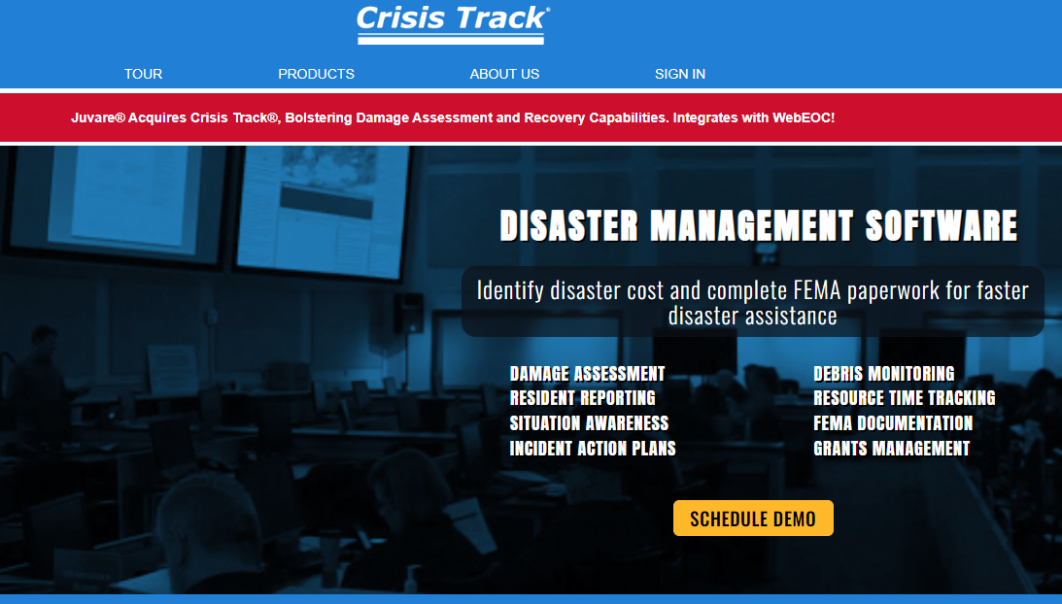
To log in to Crisis Track on a computer go to https://crisistrack.com and click “Sign in”.

Slide 12
At the bottom of the page, you will click “Alternative Login”.

Slide 13
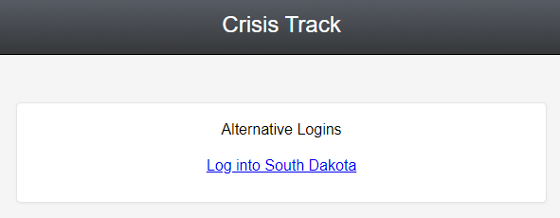
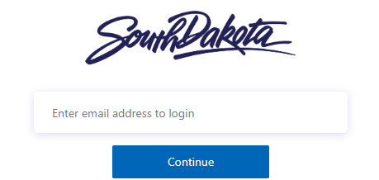
You will then click on “Log Into
South Dakota”.
Enter your email address.
Enter your password and click “sign in”.
You will then be redirected back to Crisis Track and logged in.

Slide 14
Log In process for Crisis Track Mobile Application

Slide 15
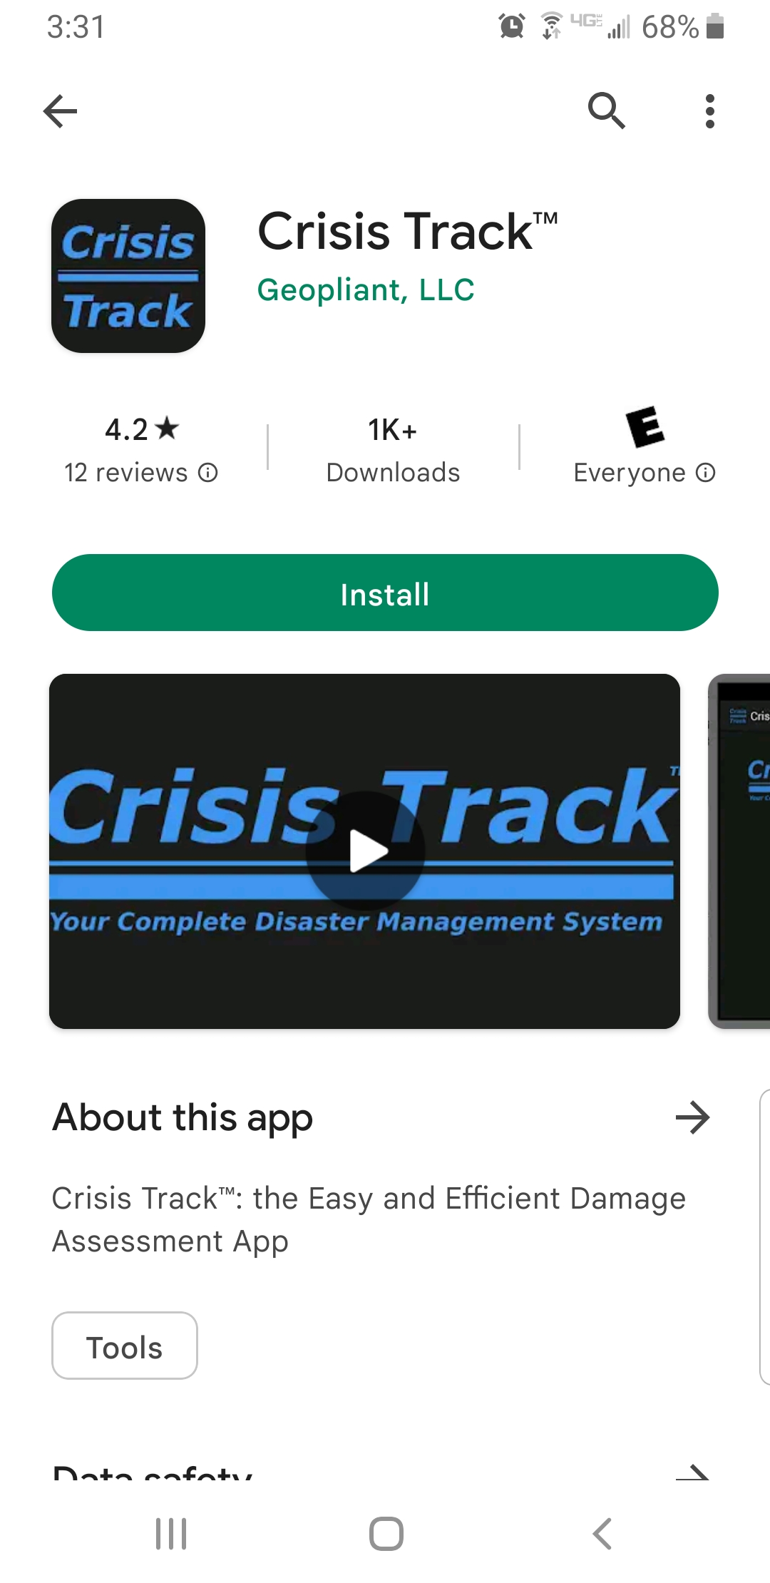
Screen images in this log in section may look different depending on your platform. But steps are the same.
Search for “Crisis Track” in either Apple Store, Google Play or Windows Store and download.

Slide 16
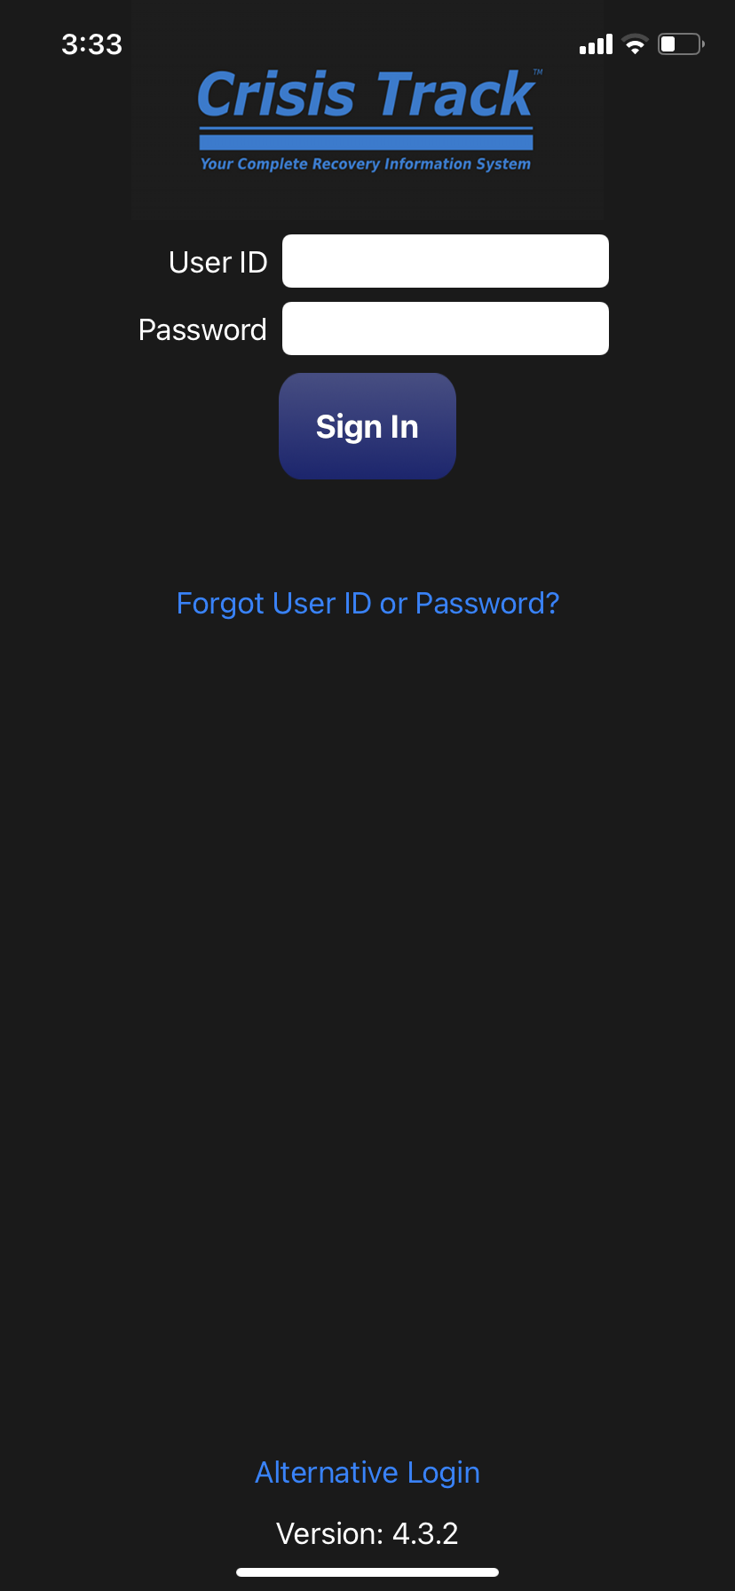
Open the app after downloaded and you will be presented the log in screen. You will click “Alternative Login”.

Slide 17
You will click “South Dakota Sign In”
If given a prompt like this just click “Continue”.
If no prompt is received, you can skip this step.

Slide 18
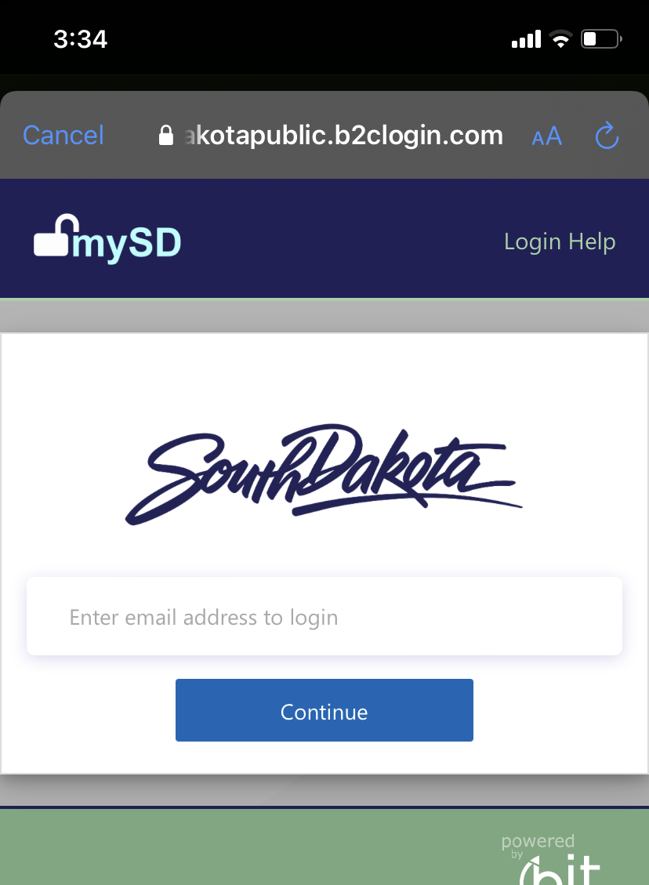
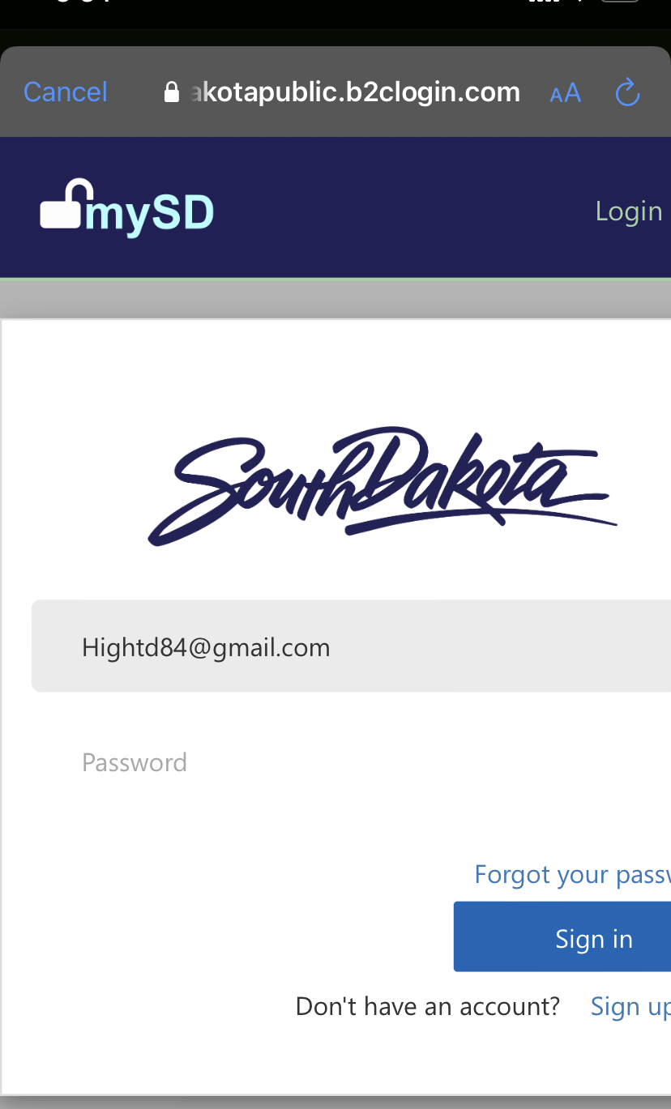
The link will take you to mySD. You will enter your email address and click “continue”.
Enter your password and click “sign in”. It will take you back to the Crisis Track App.

Slide 19
Have Questions?
If you have any questions or need assistance, contact the South Dakota Office of Emergency Management.
Dustin Hight – Recovery Team Leader
Amanda VanderPlaats – PA Coordinator
Dale Farmen – PA Coordinator
Colby Jensen – PA Coordinator
Phone: (605) 773-3231

