Slide 1
Crisis Track 101
EM and Administrators Training

Slide 2
Crisis Track 101
Crisis Track is a disaster management software that the SD Office of Emergency Management has purchased for all County Emergency Managers to use.
SDOEM wants Crisis Track to be a single source for submission of PDA data.
All County EMs should have an Administrative account in Crisis Track.
County EMs have control over who they want to have account access in their county.

Slide 3
Account Access
County EMs oversee their county’s Crisis Track account, and the administrators of their jurisdictions.
All requests for access must go through the County EM and include:
Full Name, e-mail address, work phone number, role, and jurisdiction
Anyone who wants to have an account (user or admin) in Crisis Track must create a MySD account.
The e-mail address used to create your account in MySD and in Crisis Track must be identical

Slide 4
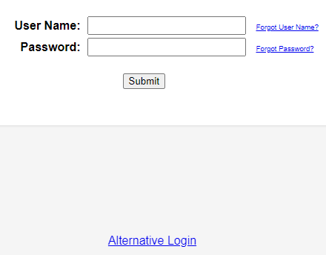
Account Access
To log in to Crisis Track, on-line or through the mobile app, you must use the “Alternative Login” button located at the bottom of the Crisis Track login screen.

Slide 5
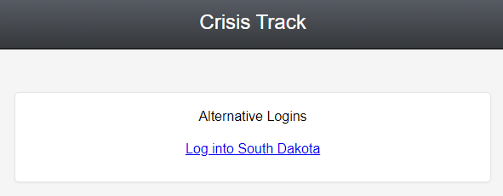
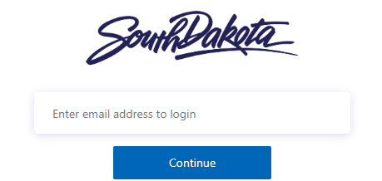
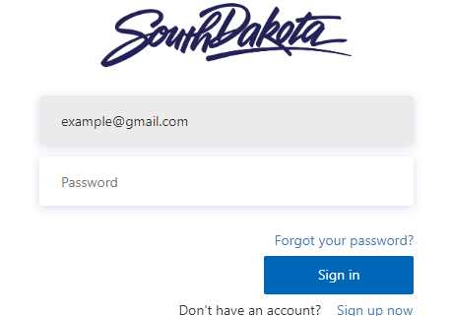
Alternative Login
You will then click on “Log Into
South Dakota”.
Enter your email address.
Enter your password and click “sign in”.
You will then be redirected back to Crisis Track and logged in.

Slide 6
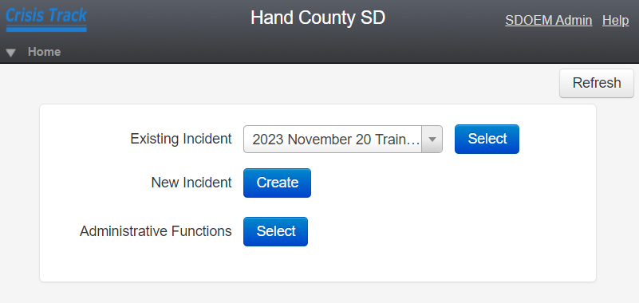
Home Screen - Admins
Once you’re logged in, you should see the home screen for your county or jurisdiction.
County level Administrators will see options for selecting existing incidents, creating new incidents, and administrative functions.

Slide 7
Administrative Functions

Slide 8
Adding Users
Account Administrators can add users, or administrators, to their account by going to the Administrative Functions menu and clicking on Users.
You should only add users that you know have created a MySD account.
Make sure that the e-mail address that was used for MySD is the exact same e-mail address used as the User ID in Crisis Track.
You can also add Guest users to your County account and your Jurisdictional accounts.

Slide 9
Jurisdictions
All counties have pre-loaded jurisdictions under your county.
These include any townships, road districts, cities, towns, and municipalities within your county.
You can click on the Jurisdictions icon and a drop down of all the jurisdictions in your county will show up.
Jurisdictional accounts will also show up in a table by clicking on the Applicants icon.
You can only add users to individual jurisdictions by clicking on the jurisdiction from the drop down.

Slide 10
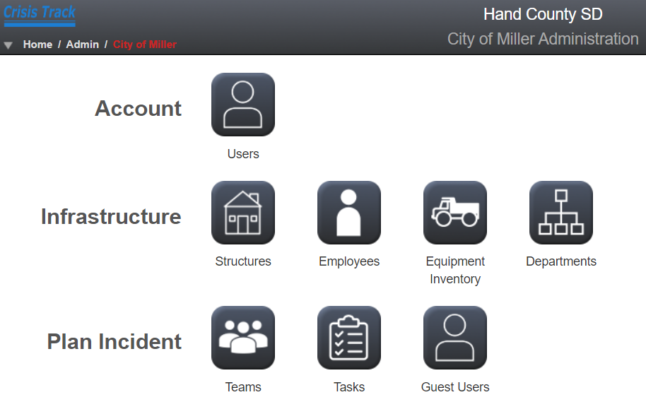
Jurisdictions

Slide 11
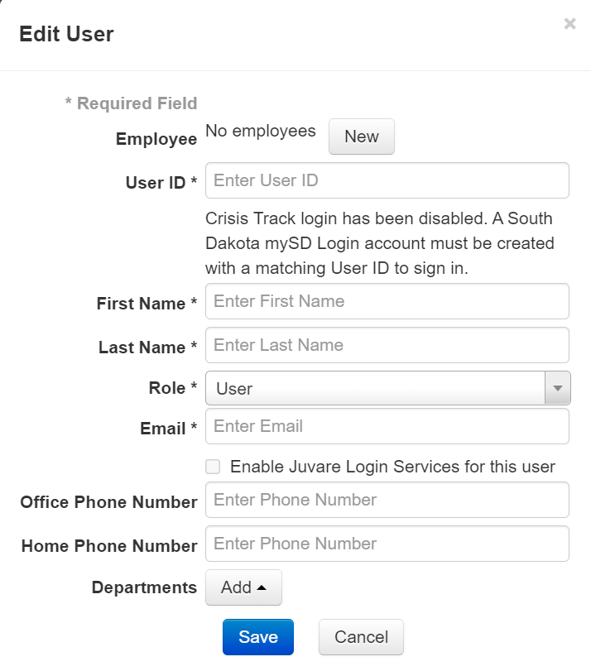
Jurisdiction Admins and Users
For each of your jurisdictions, you can add administrators and users.
Anyone you add at this level will only have access to this jurisdictions account.
This is how you can add your township supervisors and any city or municipality personnel that would want to be able to input damages.

Slide 12
Incidents
Any incidents that have included your county will show up under the Incidents.
Incidents can be created, viewed, edited, or deleted from the Incident menu.

Slide 13
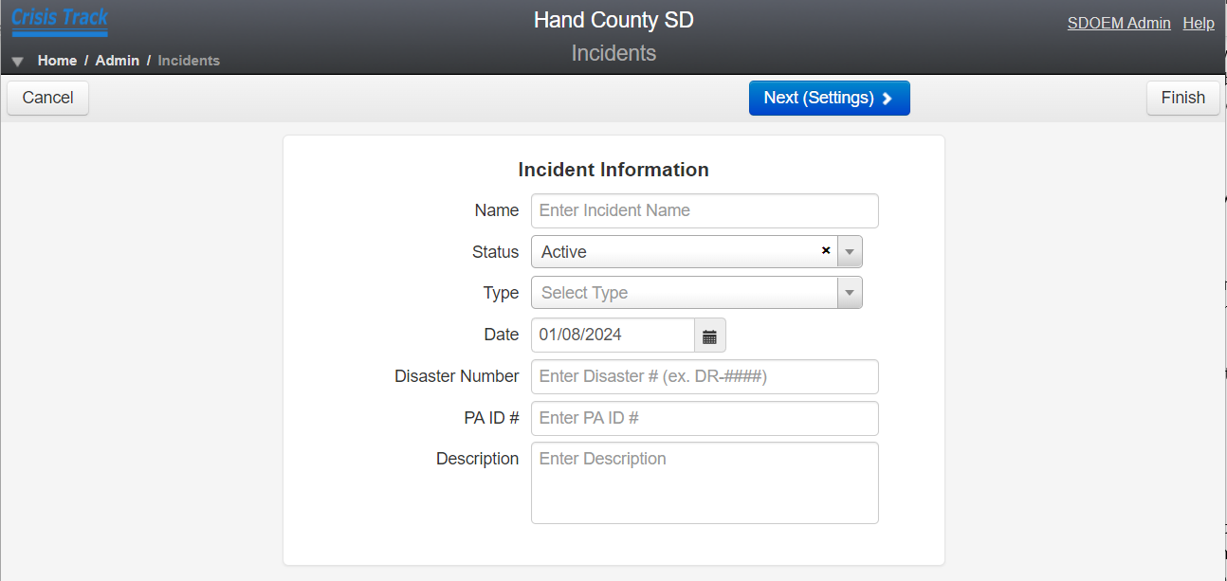
New Incidents
You can create a new incident from the Home screen, or from the Administrative Functions menu, by clicking on Incidents, then selecting New in the upper left part of the screen.
This can only be done on the desktop version of Crisis Track.

Slide 14
New Incidents
Name your Incident: Year Month Event Type
Example: 2024 January Blizzard
Once you’ve filled in the incident information and description, click the blue Next arrow.
Your County specific population and the current damage threshold per capita indicator will show up.

Slide 15
New Incidents
If you have preloaded employee and equipment information, you will be able to add personnel and equipment to the incident on the next two pages.
If you have preloaded teams and tasks, you will be able to select incident teams and tasks from the next two pages.
If you have not preloaded information into your account, you will click the blue Next button and default teams and tasks will be added to your incident.

Slide 16
New Incidents
The last step before finalizing an incident is adding map layers.
All incidents default to the National Flood Hazard map layer.
If you have pre-assigned routes for your incident teams to follow, or zones for damage assessment teams to go to, you can upload map layers to your county account, or upload shape files to your preconfigured tasks, that you can utilize when creating new incidents.

Slide 17
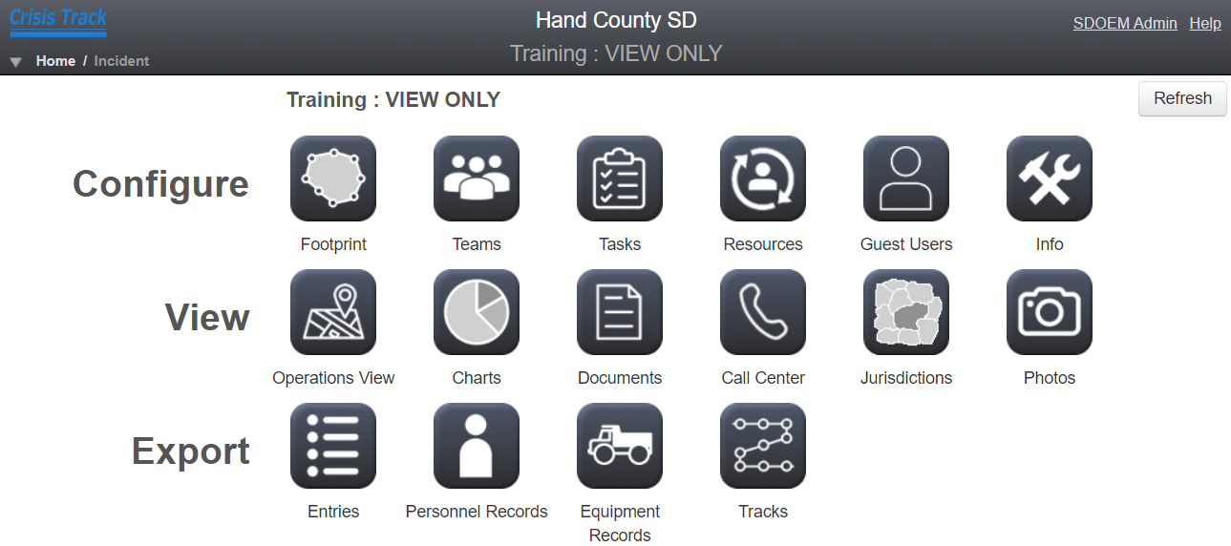
New Incidents
Your new Incident will now show up in your incident list.
Click on View next to the incident to see the Incident menu

Slide 18
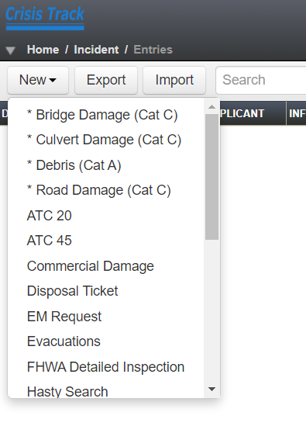
New Incidents
Incidents created in your county will only be viewable to users and administrators in your county.
You can add damages directly to your incident from the incident menu by clicking on Entries (next to Export)
Then click on the New drop down and select the type of damage you are adding.

Slide 19
Damage Entries
Types of damage that have an asterisk * next to them are the typical damage entries for a Public Assistance Preliminary Damage Assessment.
Roads, bridges, culverts, and debris all have pre-loaded forms to fill out for reporting damages.
Other forms that are available will require more manual entries and figures as they have not been preloaded with information (costs, measurements, etc.)

Slide 20
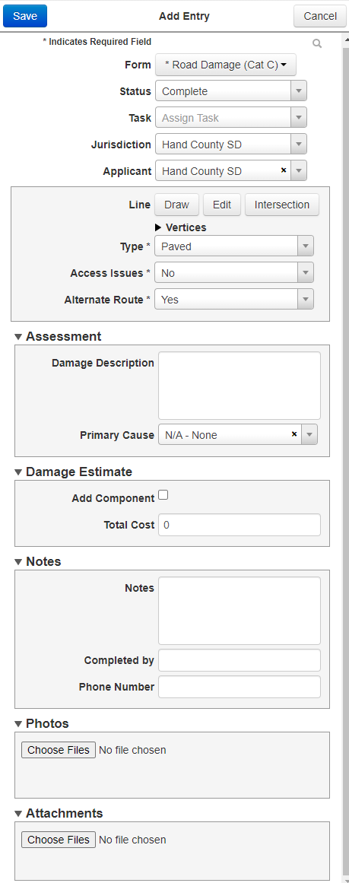
Sample Damage Entry
Damage entries should include as much information as possible.
All entries, regardless of type, should include at least two photos and accurate GPS coordinates.
When using the desktop website to enter damages, you will need to have photos of the damage saved to your computer to upload.

Slide 21
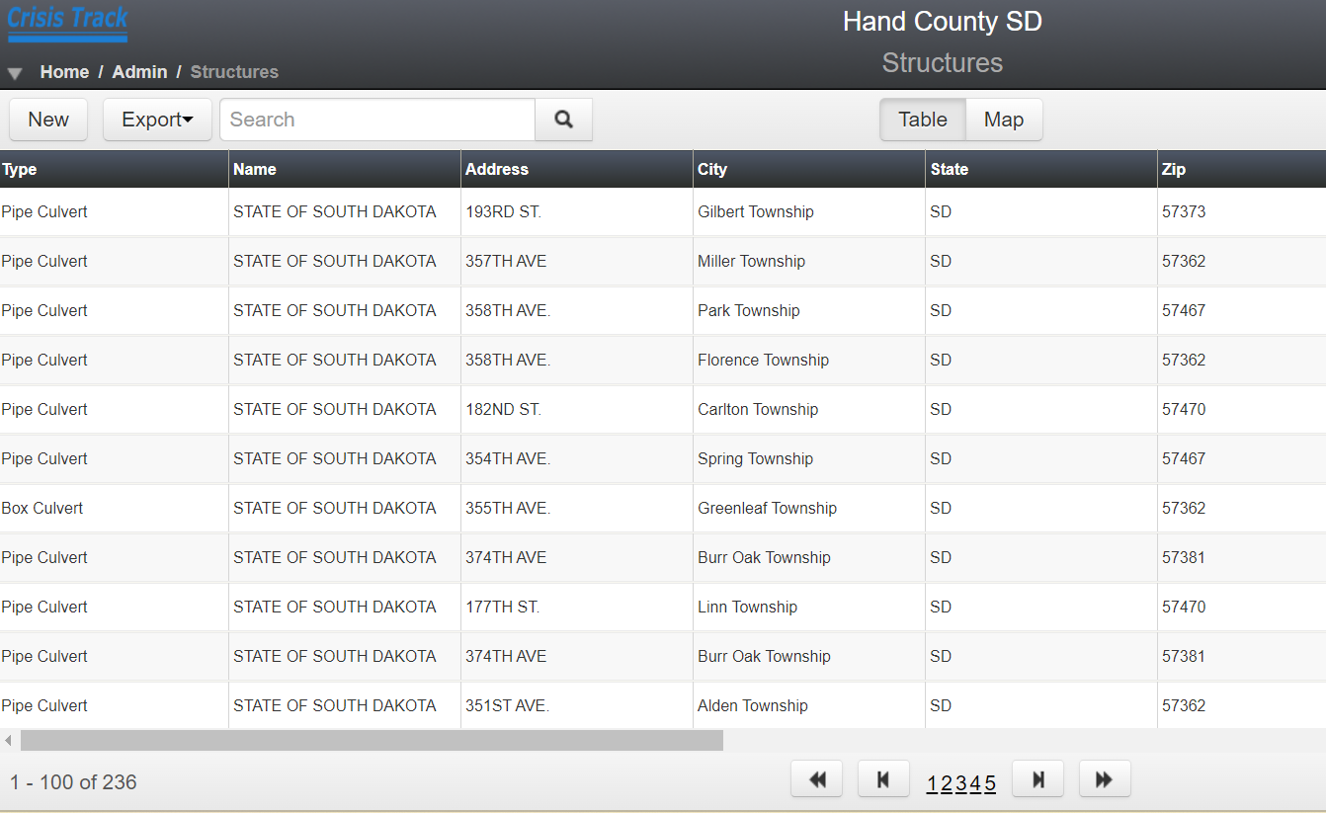
Preloaded Structures
The data collected during the small structure inventory has been preloaded into each county.
From the Administrative Functions menu, next to Infrastructure, click on Structures.

Slide 22
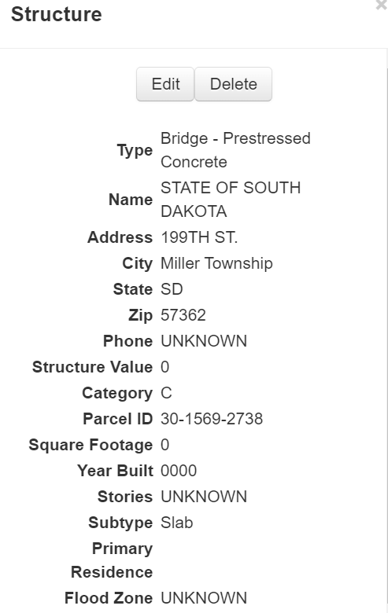
Structure Map
You can view the structures in the table, or on a county map.
You can click on individual structures to view details or edit the information on the structure.

Slide 23
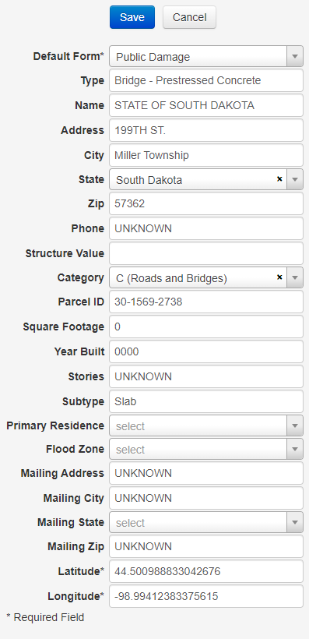
Edit Structures
If a structure has been repaired or replaced, or if the value of the structure has been established, you can click on the Edit button and the structure data will come up for you to edit.

Slide 24
New Structures
You can add new structures individually to your county, or in any jurisdiction, by clicking the New button.
The same form you saw for editing a structure will come up for you to input new structure data into.
If you have multiple structures you want to upload, your structure data can be sent to Crisis Track and someone from their development team can upload the information to your county for you.
Structures will be available from drop down lists when inputting damage information using the app.

Slide 25
Structure Upload Files
This is how Crisis Track needs data to upload structures for you.
Please provide your latest address point layer and tax parcel layer containing the following attributes, some required and some optional:
REQUIRED -PHYSICAL ADDRESS -PARCEL ID (https://app.regrid.com/us/sd)
-OWNER NAME -IMPROVED VALUE (if it's easier for you - Land Value and Total Value work as well) OPTIONAL (While this data is not required it is beneficial) -CITY (city information for the physical address) -ZIP (zip information for the physical address) -PROPERTY OWNERSHIP TYPE (such as GOVERNMENT, COMMERCIAL, RESIDENTIAL, etc.) -STRUCTURE TYPE (SINGLE FAMILY RESIDENTIAL, APARTMENT, SCHOOL, HOSPITAL, etc.) -SQUARE FOOTAGE (total square footage of the structure) -YEAR BUILT (year the structure was built) -STORIES/FLOORS (number of stories or floor in a structure) -MAILING ADDRESS (owner's mailing address) -MAILING CITY (city information for the owner's mailing address) -MAILING STATE (state information for the owner's mailing address) -MAILING ZIP (zip information for the owner's mailing address) Having the most current data will help Crisis Track best assess damage after a disaster.
If possible, we would like these as either shapefiles or geodatabases. If that isn't possible, we can utilize most any digital format (Spreadsheet, Tables, Text Files (comma or tab separated), and standard database files (.dbf).
If either file uses key codes as field inputs, please also send us the key codes and their definitions

Slide 26
Adding Employees and Equipment
From the Administrative Functions Menu, you can add employees and equipment.
Adding an employee DOES NOT give them user access to Crisis Track.
Employees and equipment that are added to your county inventory will be available for you to choose from when you are preconfiguring tasks and teams, and when you are tracking FAL & FAE.
You can upload employees and equipment in batches using .xls or .csv templates from Crisis Track.

Slide 27
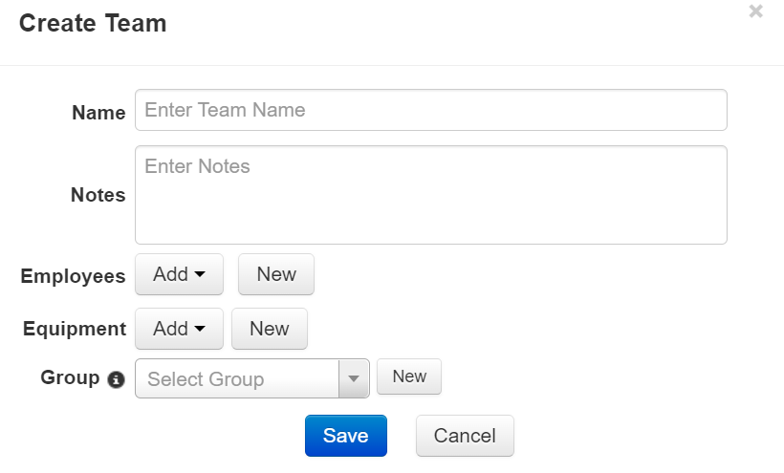
Creating Teams
Creating Teams from employees and equipment that you already have loaded can save you time when you are sending people out into the county to gather damage information.
From the Administrative Functions menu, click on Teams, then add your team information.

Slide 28
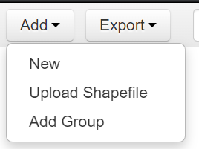
Creating Tasks
Creating tasks can also save you time when you need to gather damage information.
You can assign teams to assess damage in preconfigured areas of the county, or to look at specific structures.
You can also assign tasks to individual employees.

Slide 29
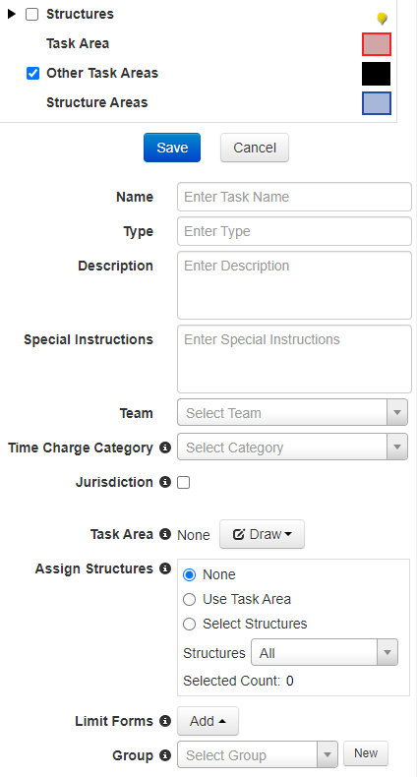
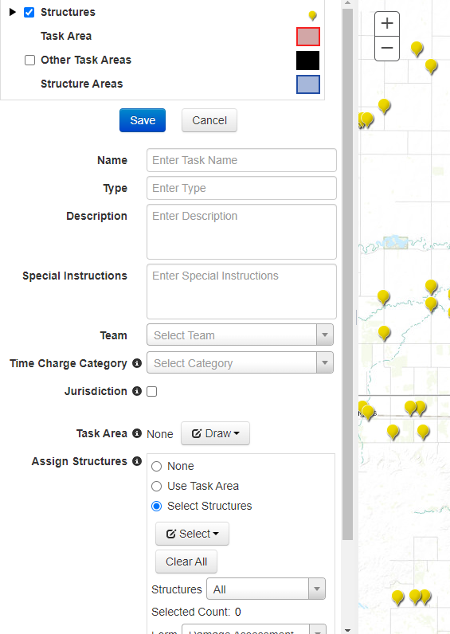
Creating Tasks
You can set a task area by entering the information in the task form.
You can choose specific jurisdictions or draw a task area on the county map.
You can also assign structures to a task.

Slide 30
Creating Tasks
If you have shapefiles, you can upload a shape file and use it to create a task.
This can be useful if you have areas of your county that are zoned or broken out into regions or routes.
You can also upload storm path information from the NWS to your incident and assign teams to assess damage within the path of a storm or tornado.

Slide 31
Crisis Track App
Always make sure that you have the most up to date version of the app installed on your device.
Update the app from the app store if there is an update available.
Make sure you click the Alternative Login at the bottom of the screen to log in to the app.

Slide 32
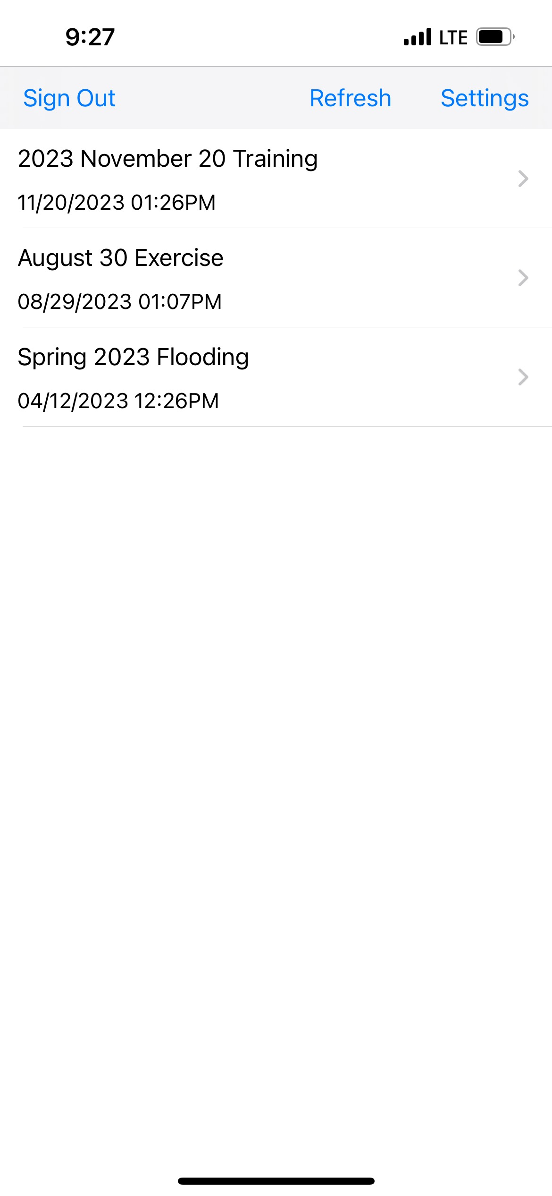
Crisis Track App
Only Incidents that are active will show up when you log in to Crisis Track.
You cannot create a new incident through the app.
If you have just created a new incident on the web version and it is not showing up when you log in to the app, hit the Refresh button.

Slide 33
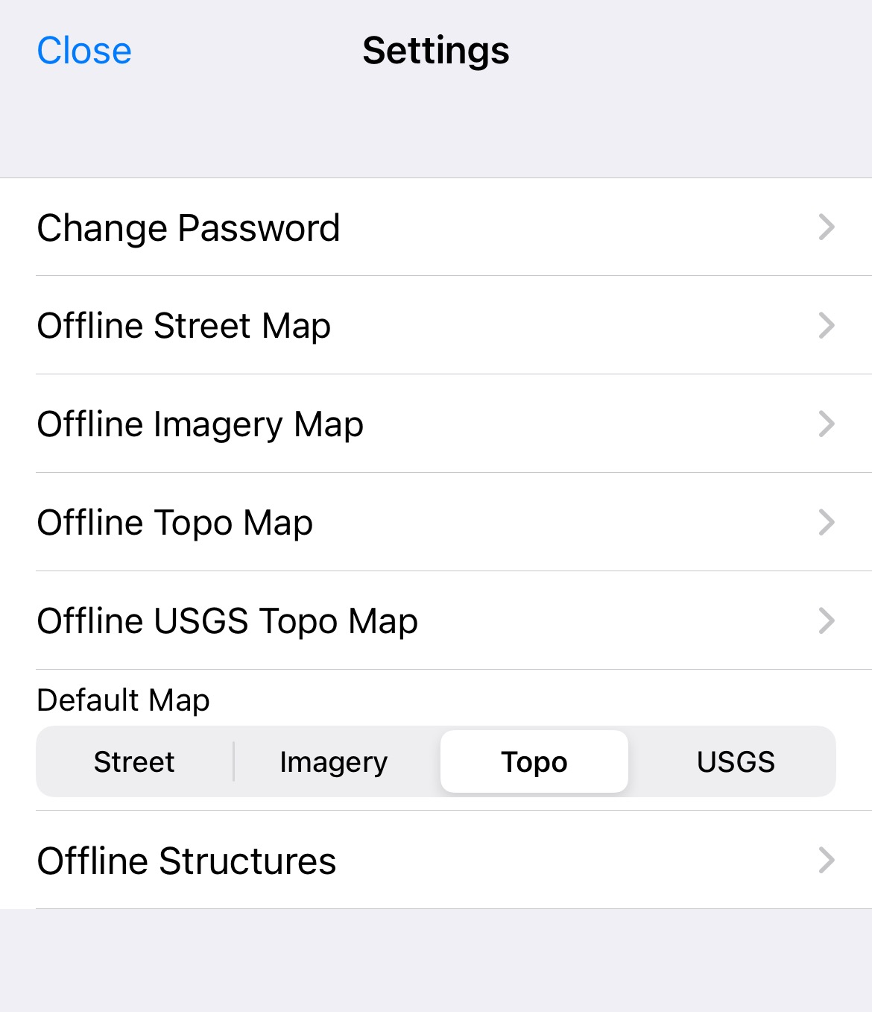
Crisis Track App
If you will be using the app in an area of low connectivity, you can go to the Settings menu and choose to work offline.
Any data entered while offline can be uploaded once you have more reliable service.
Choosing to work offline can save your battery life and limit your phones data usage.

Slide 34
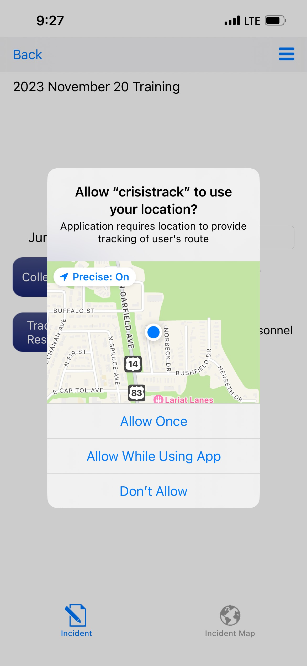
Crisis Track App
You may periodically get a pop up asking for permission to use location tracking.
You can choose how you allow the app to use your mobile devices location.
If you click Don’t Allow, then you will not be able to use the GPS functions or tracking on the app.

Slide 35
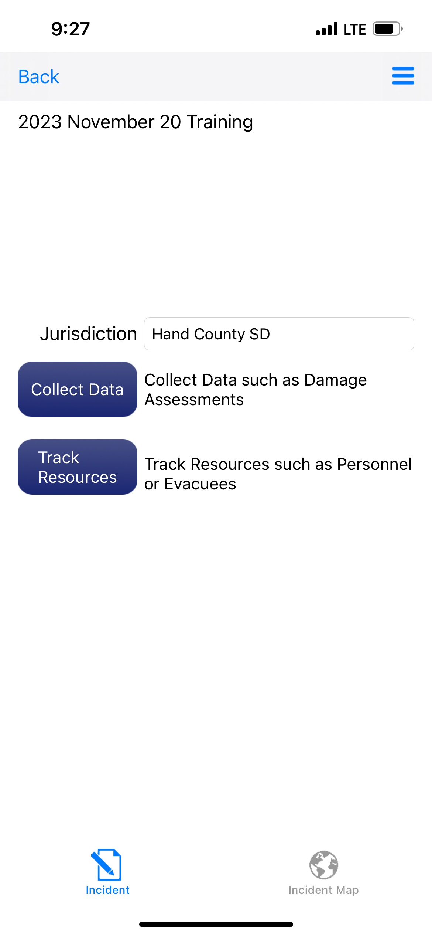
Crisis Track App
Always make sure you are adding data to the correct jurisdiction.
To add damage data, click to blue Collect Data button.

Slide 36
Crisis Track App
Default Team will always be available.
If you have preconfigured teams on the website, you should see those teams available on this screen.
You can also click on the Create Team icon to add a new team in the field.

Slide 37
Crisis Track App
Default Task will always be available.
If you have preconfigured tasks on the website, you should see those tasks available on this screen.
You can also click on the Create Task icon to add a new task in the field.

Slide 38
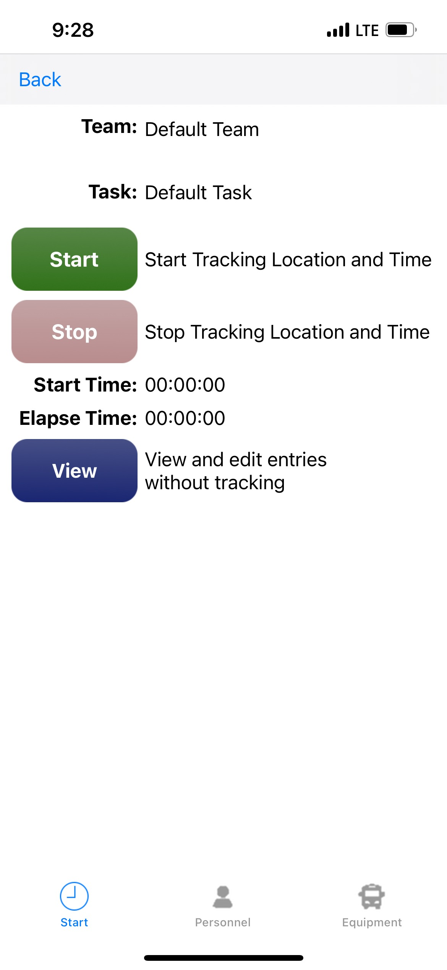
Crisis Track App
To begin entering damage information, click the green Start button.
This will keep track of your time spent in the field, as well as your location.
You can also click the blue View button to create entries without tracking your field time.

Slide 39
Crisis Track App
Any damages that have already been entered by you, or someone else in your jurisdiction, will show up on this page.
To add new damage information, click the blue plus + sign in the upper right corner of the screen.

Slide 40
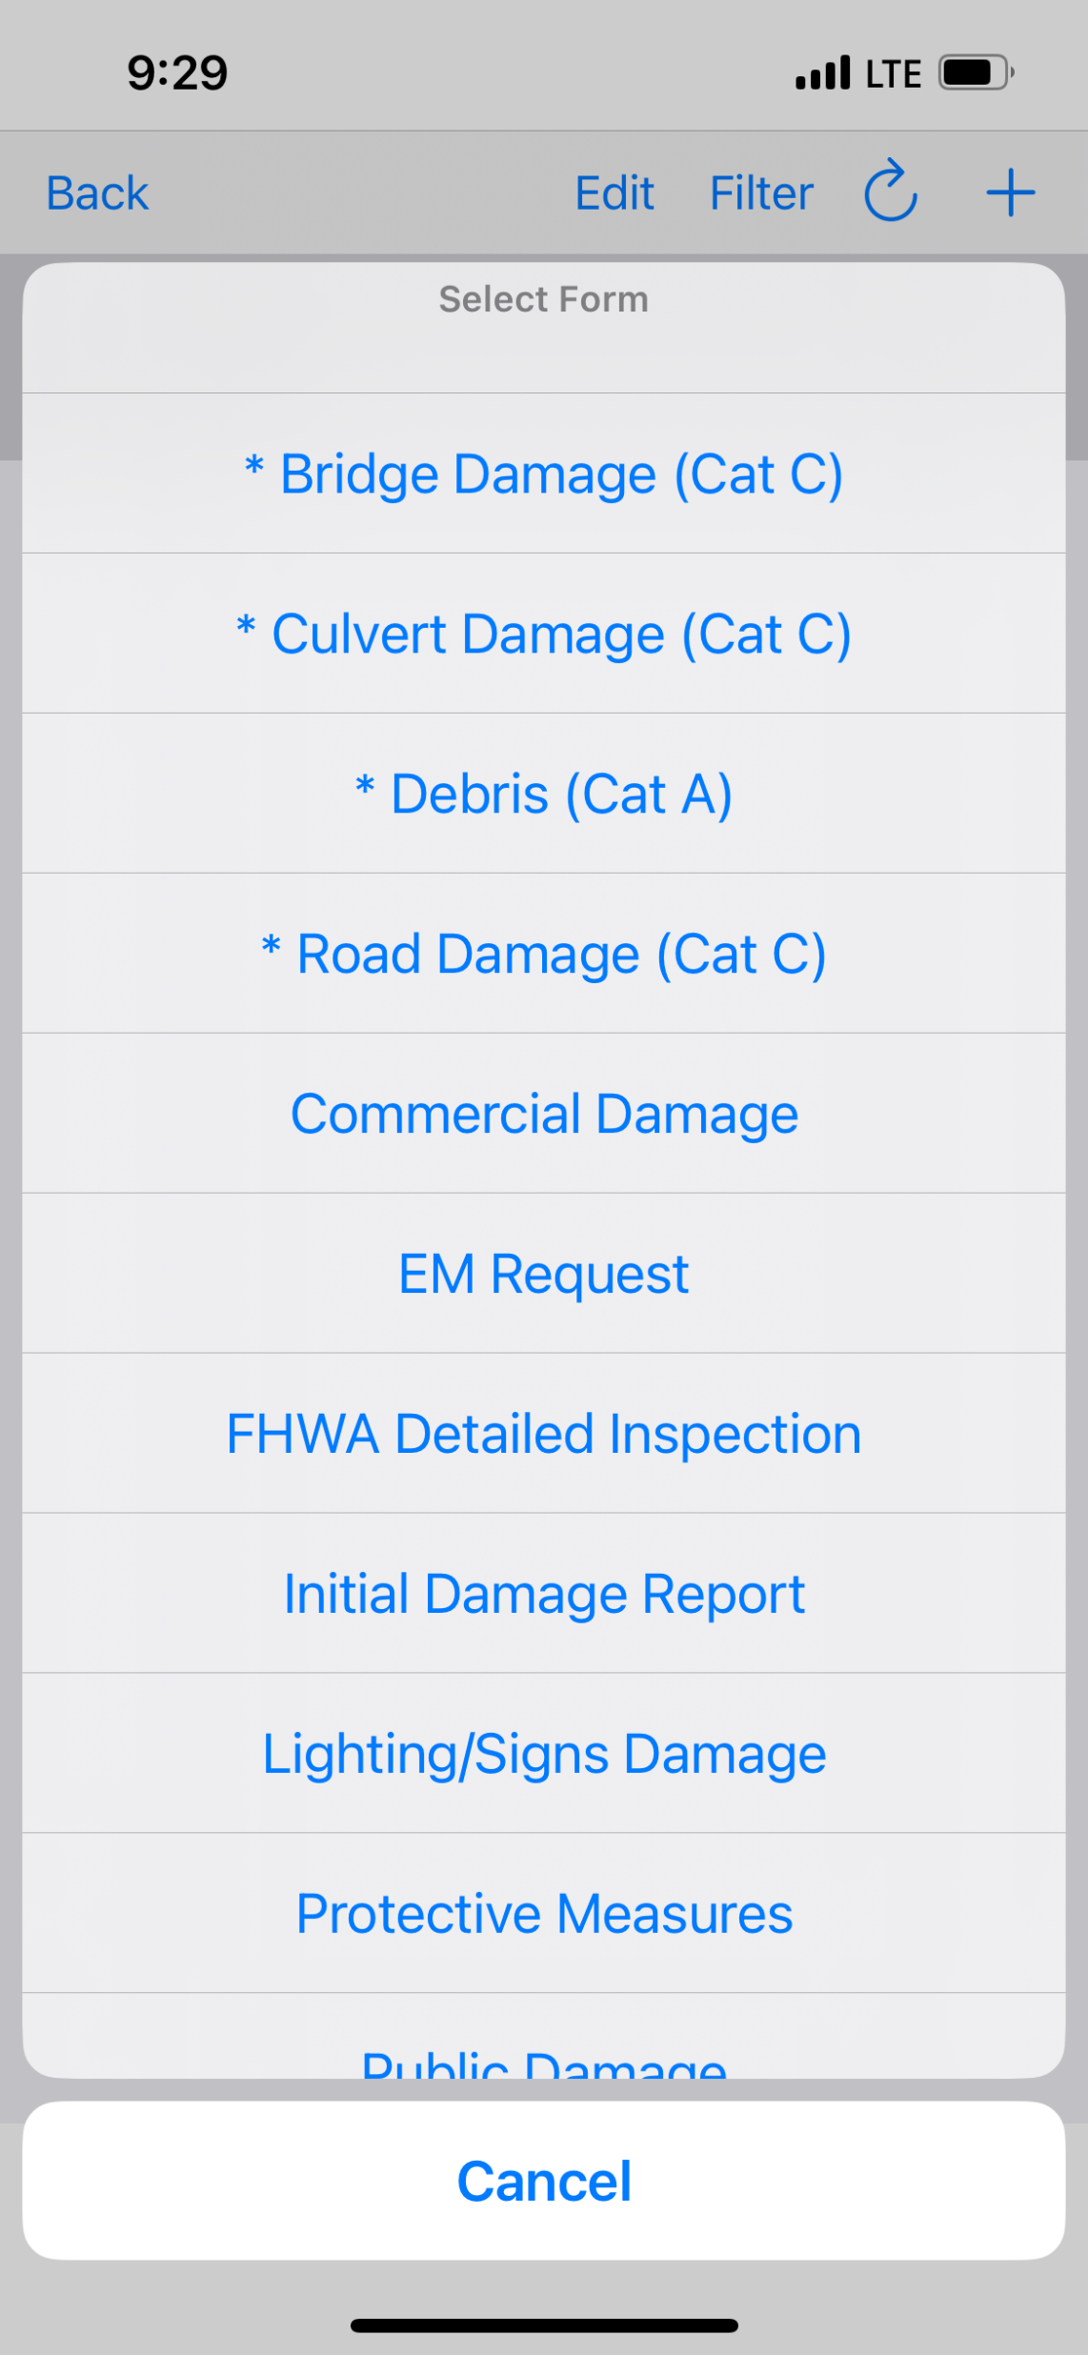
Crisis Track App
Choose the appropriate form from the menu that comes up.
If you are not entering Cat A, B, or C damage information, you can choose the Public Damage form for all other categories of damage.

Slide 41
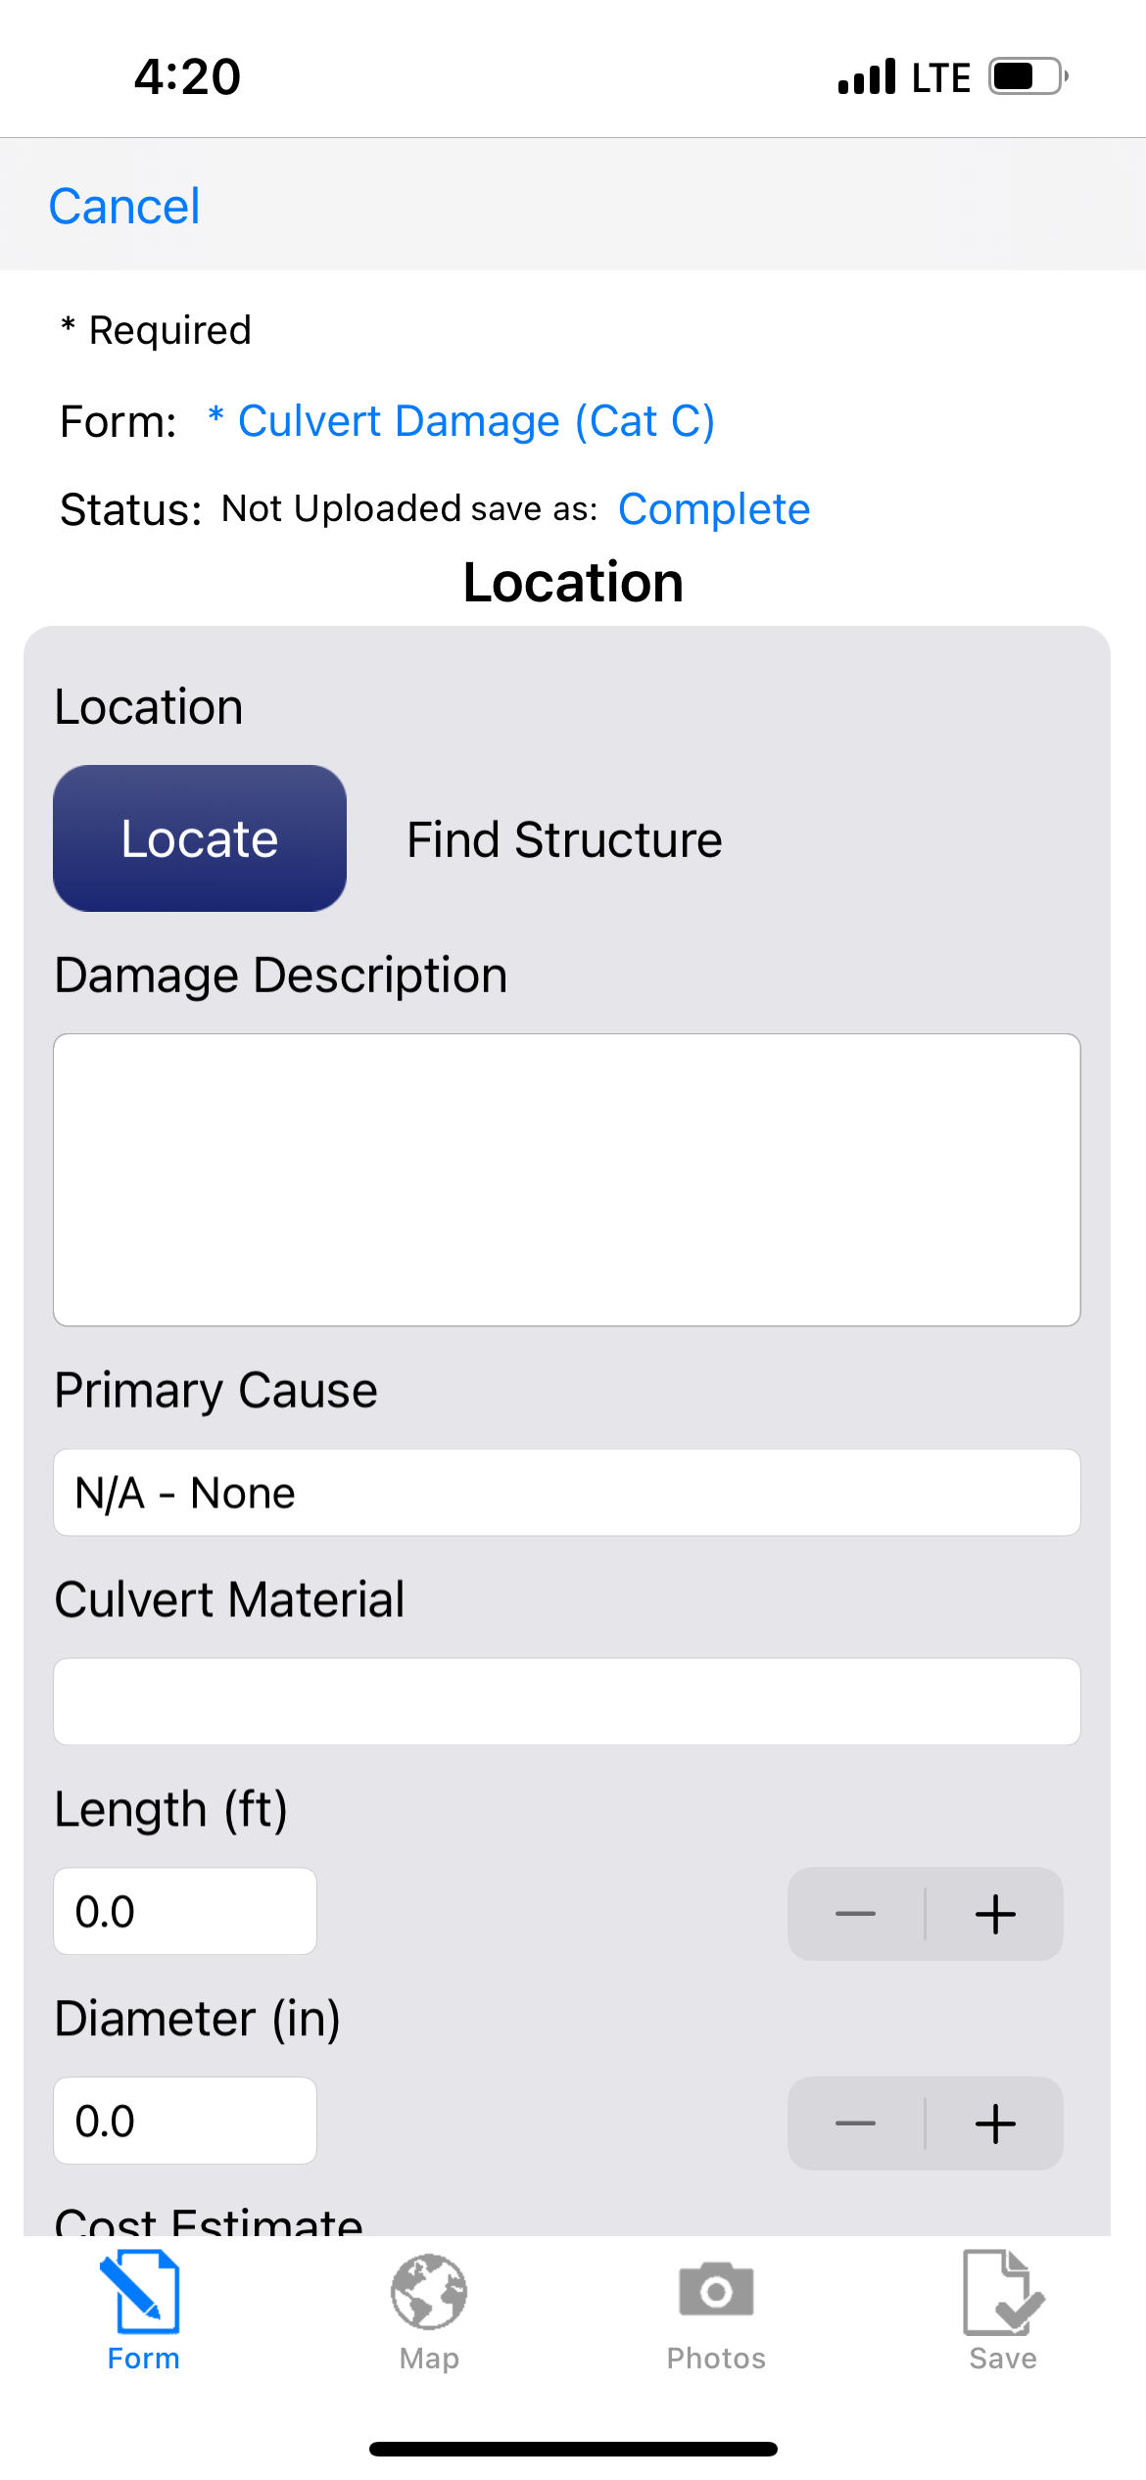
Crisis Track App
For damage to structures that have been preloaded into your county, if you click the blue Locate button, a list of nearby structures should show up for you to choose from.
If the structure you want to report damages for is not available on the drop down, you can input the structure information in the form.

Slide 42
Crisis Track App
At the top of the list of available structures, you can narrow down the type of structure by clicking on the blue Type: All
A list of structure types will appear at the bottom of the screen for you to scroll through and choose from.
Use this to narrow down the list of available nearby structures.

Slide 43
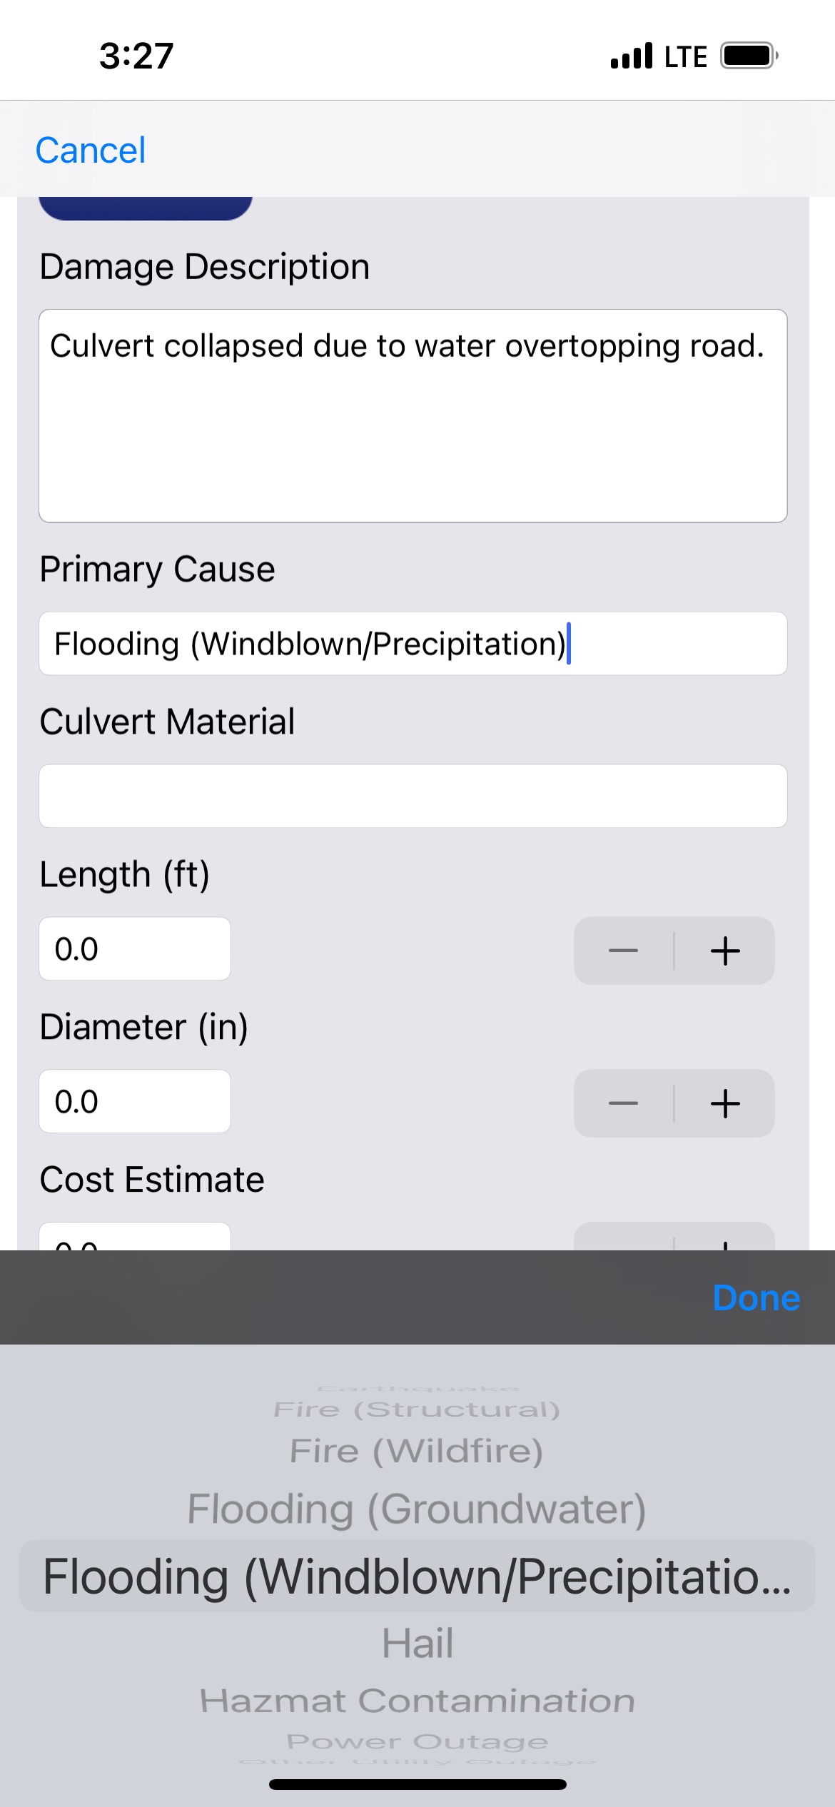
Crisis Track App
Fill in the Damage Description with the type of damage that the structure sustained.
The Primary Cause of damage will allow you to choose from a list of possible causes (Flooding, fire, tornado, etc.)
If the material and measurements do not automatically populate, fill these fields in manually.

Slide 44
Crisis Track App
If you know the approximate cost to repair the damage, put that in the cost estimate field.
This information can also be added later during validation
If you have roads and culverts located near each other that both sustained damage, put this in the notes.
The person entering the damage information should fill in the Completed By and Phone Number fields.
Then click on the Camera icon to add Photos of the damage.

Slide 45
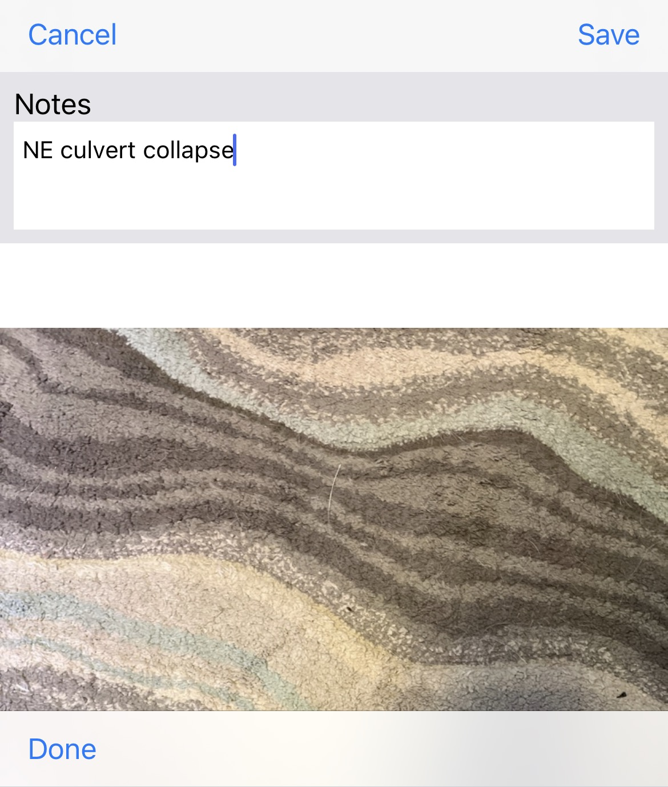
Crisis Track App
Attach a minimum of two photos that clearly show the structure damage you are reporting.
Once you have added photos, you can click on the individual photos to add notes.
You can delete photos by clicking on the Edit button.
Once you are done, click Save.

Slide 46
Crisis Track App
Once your photos are added and all information is reported, click save.
You can then review the information.
If changes need to be made, click the Form icon.
If everything is correct, hit the blue Save/Upload button.
If you are working offline, click the Save to Device button.

Slide 47
Crisis Track App
The damaged structure will now show up in a list along with any other damages that have been reported.
You can click on the Map icon to view damaged structures on a map.
The Stats icon will show reported damages based on categories.

Slide 48
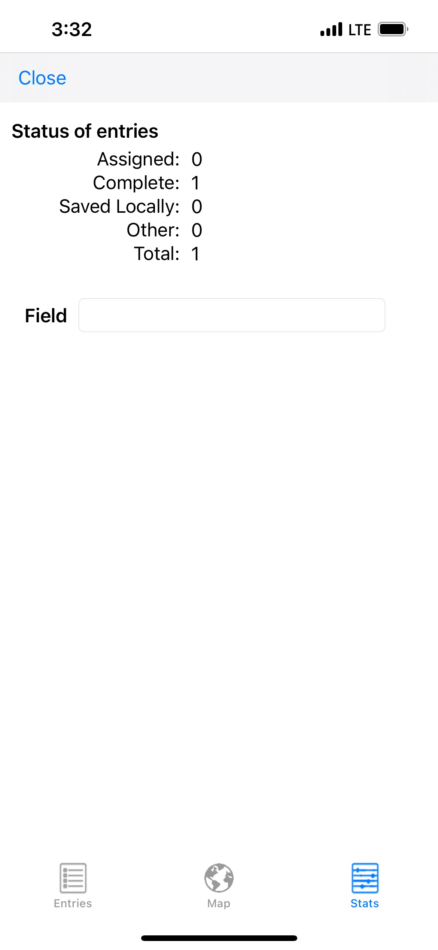
Crisis Track App
If you are working offline, you will need to click the Upload All button when you are back in an area with connectivity to sync your damages to the incident.

Slide 49
Crisis Track App
When you are done adding damages, click the blue Back button.
If you were tracking location and time, hit the red Stop button.
Hit the blue Back button until you get back to the Incident listing, then click the blue Sign Out.
You should always manually sign out of the app, otherwise it will stay on in the background and continue to use data and battery on your device.

Slide 50
Data Validation
County Emergency Managers are responsible for reviewing all damage information that is submitted by jurisdictions within their county.
SD OEM will then review damages that have been validated by the County EM.
Always check GPS information and make sure that each damage entry has good photos.
Damages that do not include photos will not count towards your county’s PDA threshold.
EMs and State staff can run a check for duplicate entries that will flag entries with the same GPS location.

Slide 51
Data Usage
Jurisdictions that enter damage information can use that data to fill out their damage inventory if a Federal Disaster is declared for their County and they choose to submit a Request for Public Assistance.
Data that is entered will be available to the jurisdiction that entered the data, the County EM, and State OEM staff.
Data will never be shared with outside entities or deleted from the incident entirely.

Slide 52
Trainings and Information
Crisis Track tutorials and training modules will be available to everyone on the DPS website: : https://dps.sd.gov/emergency-services/emergency-management/recovery/crisis-track
Please reach out to SDOEM PA staff to schedule in person trainings.

Slide 53
Any Questions?
South Dakota Office of Emergency Management
Dustin Hight - Recovery Branch Chief
Amanda VanderPlaats - Public Assistance Coordinator
Dale Farmen - Public Assistance Coordinator
Colby Jensen - Public Assistance Coordinator
Call (605) 773-3231 with any questions!

