Slide 1
Crisis Track 101
User Training

Slide 2
Crisis Track 101
Crisis Track is a disaster management software that the SD Office of Emergency Management has purchased for all County Emergency Managers to use.
SDOEM wants Crisis Track to be a single source for submission of PDA data.
All requests for access must go through the County EM and include:
    Full Name, e-mail address, work phone number, role, and jurisdiction
Anyone who wants to have an account in Crisis Track must create a MySD account.
  The e-mail address used to create your account in MySD and in Crisis Track must be identical

Slide 3
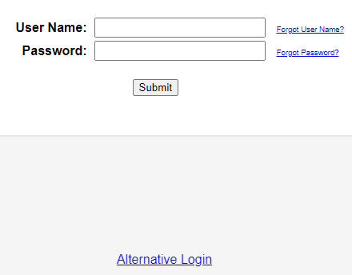
Account Access
To log in to Crisis Track, on-line or through the mobile app, you must use the “Alternative Login” button located at the bottom of the Crisis Track login screen.

Slide 4
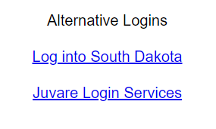
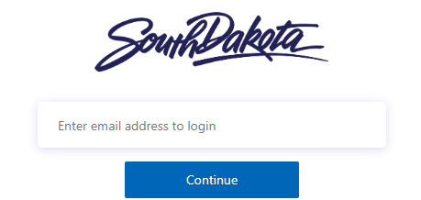
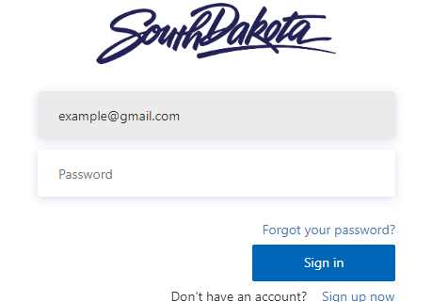
Alternative Login
You will then click on “Log Into
South Dakota”.
Enter your email address.
Enter your password and click “sign in”.
You will then be redirected back to Crisis Track and logged in.

Slide 5
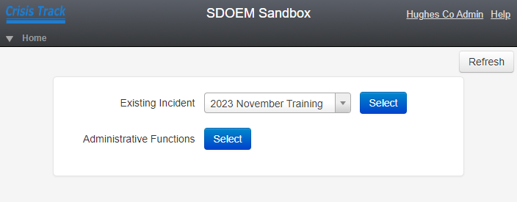
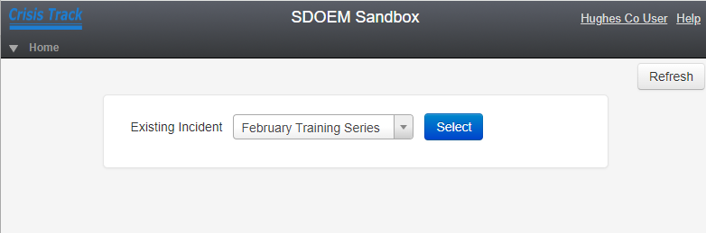
Home Screen - Users
Once you’re logged in, you should see the home screen for your jurisdiction.
Administrators will see options for selecting existing incidents and administrative functions.
Users will see a drop down and option to select an incident.

Slide 6
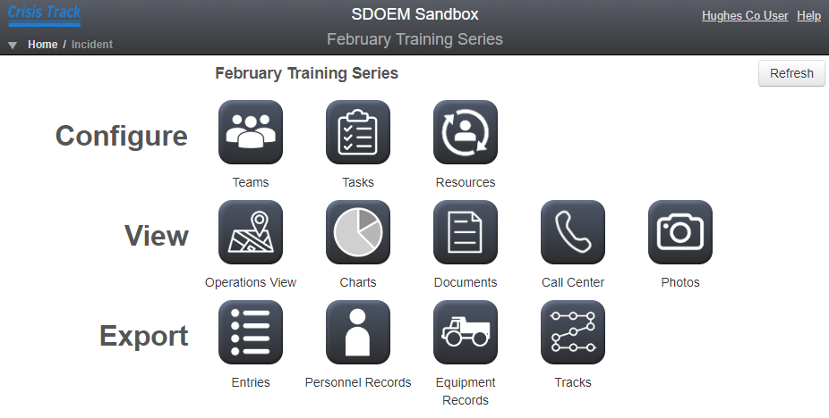
Incident Menu – Web Version
Any active incidents that have included your county will show up under the Incidents dropdown.
Once you select an incident, you should see the incident menu.

Slide 7
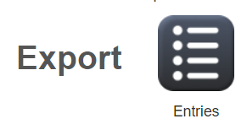
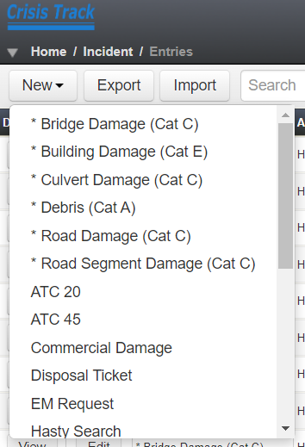
Adding Damages
Before you add damage using the web version of Crisis Track, make sure you have photos of the damage saved to your device.
Click the Entries Icon (next to Export) on the Incident page.
Then click the New drop down and
choose the type of damage you want to
enter.

Slide 8
Damage Entries
Types of damage that have an asterisk * next to them are the typical damage entries for a Public Assistance Preliminary Damage Assessment.
Roads, bridges, culverts, and debris all have pre-loaded forms to fill out for reporting damages.
Other forms that are available will require more manual entries and figures as they have not been preloaded with information (costs, measurements, etc.)

Slide 9
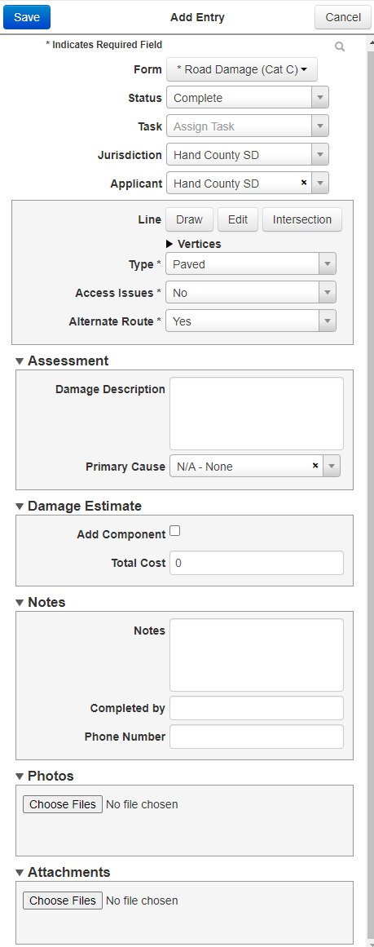
Sample Damage Entry
Damage entries should include as much information as possible.
All entries, regardless of type, should include at least two photos and accurate GPS coordinates.
When using the desktop website to enter damages, you will need to have photos of the damage saved to your computer to upload.

Slide 10
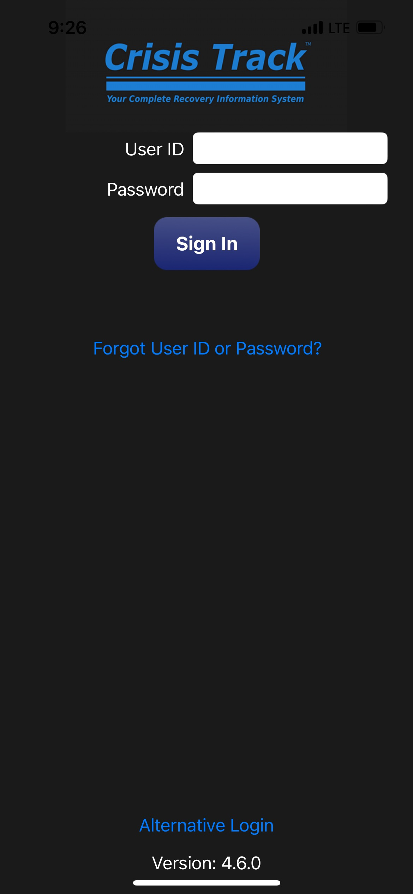
Crisis Track App
Always make sure that you have the most up to date version of the app installed on your device.
Update the app from the app store if there is an update available.
Make sure you click the Alternative Login at the bottom of the screen to log in to the app.

Slide 11
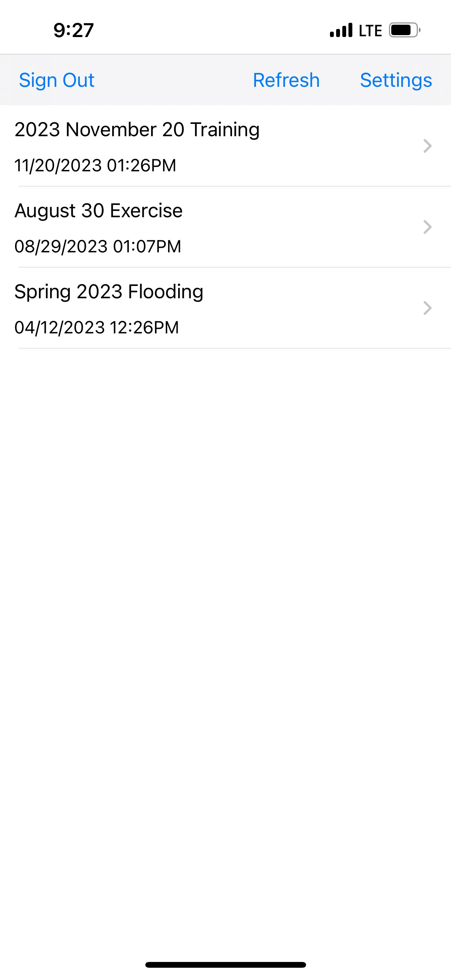
Crisis Track App
Only Incidents that are active will show up when you log in to Crisis Track.
If a new incident has recently been created and it is not showing up when you log in to the app, hit the Refresh button.

Slide 12
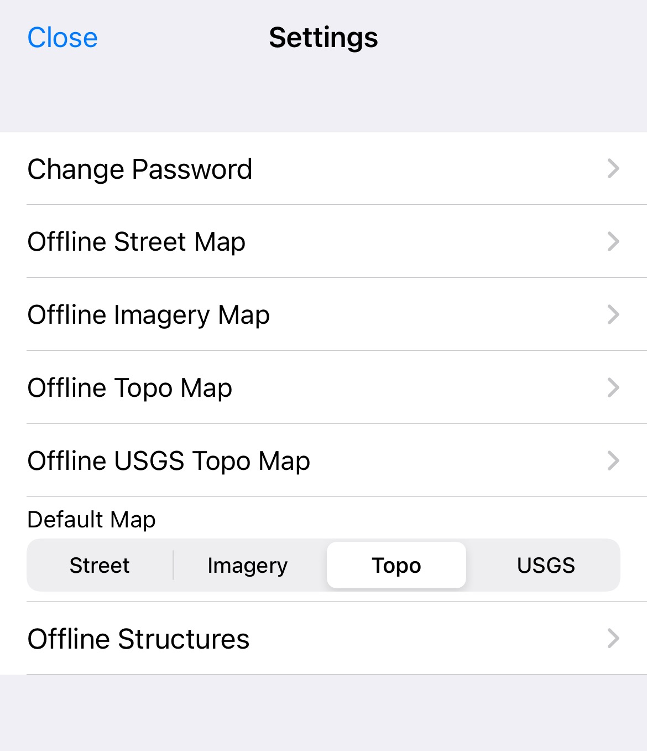
Crisis Track App
If you will be using the app in an area of low connectivity, you can go to the Settings menu and choose to work offline.
Any data entered while offline can be uploaded once you have more reliable service.
Choosing to work offline can save your battery life and limit your phones data usage.

Slide 13
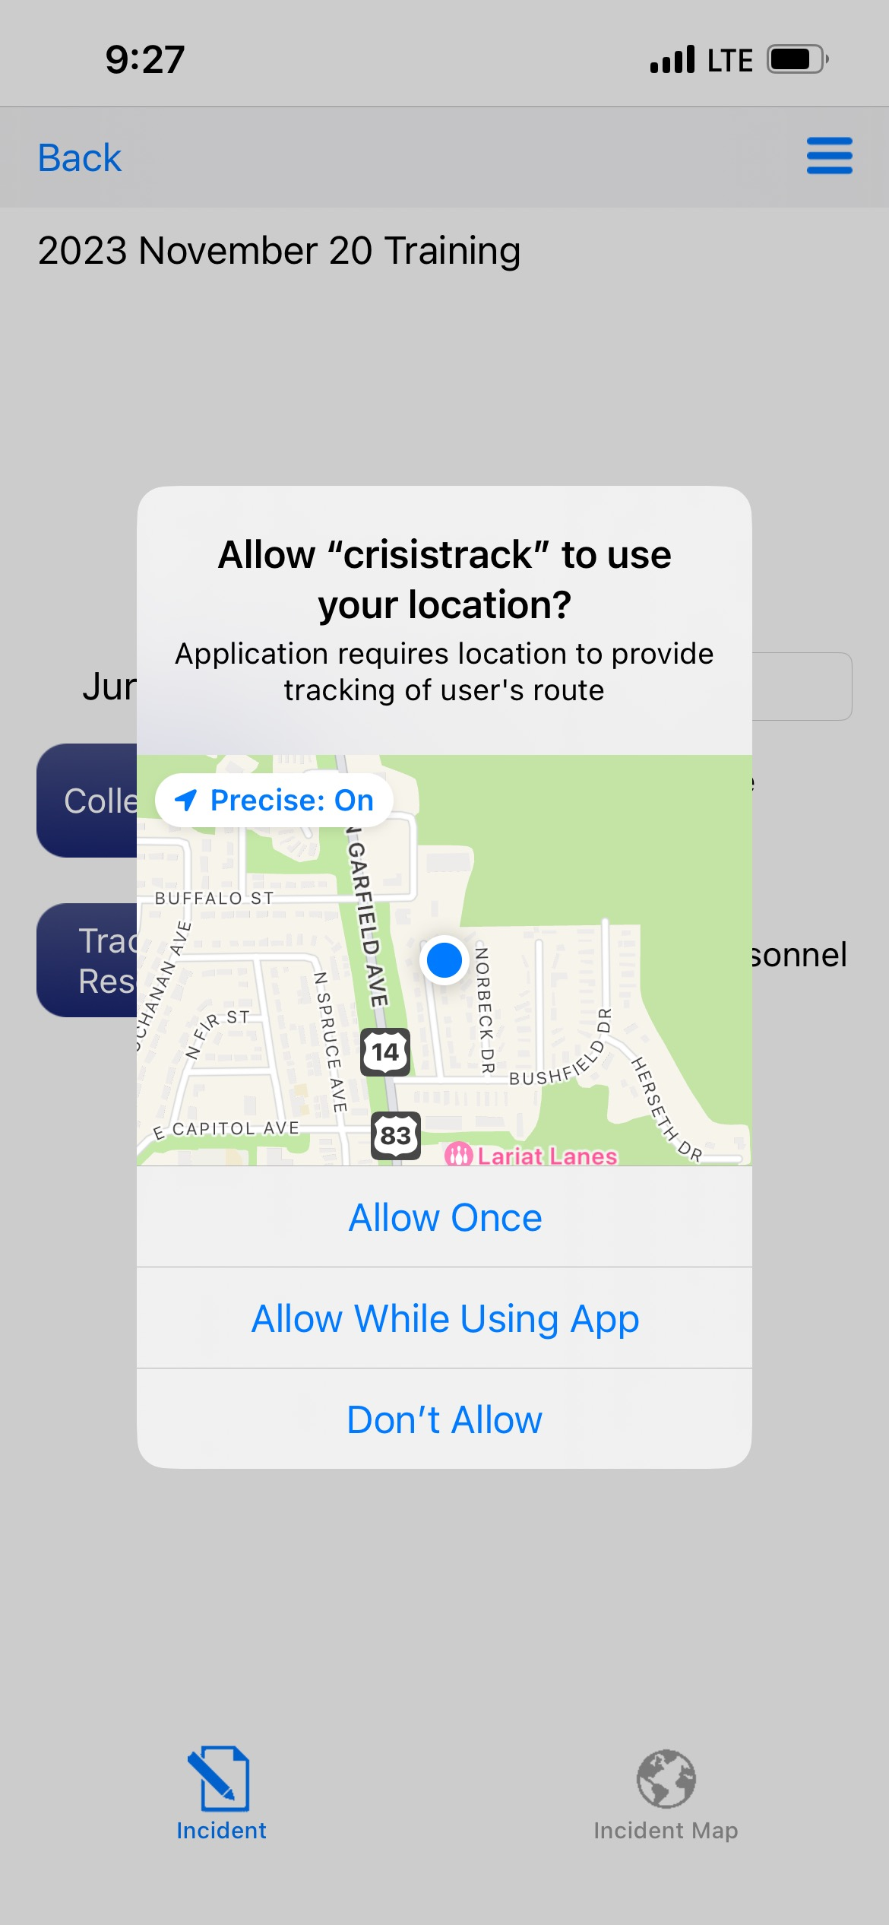
Crisis Track App
You may periodically get a pop up asking for permission to use location tracking.
You can choose how you allow the app to use your mobile devices location.
If you click Don’t Allow, then you will not be able to use the GPS functions or tracking on the app.

Slide 14
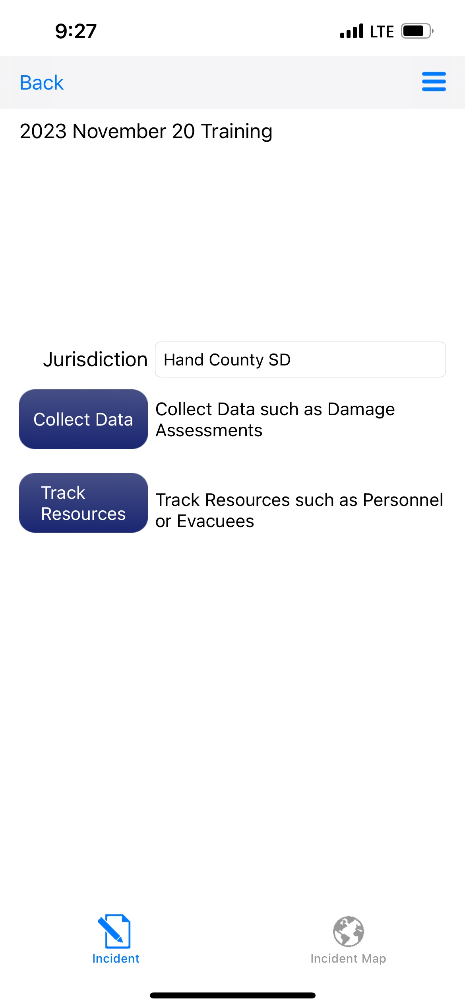
Crisis Track App
Always make sure you are adding data to the correct jurisdiction.
To add damage data, click the blue Collect Data button.

Slide 15
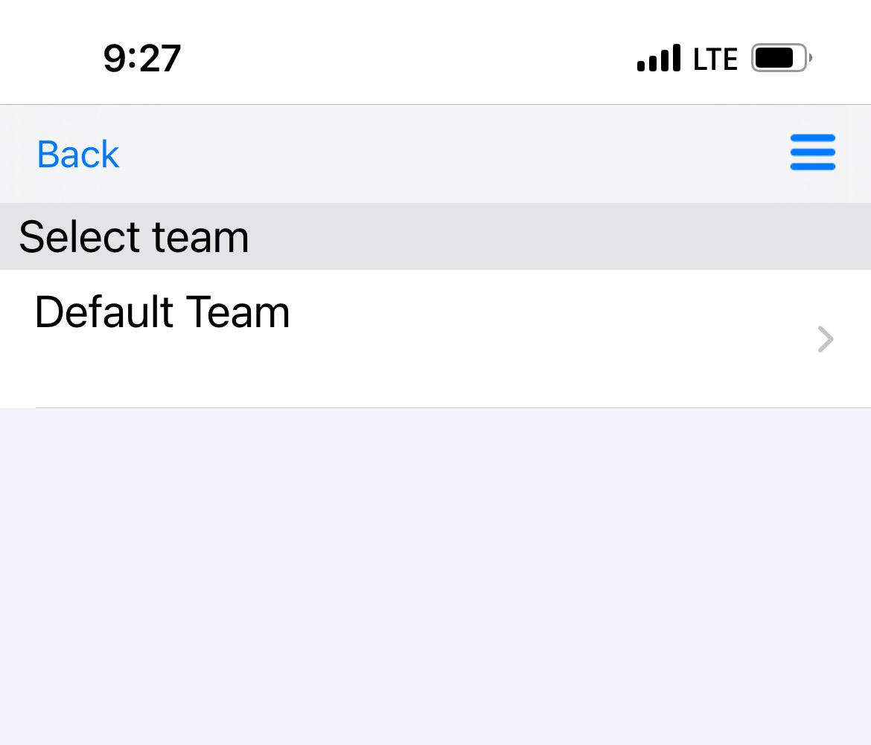
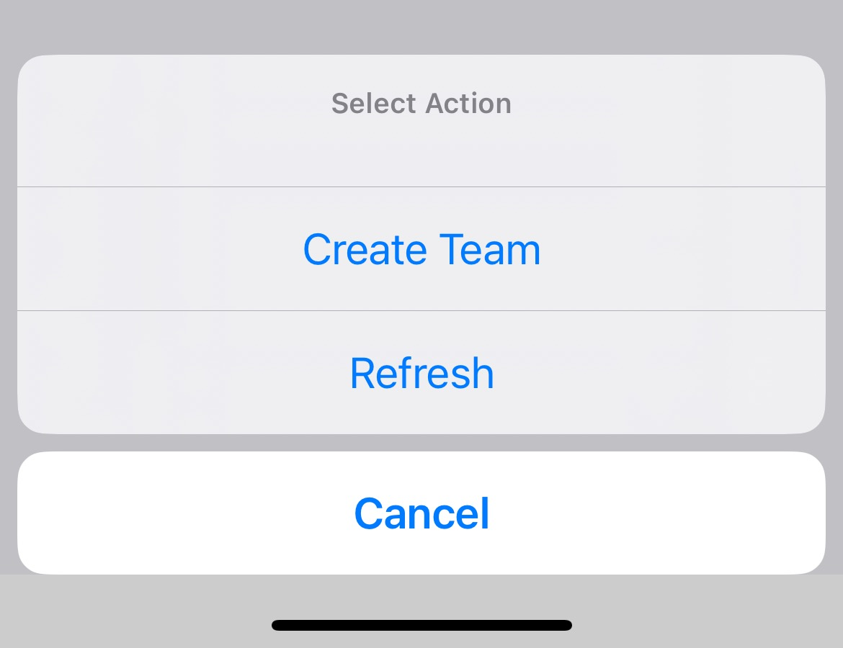
Crisis Track App
Default Team will always be available.
If your jurisdiction has preconfigured teams, you should see those teams available on this screen.
You can also click on the Create Team icon to add a new team in the field.

Slide 16
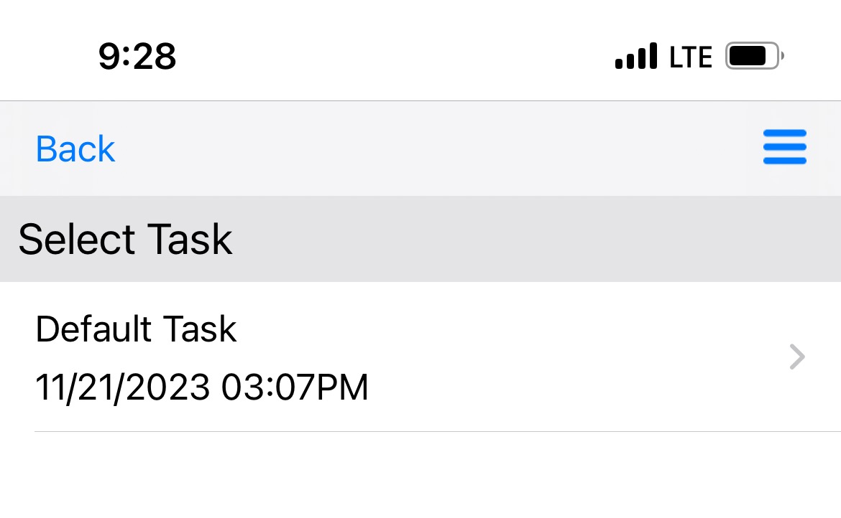
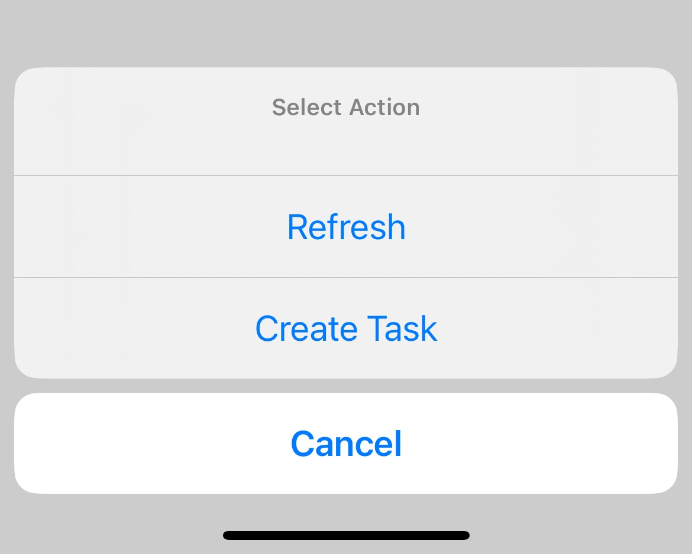
Crisis Track App
Default Task will always be available.
If your jurisdiction has preconfigured tasks, you should see those tasks available on this screen.
You can also click on the Create Task icon to add a new task in the field.

Slide 17
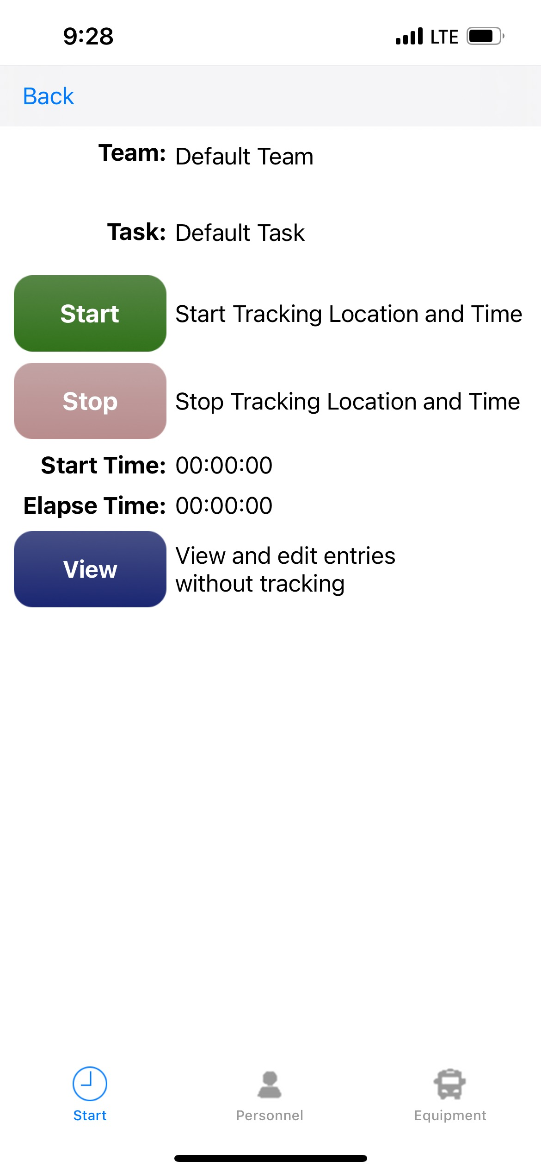
Crisis Track App
To begin entering damage information, click the green Start button.
This will keep track of your time spent in the field, as well as your location.
You can also click the blue View button to create entries without tracking your field time.

Slide 18
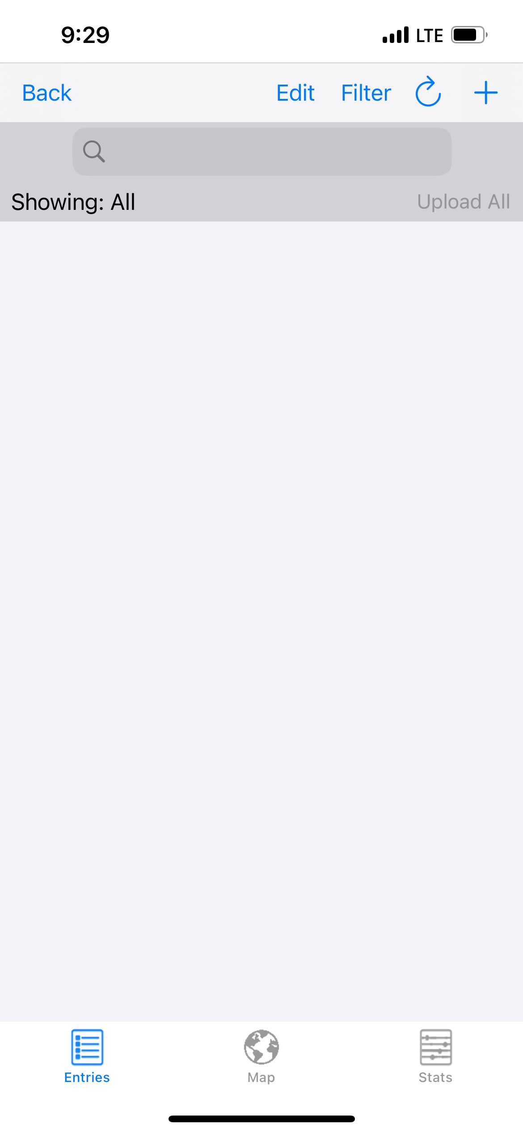
Crisis Track App
Any damages that have already been entered by you, or someone else in your jurisdiction, will show up on this page.
To add new damage information, click the blue plus + sign in the upper right corner of the screen.

Slide 19
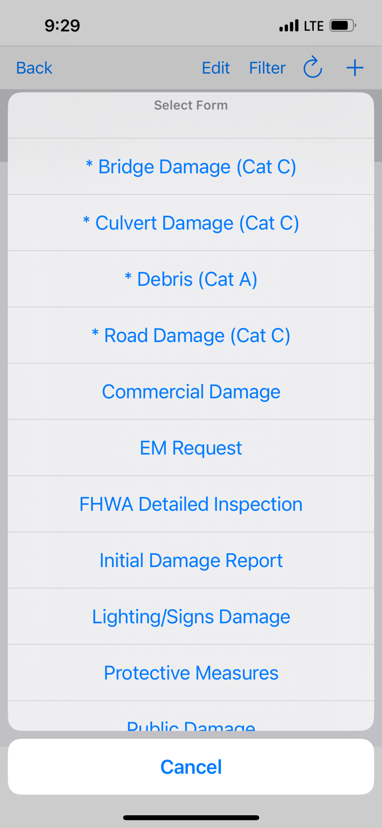
Crisis Track App
Choose the appropriate form from the menu that comes up.
If you are not entering Cat A, B, or C damage information, you can choose the Public Damage form for all other categories of damage.

Slide 20
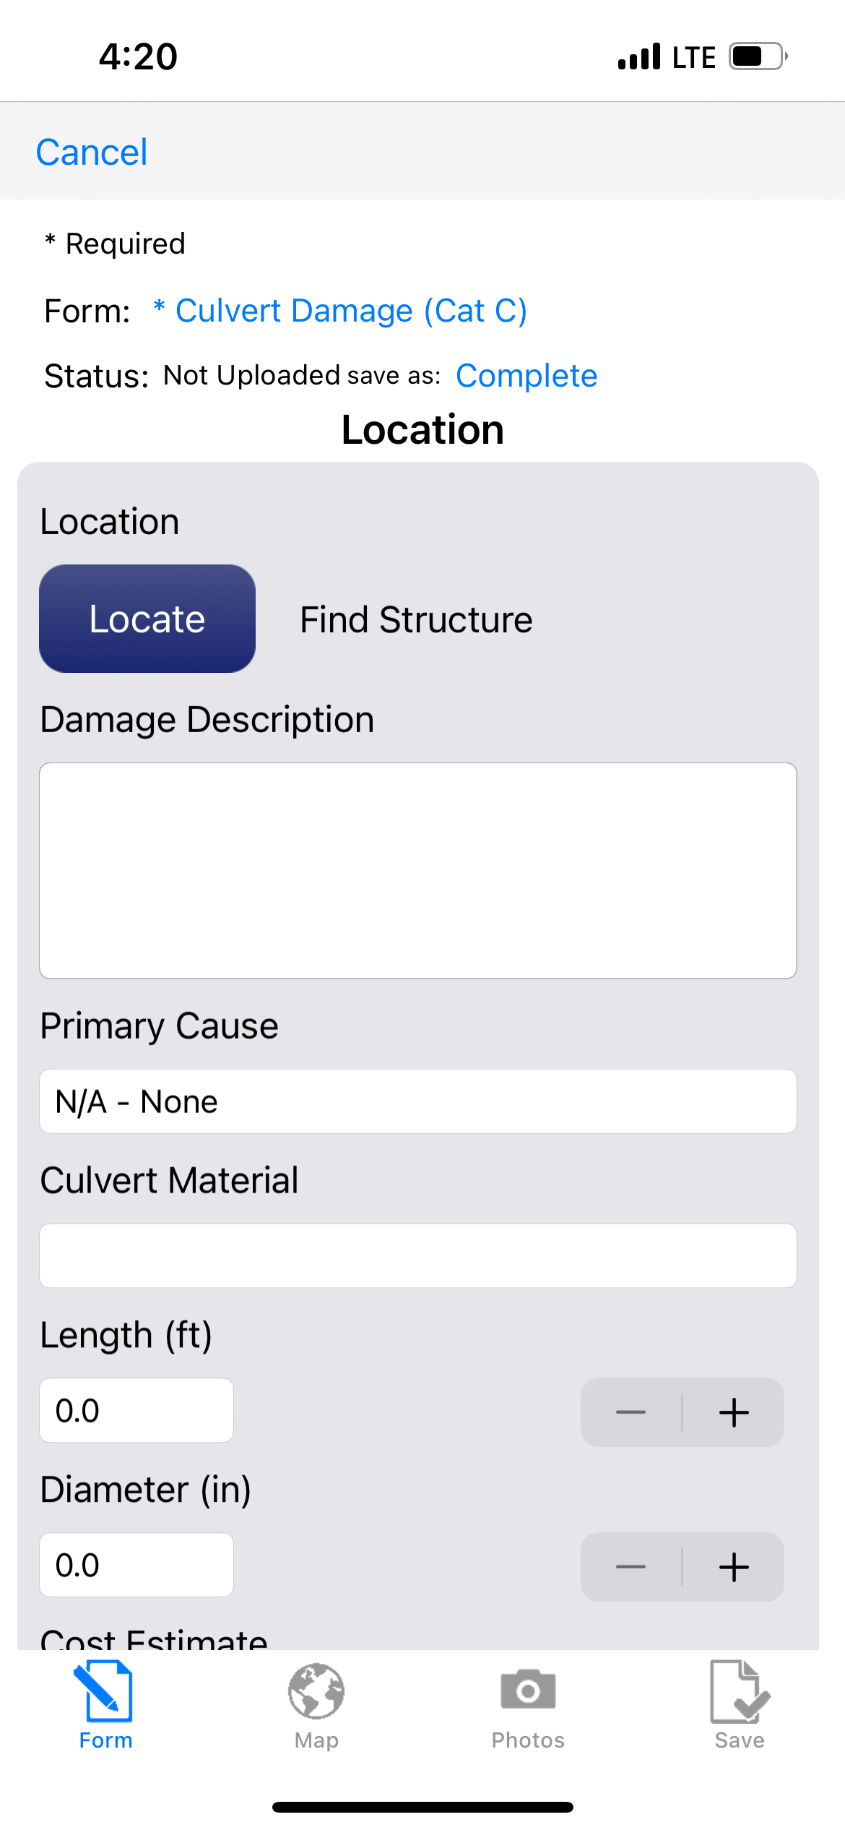
Crisis Track App
For damage to structures that have been preloaded into your county, if you click the blue Locate button, a list of nearby structures should show up for you to choose from.
If the structure you want to report damages for is not available on the drop down, you can input the structure information in the form.

Slide 21
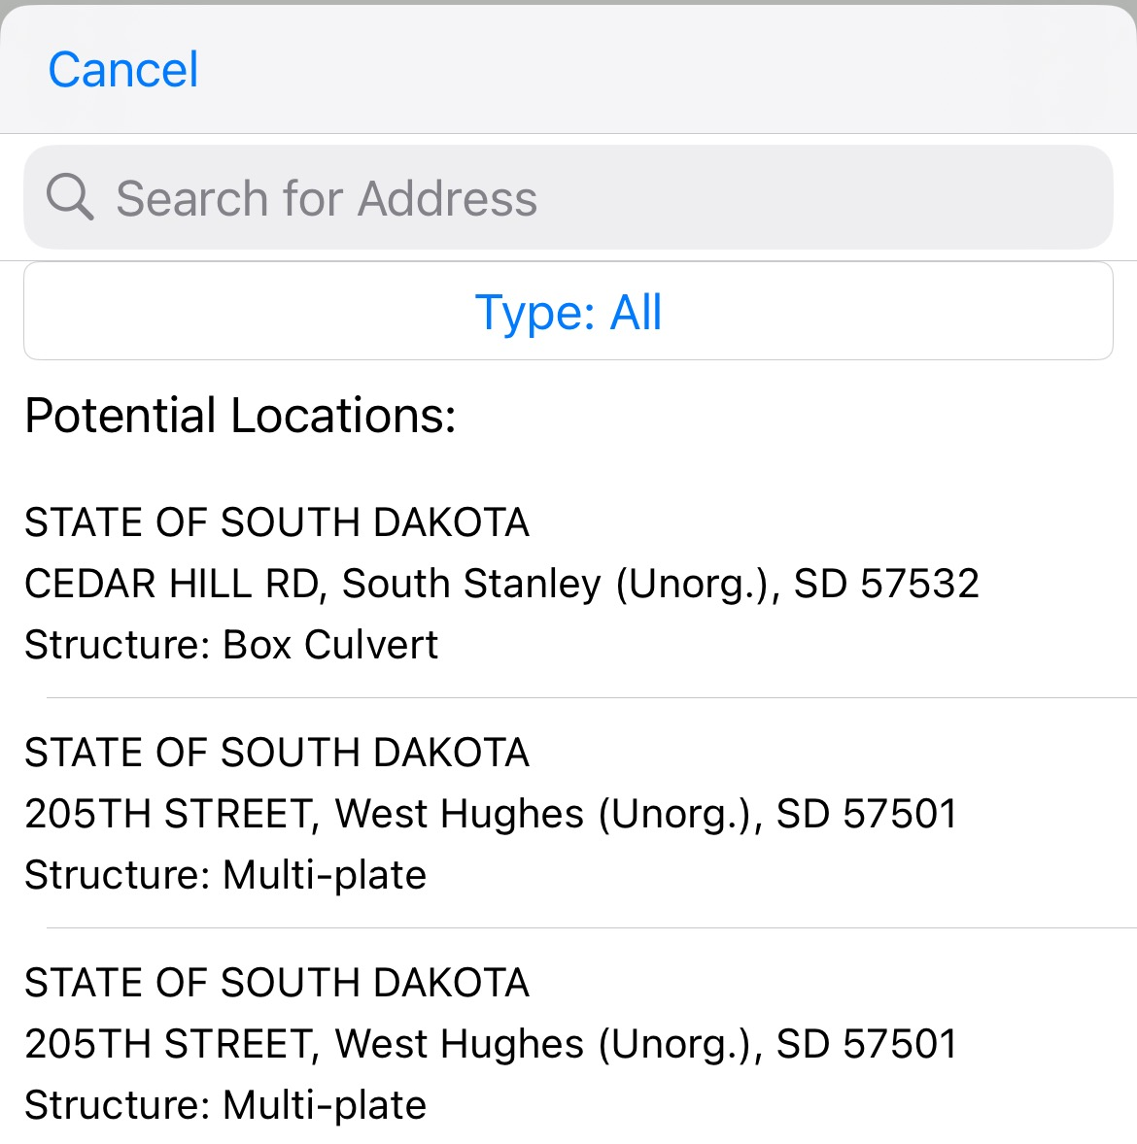
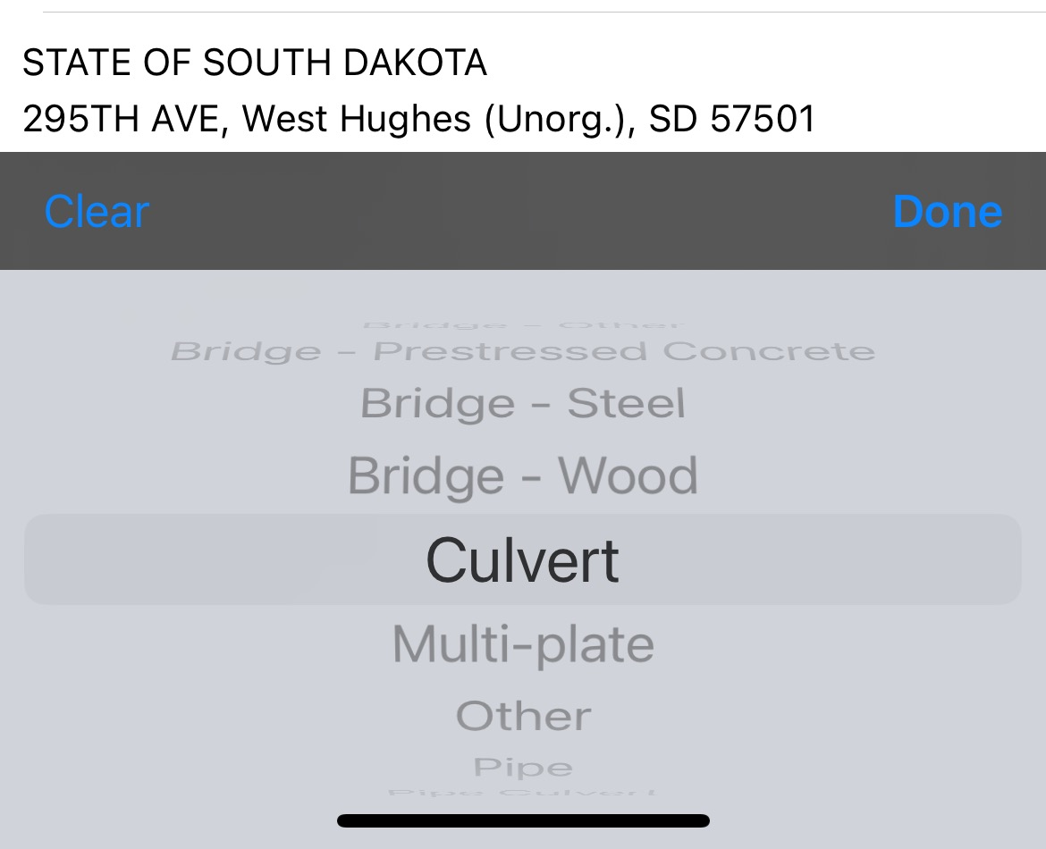
Crisis Track App
At the top of the list of available structures, you can narrow down the type of structure by clicking on the blue Type: All
A list of structure types will appear at the bottom of the screen for you to scroll through and choose from.
Use this to narrow down the list of available nearby structures.

Slide 22
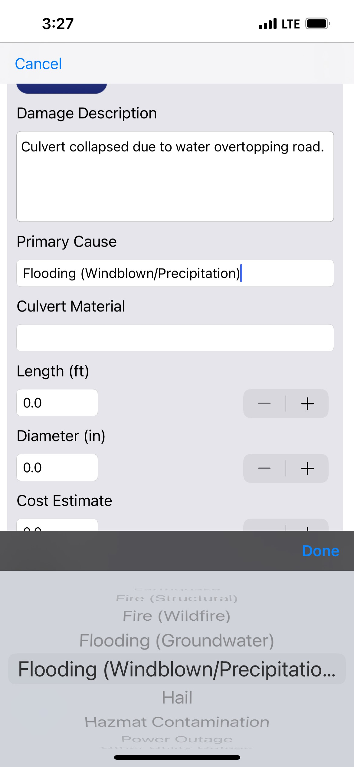
Crisis Track App
Fill in the Damage Description with the type of damage that the structure sustained.
The Primary Cause of damage will allow you to choose from a list of possible causes (Flooding, fire, tornado, etc.)
If the Material and measurements do not automatically populate, fill these fields in manually.

Slide 23
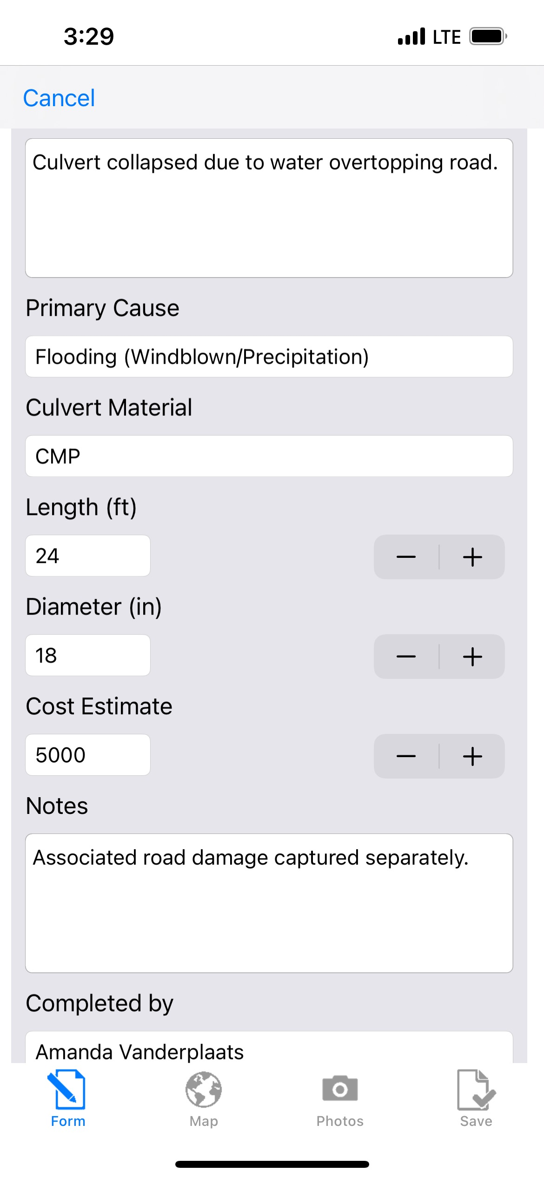
Crisis Track App
If you know the approximate cost to repair the damage, put that in the cost estimate field.
This information can also be added later during validation
If you have roads and culverts located near each other that both sustained damage, put this in the notes.
The person entering the damage information should fill in the Completed By and Phone Number fields.
Then click on the Camera icon to add Photos of the damage.

Slide 24
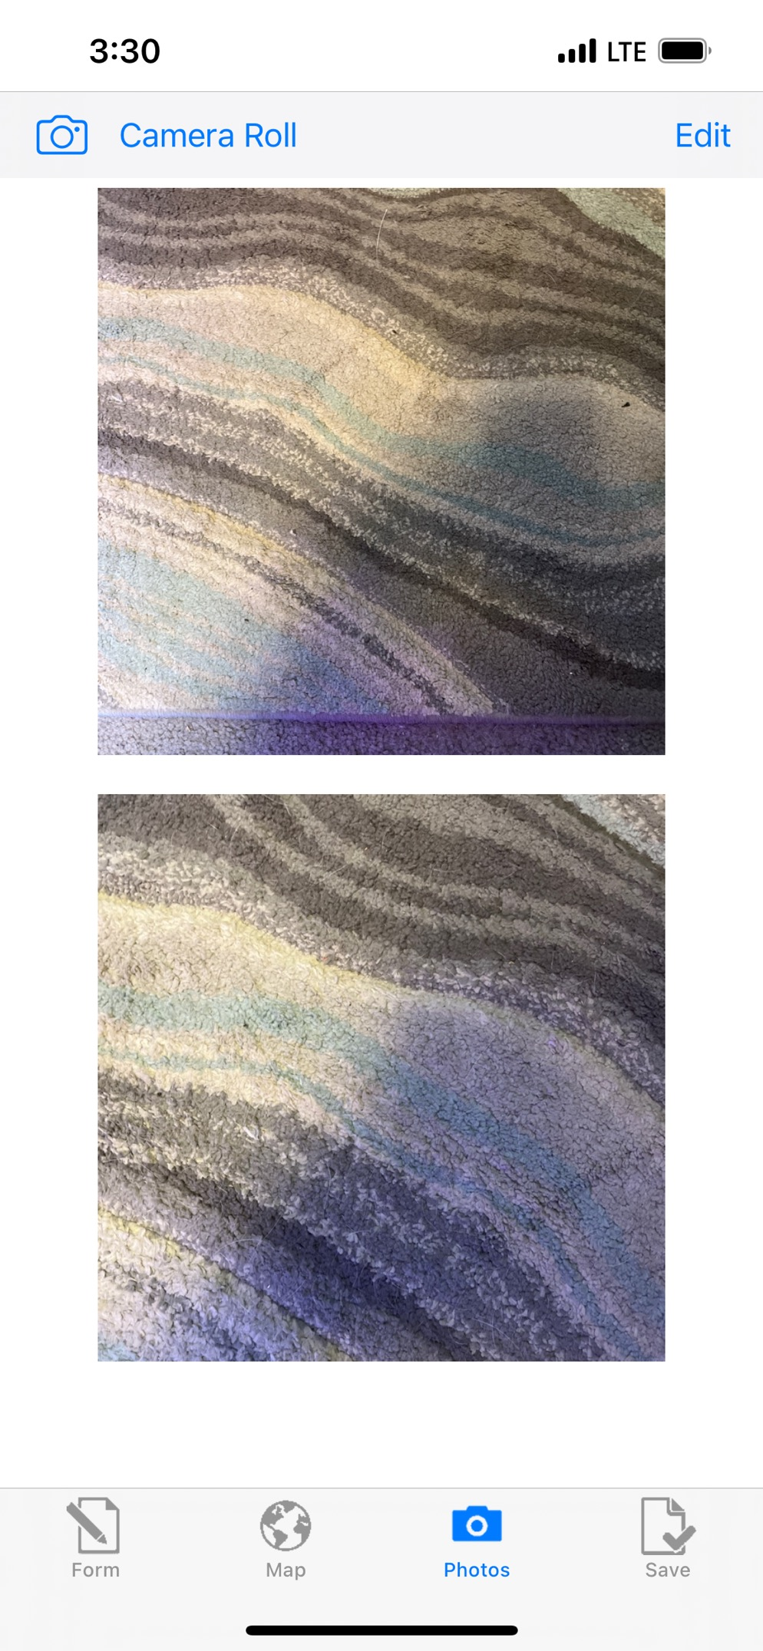
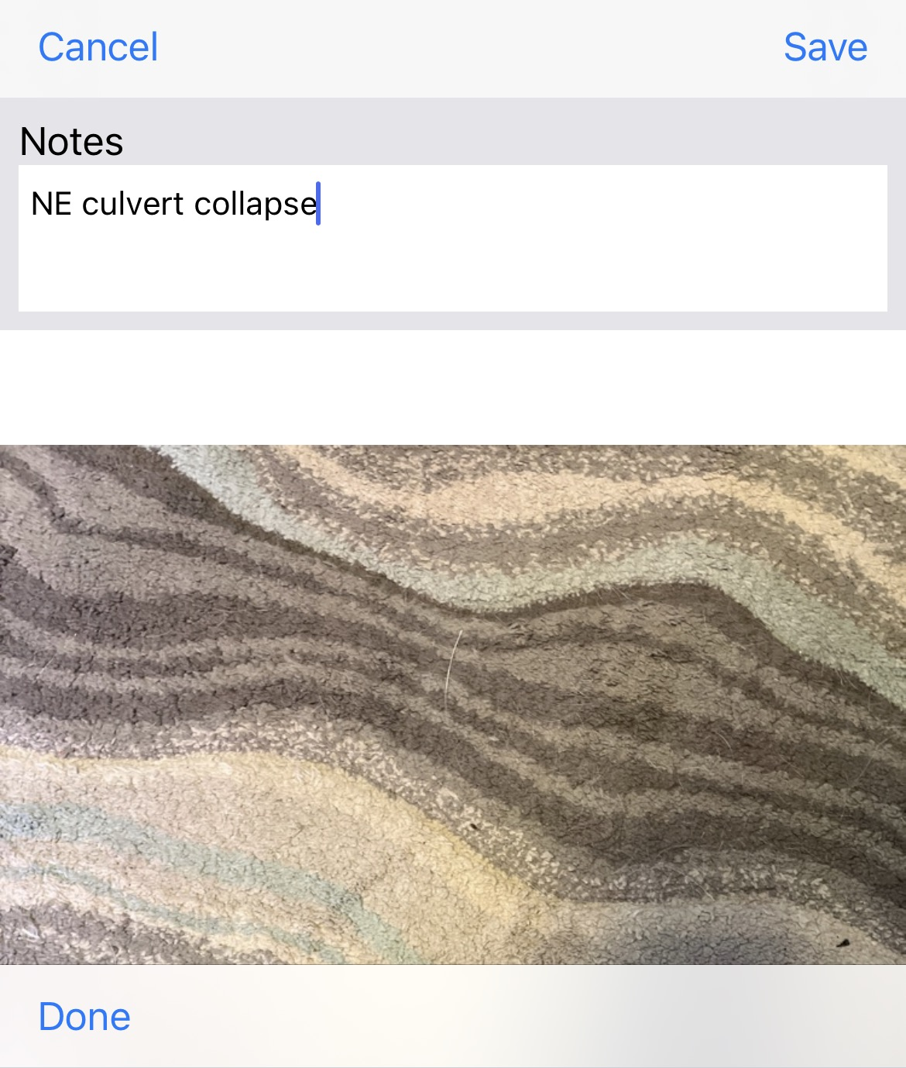
Crisis Track App
Attach a minimum of two photos that clearly show the structure damage you are reporting.
Once you have added photos, you can click on the individual photos to add notes.
You can delete photos by clicking on the Edit button.
Once you are done, click Save.

Slide 25
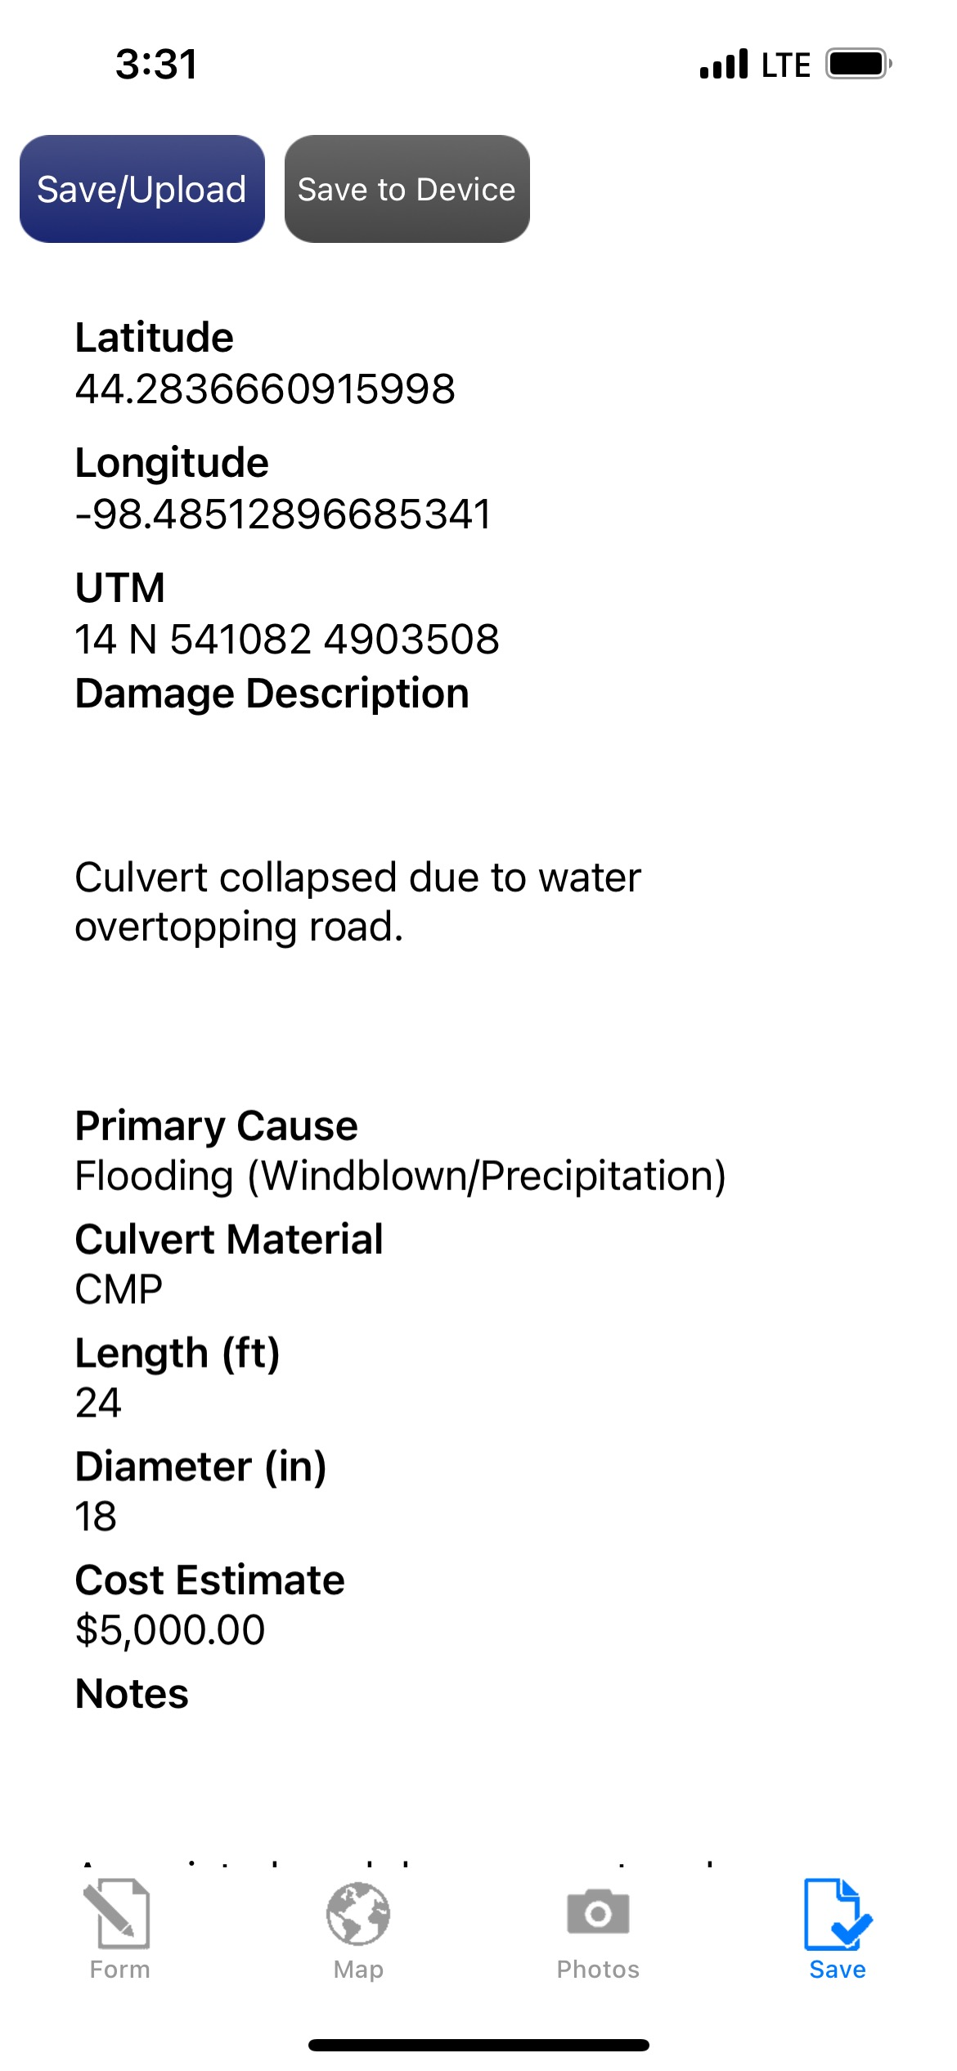
Crisis Track App
Once your photos are added and all information is reported, click save.
You can then review the information.
If changes need to be made, click the Form icon.
If everything is correct, hit the blue Save/Upload button

Slide 26
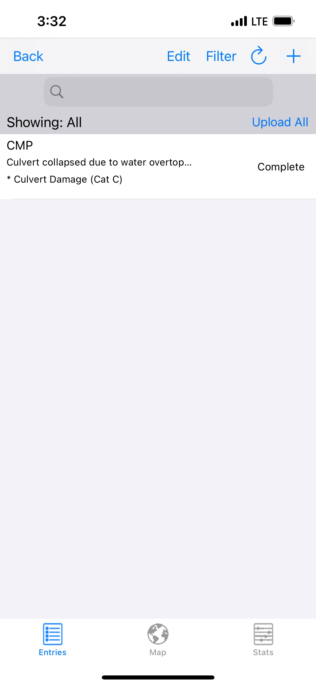
Crisis Track App
The damaged structure will now show up in a list along with any other damages that have been reported.
You can click on the Map icon to view damaged structures on a map.
The Stats icon will show reported damages based on categories.

Slide 27
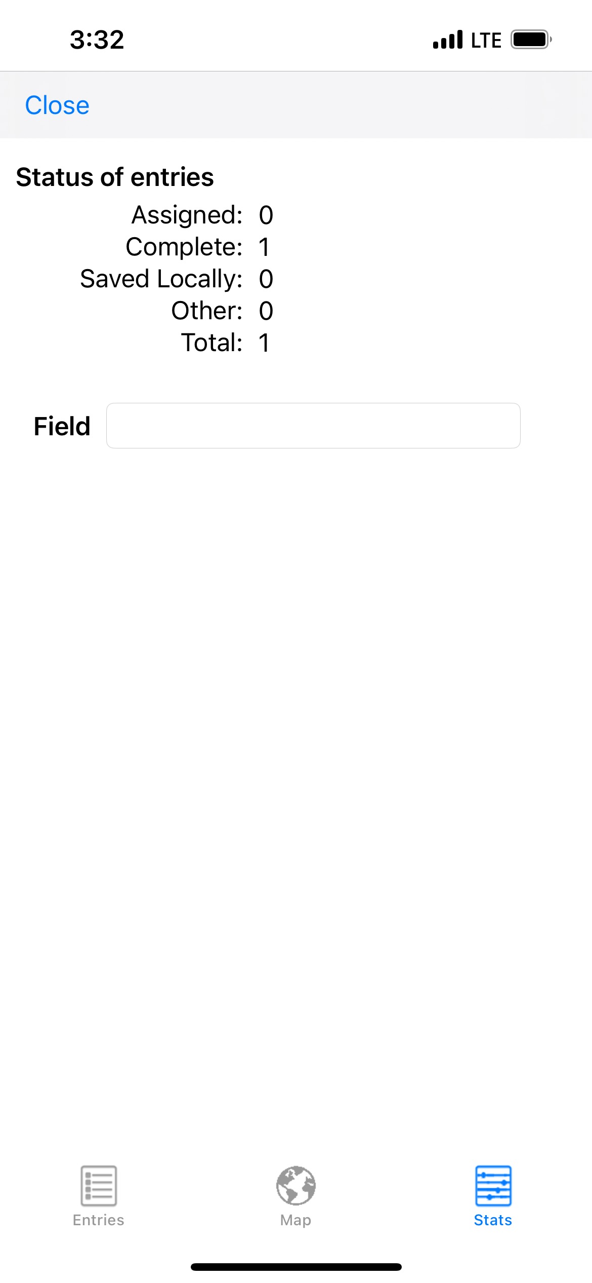
Crisis Track App
The damaged structure will now show up in a list along with any other damages that have been reported.
You can click on the Map icon to view damaged structures on a map.
The Stats icon will show reported damages based on their status.

Slide 28
Crisis Track App
When you are done adding damages, click the blue Back button.
If you were tracking location and time, hit the red Stop button.
Hit the blue Back button until you get back to the Incident listing, then click the blue Sign Out.
You should always manually sign out of the app, otherwise it will stay on in the background and continue to use data and battery on your device.

Slide 29
Data Validation
County Emergency Managers are responsible for reviewing all damage information that is submitted by jurisdictions within their county.
SD OEM will then review damages that have been validated by the County EM.
Always check GPS information and make sure that each damage entry has good photos.
Damages that do not include photos will not count towards your county’s PDA threshold.
EMs and State staff can run a check for duplicate entries that will flag entries with the same GPS location.

Slide 30
Data Usage
Jurisdictions that enter damage information can use that data to fill out their damage inventory if a Federal Disaster is declared for their County and they choose to submit a Request for Public Assistance.
Data that is entered will be available to the jurisdiction that entered the data, the County EM, and State OEM staff.
Data will never be shared with outside entities or deleted from the incident entirely.

Slide 31
Trainings and Information
Crisis Track tutorials and training modules will be available to everyone on the DPS website: : https://dps.sd.gov/emergency-services/emergency-management/recovery/crisis-track
Please reach out to SDOEM PA staff for information on upcoming trainings, or issues you encounter when using Crisis Track.

Slide 32
Any Questions?
South Dakota Office of Emergency Management
  Dustin Hight - Recovery Branch Chief
  Amanda VanderPlaats - Public Assistance Coordinator
  Dale Farmen - Public Assistance Coordinator
  Colby Jensen - Public Assistance Coordinator
Call (605) 773-3231 with any questions!

