Slide 1
Task Force on Safe Teen Driving
Joint Transportation Committee
January 10, 2013

Slide 2
Task Force Created in 2011 Session:
HB1221 – Duties of Task Force:
(1) Examine data on teen driving by age groups and urban and rural setting including traffic citations, crashes, injuries, fatalities, and circumstances and causal factors in crashes;
(2) Review current laws affecting teen drivers;
(3) Examine data on driver education available for teens, including preparation and ongoing training of instructors, costs for driver education, current payers, and enrollment statistics;
(4) Examine barriers to teen driving safety; and
(5) Review national best practices to improve safety of teen drivers.

Slide 3
South Dakota Teen Drivers at Risk
Drivers in 14-17 age group account for 4.3% of all permitted or licensed in South Dakota.
Yet of drivers involved in crashes this age group 8.8% of all state reportable crashes – an average annual number of 2,027 crashes!
Study Years 2008-2010 = 10 Young Drivers Killed and 1,055 Injured in Crashes!

Slide 4
South Dakota Teen Drivers at Risk
Top Driver (14-17) Contributing Circumstances:
1. Running off road
2. Failure to yield
3. Driving too fast for conditions
4. Over correcting
5. Speeding
6. Drinking
7. Distracted

Slide 7
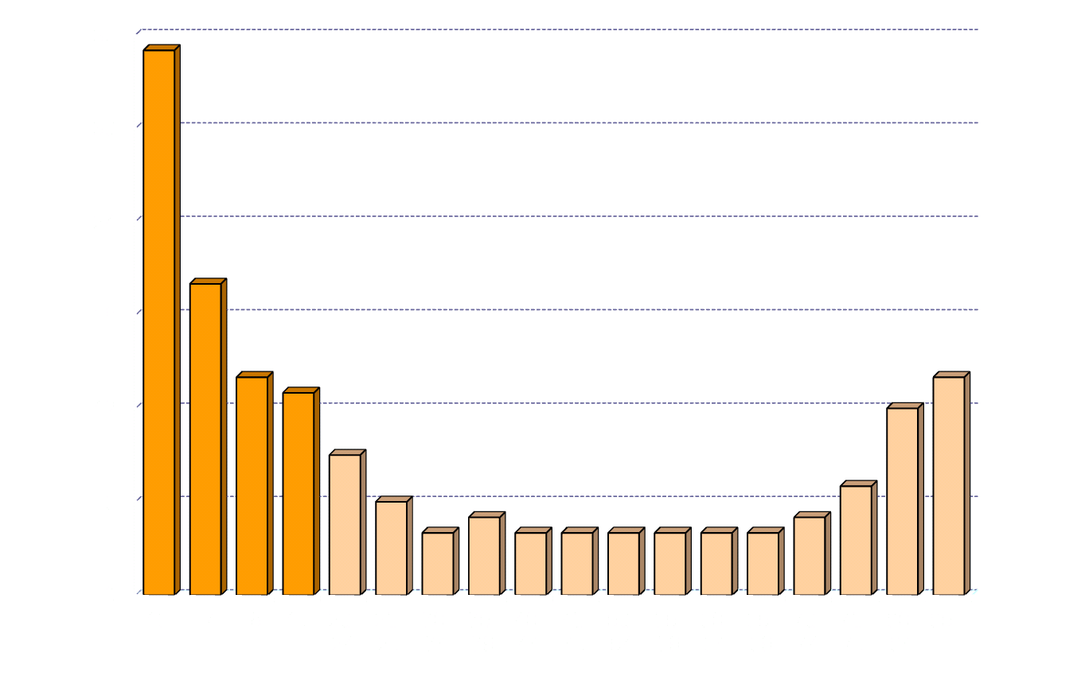
Crash Rates by Age
Driver crash involvements per million miles traveled
Source: A.F. Williams, Journal of Safety Research 34 (2003) 5-15
Notes:
(RF) This is the single most important slide. The previous two provide a “researcher” lead-in, but they stand to confuse people and prompt a lot of questions as a result. I think this is particularly useful in illustrating that 16 is the magic age of driving competence, which the SD licensing system currently appears to assume. The next graph illustrates that the issue isn’t really age nearly so much as experience.

Slide 8
Teen Drivers at Risk Nationwide
Leading cause of death of 14-17 year-olds across United States is motor vehicle crashes at 39% (in South Dakota it is number one at 44%)!
The national downward trend of motor vehicle deaths in this age bracket has ceased. The trending down was largely credited to enhanced GDL laws (11% uptick in driver fatalities from 2010 to 2011).

Slide 9
Legislative Recommendation One:
Restrict Unrelated Minor Passengers
Add new section to chapter 32-12
No holder of a restricted minor’s permit may operate a motor vehicle carrying more than one passenger under the age of 18 who is not a member of the immediate family or lives at the permit holder’s primary residence unless a parent or guardian is in vehicle.
Research clearly indicates that limiting passengers during this phase is correlated with a reduction in crashes.
School exemption will be provided.

Slide 10
Legislative Recommendation Two:
Prohibit the Use of Electronic Devices
During Instructional and Restricted Permit Periods for 14-16 year old drivers
Exempts car radios
Handheld devices are the target
Enhance the development of safe driving skills during the learning curve
Recent Office of Highway Safety survey of South Dakota drivers finds that 93% believe the use of texting devices should be banned by those who are driving.

Slide 11
Legislative Recommendation Three:
Increase Instruction Permit Period
Amend SDCL 32-12-11
Carrot on a stick
Increase the permit period to 365 days but allow for a reduction if the driver has successfully completed a driver education course approved by the state.
Reduction from 365 days to 270.

Slide 12
Legislative Recommendation Four:
Establish Driver Education Coordinator
South Dakota lacks any standard curriculum and testing methods for driver education.
Position would be funded by Office of Highway Safety.
Establish a standard training program for instructor licensing, recertification, and continuing education.
Consider re-establishing Driver Education Association in South Dakota.
Establish statistical tracking methodology to create data linkages.
SDDOT studied this and reported out in April 2011. This report was a significant resource for the task force.

Slide 13
Policy Recommendations
Increase license age from 16 to 17.
  Enhancement of GDL provision to reduce teen driving fatalities and injuries. Removes high risk situations until the young driver is more experienced.
Develop more detailed crash reporting on cell phone usage.
Examine options available to create better statistical linkages to driver contributing circumstance of cell phone and texting.

