Slide 1
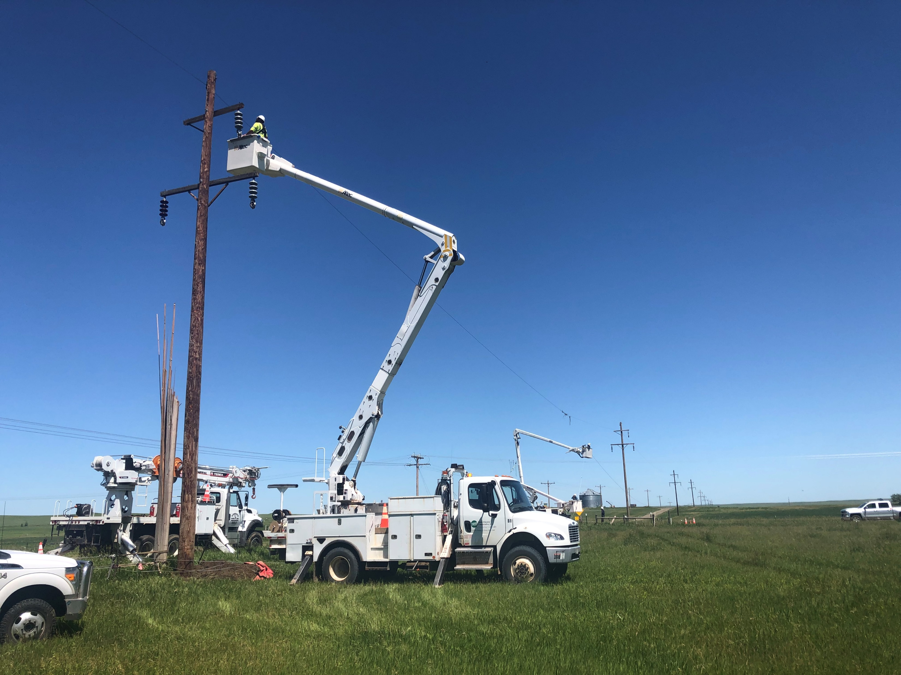
Applicant’s Briefing
DR-4664

Slide 2
FEMA-4664-DR-SD
Declaration Date:
August 2, 2022
Incident Period:
June 11 - 14, 2022

Slide 3
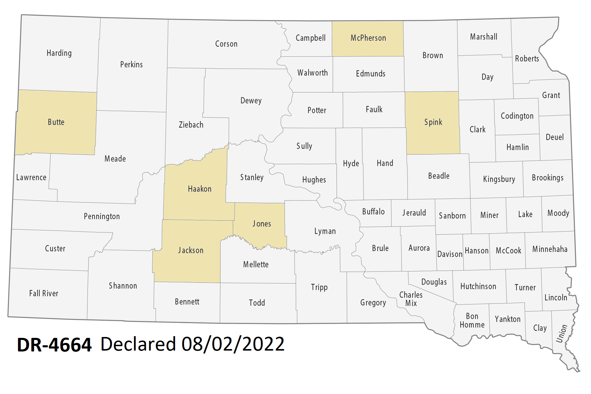
DR-4664 Declared Counties

Slide 4
The Public Assistance Process
Phase I
PDMG assigned
Exploratory Call
Phase II
Recovery Scoping Meeting
Damage Inventory
Phase III
Scoping and Costing
Phase IV
Reviews
You will have a Program Delivery Manager assigned to you throughout the whole process

Slide 5
Deadlines for Submission
Request for Public Assistance
All RPA’s Due September 1, 2022

Slide 6
Eligibility
COST
WORK
FACILITY
APPLICANT

Slide 7

Eligible Applicants
State Agencies
County Governments
City Government
Certain Non-profit Organizations
Native American Tribes or Tribal Organizations
Townships and Road Districts

Slide 8

Private Non-Profit Entities
Critical:
Fire/Emergency- Rescue
Emergency Medical Care
Utility – Power companies, Water Systems, Sewer, WWTP, Communications
Educational Institutions

Slide 9

Private Non-Profit Entities
Non-Critical:
Senior Citizen Centers
Daycare Centers
Homeless Shelters
Shelter Workshops
Libraries
Rehabilitation Facilities
Community Centers
Houses of Worship

Slide 10

Private Non-Profit Requirements
Completed RPA Package
Articles of Incorporation & By-Laws
Tax Exempt Letter, 501(c), (d), or (e)
IRS 990
  PNP’s go through an eligibility evaluation. This evaluation can not be conducted until all of the above is submitted.

Slide 11
Eligibility
COST
WORK
FACILITY
APPLICANT

Slide 12
Facility Eligibility Requirements
Damage – Result of the disaster(document ASAP)
Located within the Federally Declared County
Legal Responsibility of eligible applicant
In active use at the time of the disaster
Not under the authority of another federal agency (e.g. FHWA roads are not eligible for permanent repair, debris removal is eligible)

Slide 13
Eligibility
COST
WORK
FACILITY
APPLICANT

Slide 14

Emergency Work
Category A (Debris Removal)
-Clearing, removal, storage, disposal
Category B (Emergency Protective Measures)
-Access, protection, emergency services, eliminate hazards, support, highways and community needs
6 Month Completion Deadline:
DR-4664 – February 2, 2023

Slide 15
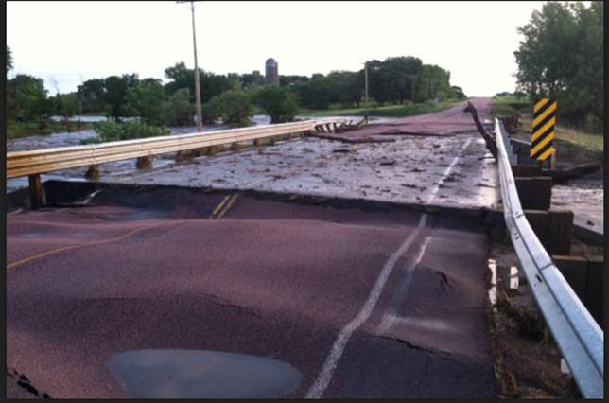

Permanent Work
Category C (Road and Bridge Systems)
Category D (Water Control Facilities)
Category E (Public Buildings/Equipment)
Category F (Public Utilities)
Category G (Other-Parks, Recreation)
18 Month Completion Deadline:
DR-4664 – February 2, 2024

Slide 16
Deadlines for Completion
From the date of the declaration,
DR-4664 – August 2, 2022
Emergency work – 6 months
February 2, 2023
(eligible for an additional 6 months if requested by the applicant)
Permanent work – 18 months
February 2, 2024
(eligible for an additional 30 months if requested by the applicant)
Further extensions require FEMA approval

Slide 17
Time Extensions
The State is responsible for granting Time Extensions to Applicants.
  Emergency Work: up to one year from declaration
  Permanent Work: up to four years from declaration
  FEMA must grant further extensions.
Applicants should contact the State as soon as they know they will not meet the project deadline.
Applicants must provide:
  The project number
  Reason the deadline will not be met
  Expected project completion date

Slide 18
Eligibility
COST
WORK
FACILITY
APPLICANT

Slide 19

Cost
Is it Reasonable and Necessary
Complies with federal, state, and local laws and regulations
Insurance proceeds and purchase discounts must be deducted

Slide 20

Equipment
Perform eligible work
Auto/Truck – mileage or hourly rate
Other equipment – hourly rate
Stand-by time ineligible
Intermittent Use
  Half day or more = full day
  Less than half day = actual hours

Slide 21
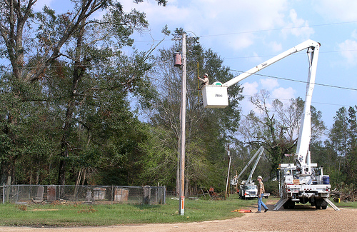
Equipment Rates
FEMA rates are used for determining project costs (estimating and comparing)
  For this disaster, 2021 Equipment rate codes will be used
  https://www.fema.gov/assistance/public/tools-resources/schedule-equipment-rates
Local rates can be used if established prior to the disaster. The lower of the two rates (local or FEMA) will be used. Applicant must justify using local rates.

Slide 22

Labor
Force Account Labor plus Fringe Benefits
  Emergency Work:
    Cat A - Regular and OT are eligible for Debris removal
    Cat B - Only OT is eligible for Emergency Protective Measures
  Permanent Work: Regular and OT are eligible
Travel and per diem for employees performing eligible activities may be claimed

Slide 23
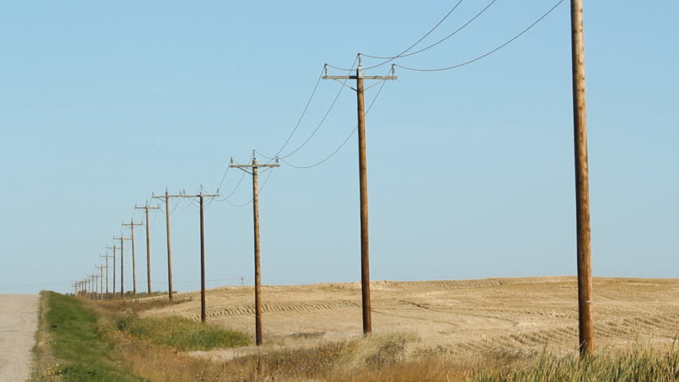

Materials
Purchased or stock
Used for eligible work
Need invoices, historical data, or vendor quotes

Slide 24
Procurement & Contracting
Procurement is subject to 2CFR Part 200.317-326 SDCL 5-18A
Applicants must have adopted an official procurement policy and upload a copy of their procurement policy to their Grants Portal account.
Resources:
  SDOEM Procurement Fact Sheet
  SD Procurement Technical Assistance Center www.aptac-us.org

Slide 25
Contracts
All contracts incurred for eligible work are reviewed on a case by case basis.
Competitive procurement procedures are strongly recommended
Provide full and open competition
Lump sum contracts are acceptable
  Easy to monitor when the scope of work is well defined; requires minimum labor for monitoring; quantities do not have to be documented
Time and material contracts should not be used except for emergency circumstances – must be monitored and have a price cap

Slide 26


Ineligible Contracts
Cost-plus percentage of cost
Contingent upon FEMA reimbursement
Contract with a debarred contractor www.sam.gov/

Slide 27
Large or Small Project???
Depending on the amount of expenses incurred applicants receive either a large project or small project based on the dollar amount
Differences between large and small projects:
  Project threshold
  Payment
  Closeout
Category Z Management cost projects will go through closeout regardless of project size.

Slide 28
Small Projects
Must meet the minimum amount of:
  DR4664 $3,500
    Between $3,500 and $999,999
Based on estimate or actual costs written in the Project Worksheet
Paid upon Project Worksheet approval
No extra closeout procedures beyond verification that work is complete.

Slide 29
Large Projects
If the project is in excess of:
  DR4664 $1,000,000
Based on estimate or actual costs written in the Project Worksheet
Paid upon Project Completion
  Payment made for percentage of completed work at the time of project obligation
  Remainder paid out upon closeout
Requires closeout request and full review by State and FEMA staff

Slide 30
Large Projects
Initial payment based on percent completed
Final Payment – actual documented approved costs
Quarterly Report Requirements
  Until the project is completed, OEM staff will request a progress update once per quarter.
  This update will include total project cost to date and percentage of work completed.
Time Extension requests should be submitted to the State if project completion dates will not be met.

Slide 31
Management Costs
Category Z (Management Costs)
  Applicants are eligible to claim management costs up to 5% of their total project costs but are only paid actual costs spent up to the 5%
  Applicants must have a pay policy in place prior to the declaration date of the disaster
  Documentation of work must be provided, including dates, times, and projects worked on
  Mileage for driving to sites can be claimed
  Management Cost projects are reconciled after all work is completed and Large Project Closeout is completed

Slide 32
Improved Projects
Must be identified to the State in ADVANCE of the start of work
Improvements that increase size, capacity, or add additional functions (not mitigation)
Funds limited to Federal share of estimated costs for facility restoration or project cost, whichever is less
All portions of project reviewed for Special Considerations

Slide 33
Alternate Projects
Repair or expansion of other public facilities, construction of new facilities, demolition or purchase of equipment
Cannot have 406 (PA) mitigation funding
Must be requested within 12 months of scope meeting
All parts of project will be reviewed for Special Considerations

Slide 34
Alternative Procedures for Permanent Work
Applicants will decide project by project if they will utilize alternate procedures or remain in the actual cost program
Capped Grant on the basis of an estimate
FEMA, the recipient, and the applicant agree on capped costs
Only available for Large Projects
Applicants may be permitted to keep any excessive funds
If applicants exceed capped costs, additional costs will be the responsibility of the applicant
Paid out upon Project Worksheet approval

Slide 35

Unspent Funds (Under Runs)
Acceptable uses of unspent funds:
  Hazard mitigation projects on damaged facilities or otherwise eligible facilities
  Activities to improve PA program operations such as training or planning
Require FEMA and State approval

Slide 36
Special Considerations
Environmental and Historic Preservation
Flood Plain
Insurance
Hazard Mitigation

Slide 37





Regulatory Offices

Slide 38
Special Considerations
Environmental and Historic Preservation (EHP)
Ensure all practical means are used to protect, restore, and enhance the environment.
Make sure all regulatory offices are contacted
Obtain all permits and consultations from the regulatory offices
Utilize Best Management Practices
Contact: Charlie Bello (charles.bello@fema.dhs.gov; 720-245-1400)
** Local Regulations Also Apply**

Slide 39
Clean Water Act and USACE Permits
The USACE point of contact for Applicants to call is:
Cathy Juhas, Catherine.D.Juhas@usace.army.mil
USACE South Dakota Regulatory Office, 28563 Powerhouse Road, Pierre, South Dakota 57501.
605-224-8531

Slide 40
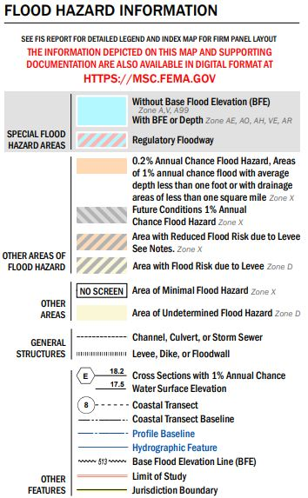
Special Considerations
Flood Plains
Each South Dakota county will have a flood plain manager that can grant permits for working in designated flood hazard areas.
FEMA EHP can assist with determining if your project is in a designated flood hazard area
https://www.fema.gov/flood-maps

Slide 41
Special Considerations
Endangered Species
South Dakota is home to 16 endangered species, including: Topeka Shiner, Northern Long Eared Bat, Whooping Crane, Dakota Skipper, Piping Plover, Black Footed Ferret, and Pallid Sturgeon.
FEMA EHP staff have worked with other Federal agencies on programmatic agreements that help applicants comply with laws and regulations that impact projects in the habitats of endangered species.

Slide 42
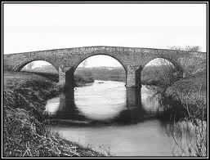
Special Considerations
Historic Preservation
Listing on the National/State Register of Historic Places
Buildings, landscapes, archaeological sites, bridges and water treatment plants, or even Tribal Traditional Cultural Properties
Not necessarily old but important to local, state, or national history
Requires special consideration under Section 106, National Historic Preservation Act
Will be reviewed by FEMA if 50 years or older
Special construction practices may be placed on a PW if deemed Historical

Slide 43
Special Considerations
Insurance
Proceeds (actual or anticipated) deducted from eligible project costs
If a PW is over $5,000 an insurance requirement is placed on items that can be reasonably insured for life
Funds will be paid upon proof of insurance

Slide 44
Special Considerations
Hazard Mitigation
Cost effective measures that reduce the potential for damages to a facility from a future event
Optional
FEMA uses cause of damage to see if 406 Mitigation will apply
Only Permanent Work is eligible for
Hazard Mitigation

Slide 45

Web based system (works best in Google Chrome or Firefox)
Utilized to develop applicant profiles during non-disaster periods
Primary source for uploading damages, descriptions, dimensions, costs, and supporting documentation
Manage your Project Worksheet (PW) from formulation to obligation

Slide 46
How to Access the Grants Portal
The applicant will receive account access via email from support@pagrants.fema.gov (watch your Junk Mail)
Grants Portal web address: https://grantee.fema.gov
Complete your Organization profile(add main points of contact) and register Organization
Add and Manage Personnel, update and maintain information (insurance, IRS forms)

Slide 47
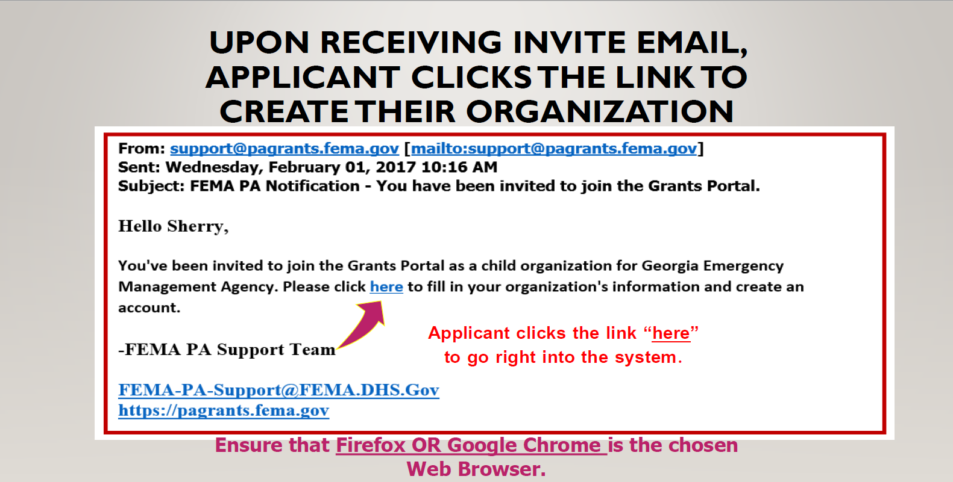

Slide 48
GRANTS PORTAL
You can use Grants Portal to:
  Update your organizations information
  Upload documents
  Complete the Damage Inventory
  File your RPA for disasters
  Complete EEI questions
  Respond to RFI’s
  Sign Project Damage Description and Dimension
  Sign Projects Scope and Cost
Follow your project status throughout the 4 phases of FEMA’s PA process

Slide 49
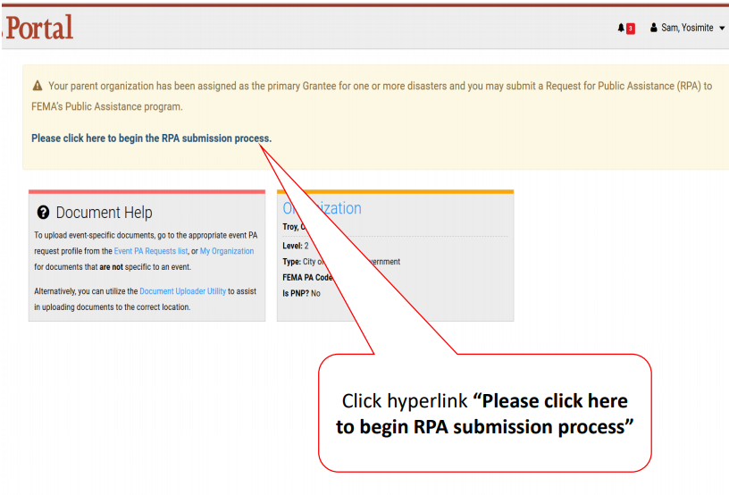
Submitting Your RPA

Slide 50
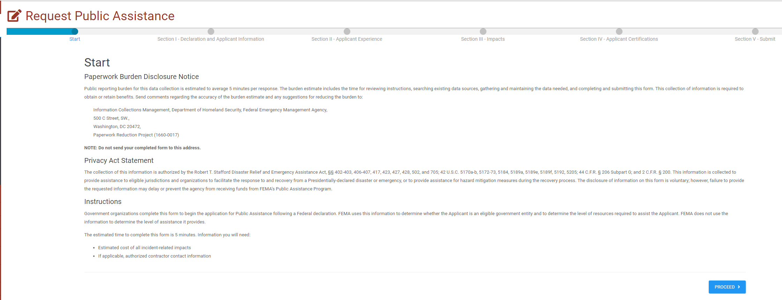
Click the blue Proceed box to advance to the next screen.

Slide 51
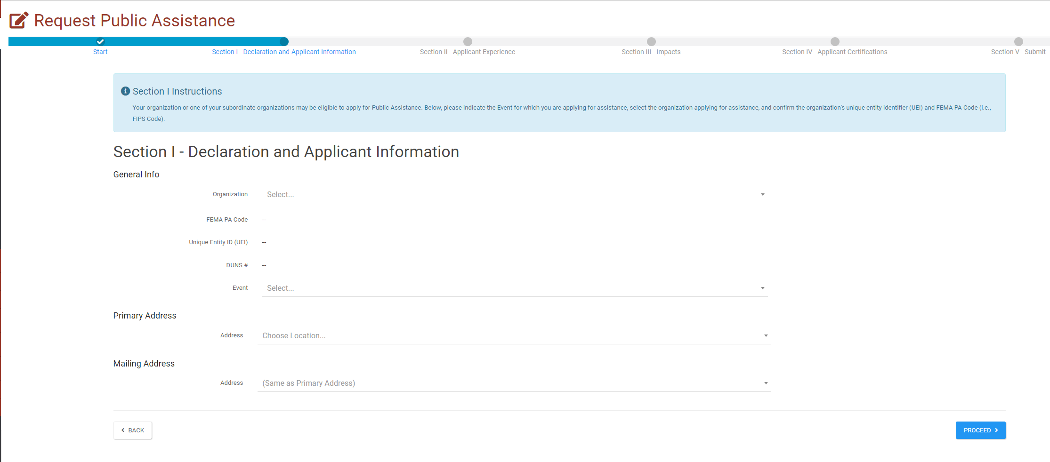
The Event, DR4664, should show up in the Event Dropdown.
If your Grants Portal account has been updated with your UEI number, and you have participated in a disaster through Grants Portal before, your FEMA PA code, UEI, and DUNS # will automatically populate in the respective fields.

Slide 52
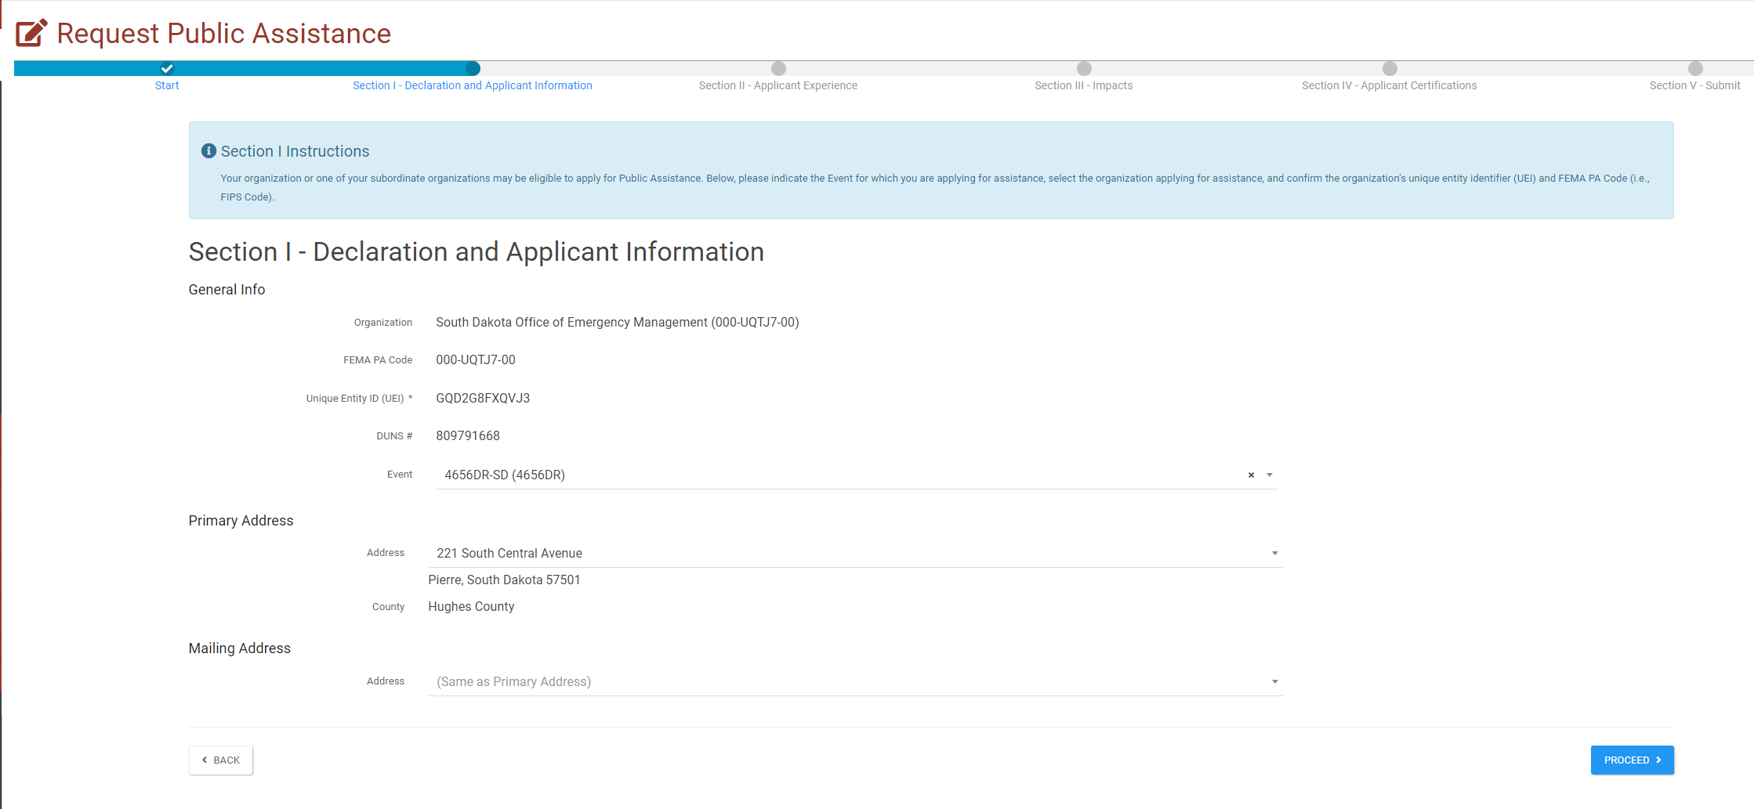
You will be able to select your Primary and Mailing address from these dropdowns. Any address that you have added to your profile in Grants Portal, will show up in these drop downs.
Click the blue Proceed box to advance to the next screen.

Slide 53
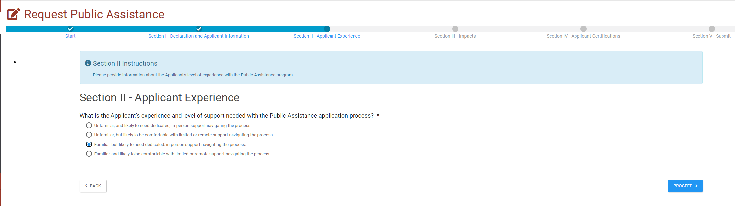
Select your level of familiarity with Grants Portal and the PA process.
Click the blue Proceed box to advance to the next screen.

Slide 54
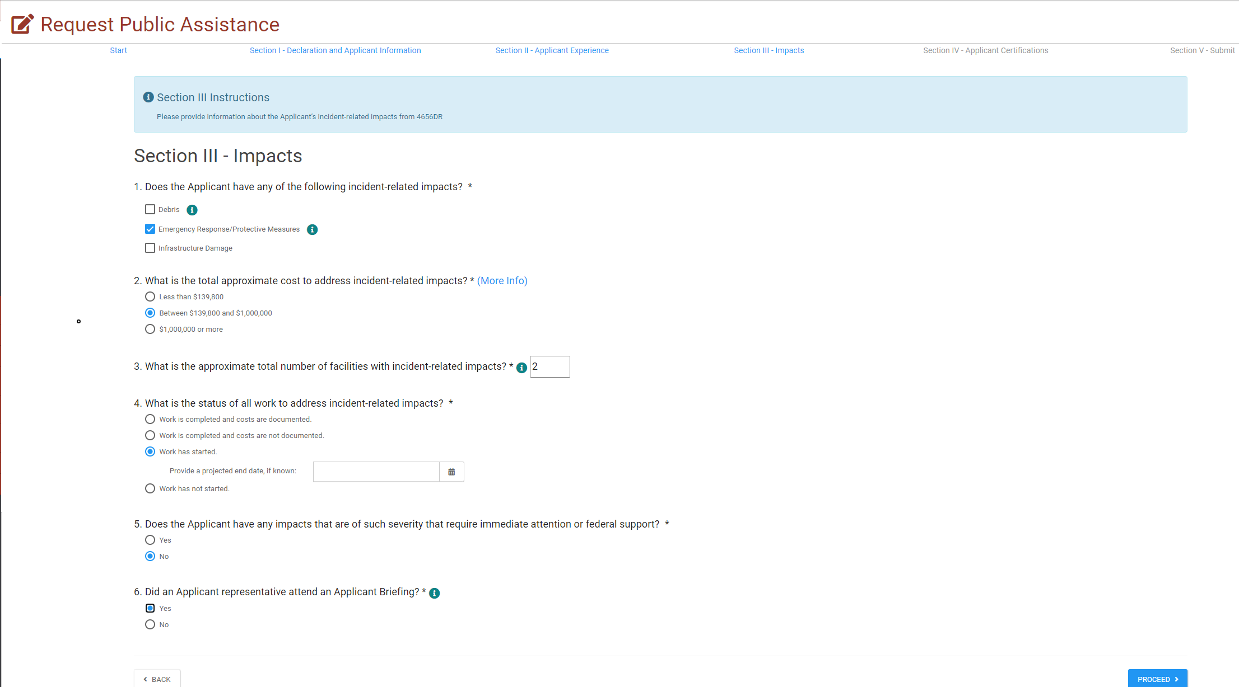
Fill out the questions to the best of your ability. Your answers help provide FEMA with information about the disaster and the types and number of projects they can expect to formulate.
Click the blue Proceed box to advance to the next screen.

Slide 55
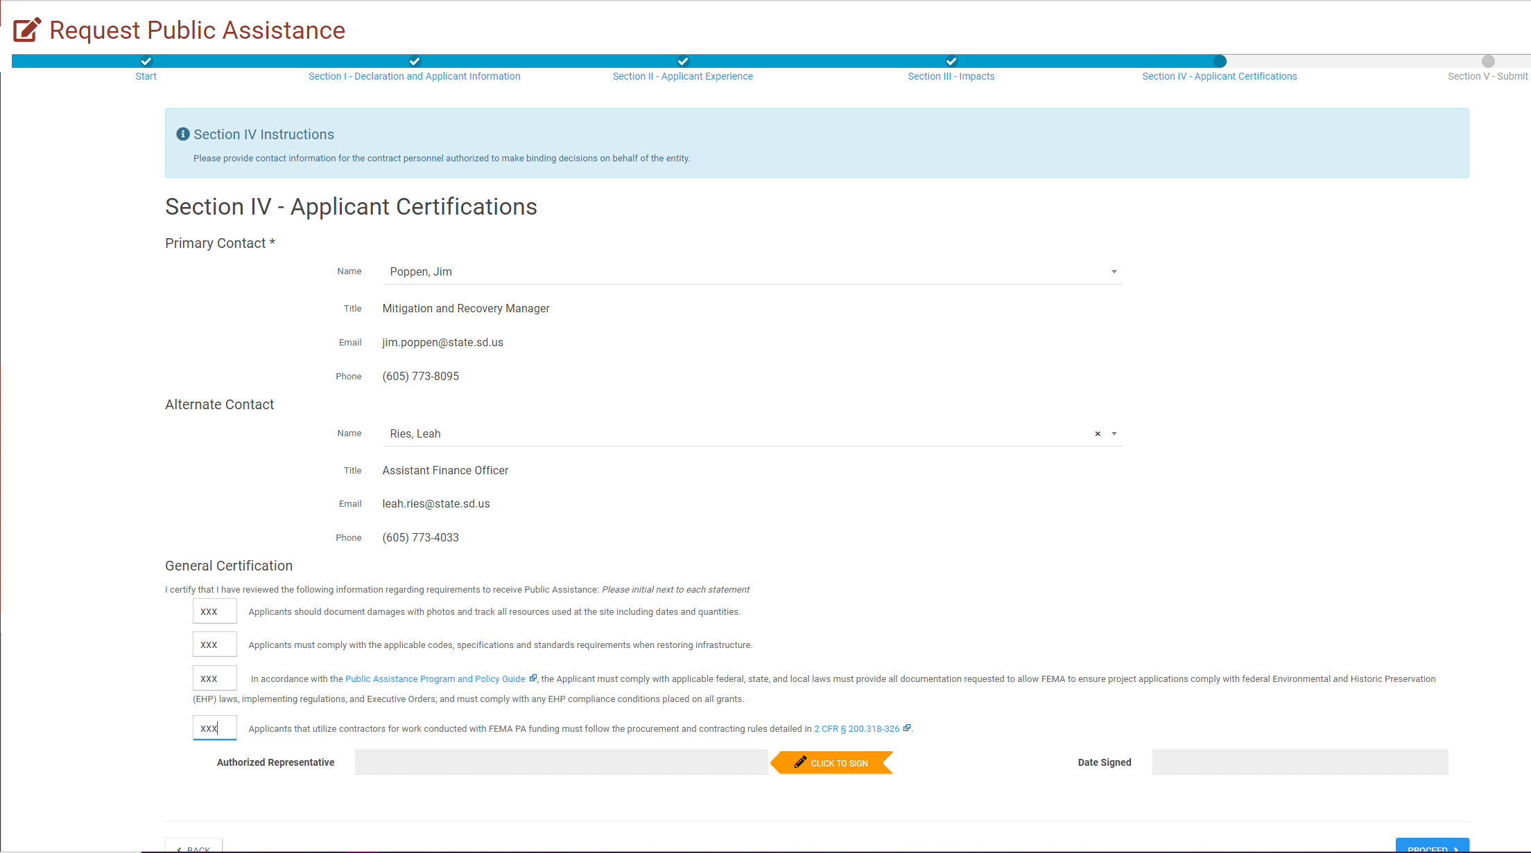
Choose the Primary and Alternate contacts from the drop down list. Any personnel entered into your Grants Portal account will show up in the drop down menus.
Initial in the box next to each certification.
Click the orange Click to Sign box to advance to the signature screen.

Slide 56
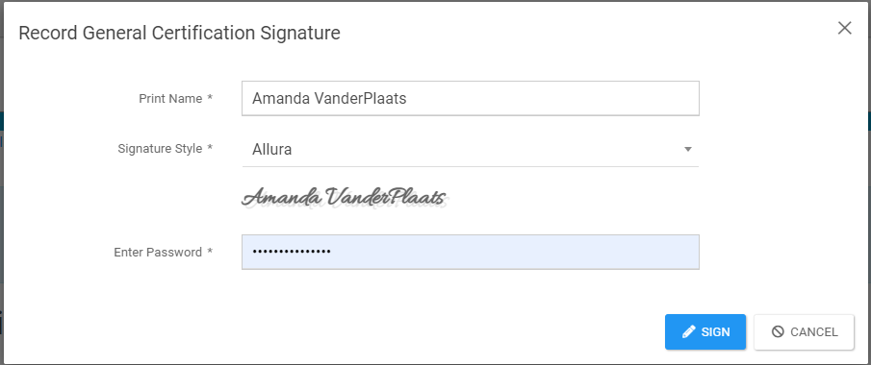
Type your name in the Print Name field. It will automatically show up as a signature in the font style below the box. (You may change the font style)
Enter the password for your Grants Portal account.
Click the blue Sign box to advance to the next screen.

Slide 57
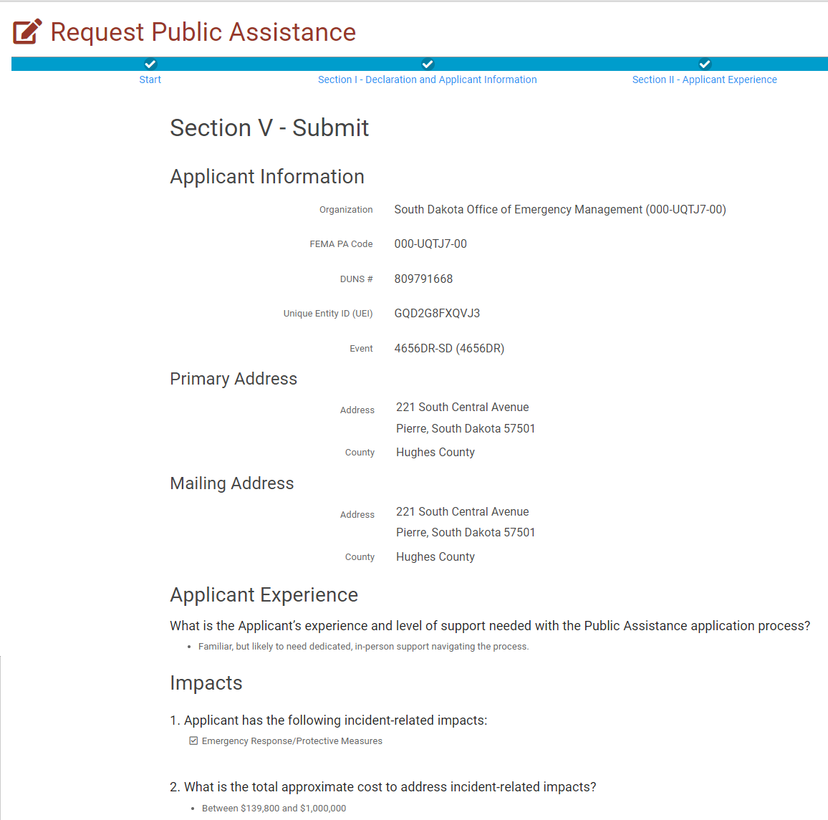
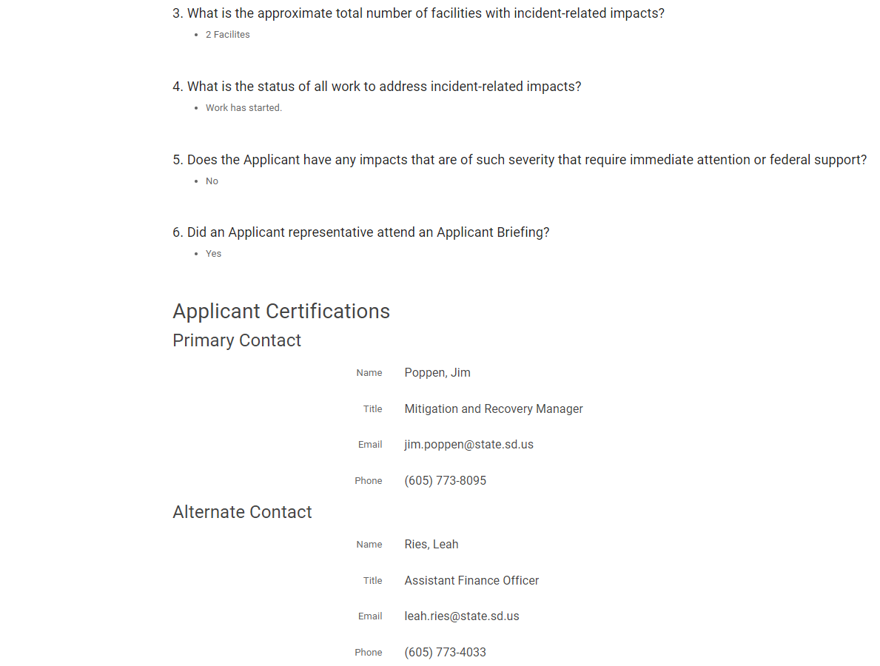
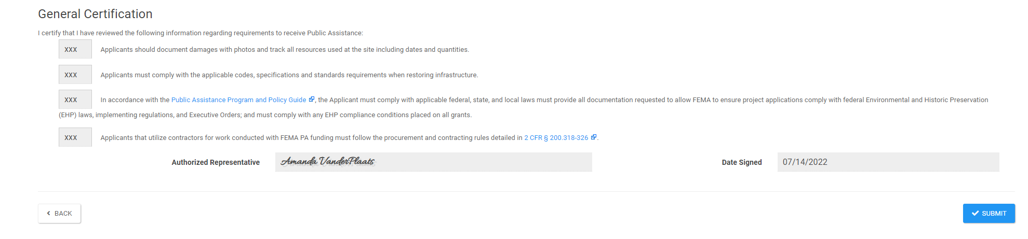
Verify ALL of the information on the RPA form.
Click the blue Submit box to advance to the next screen.

Slide 58
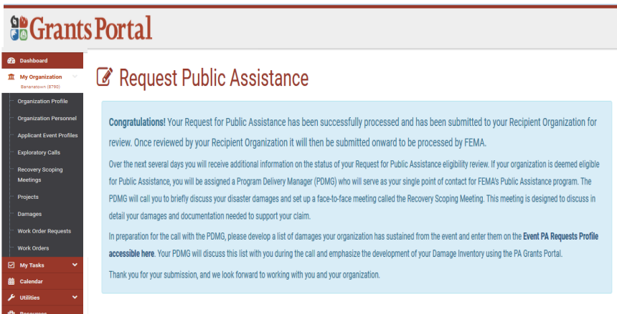

Slide 59
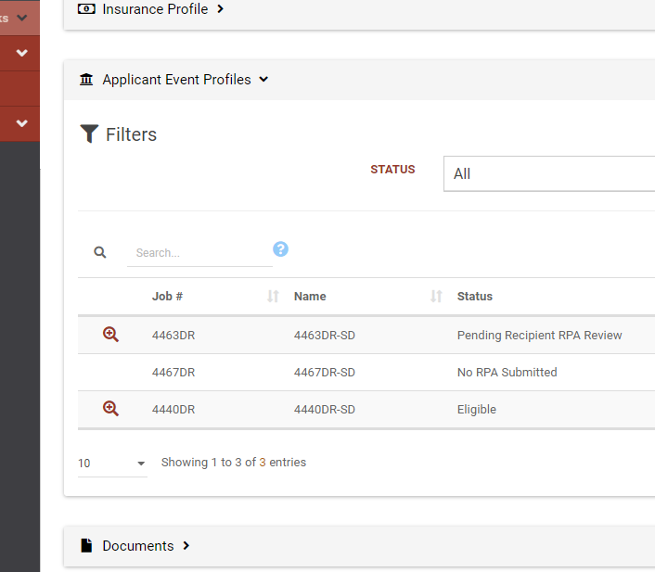
Once your RPA is submitted, the new disaster will show up under your applicant event profiles and a PDMG will be assigned to you.

Slide 60
Damage Inventory
PDMG will assist with completion
Applicant identification of damage sites
Establishes Applicant recovery priorities
Identifies potential 406 Hazard Mitigation
Establishes potential Environmental and Historic Preservation assistance needs
Spreadsheet available through the Grants Portal
  PDMG will assist with importing back into the portal

Slide 61
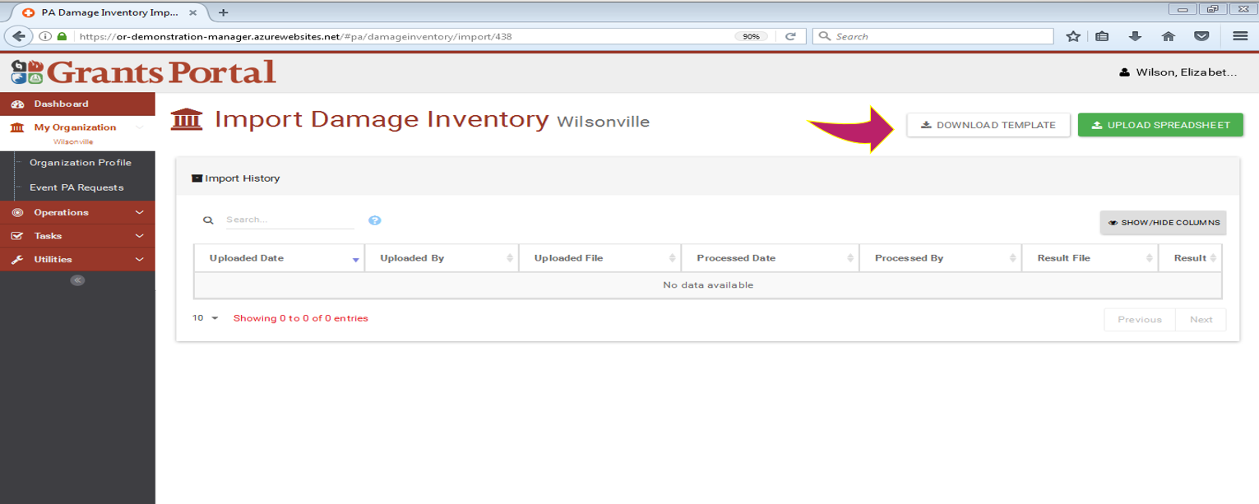

Slide 62
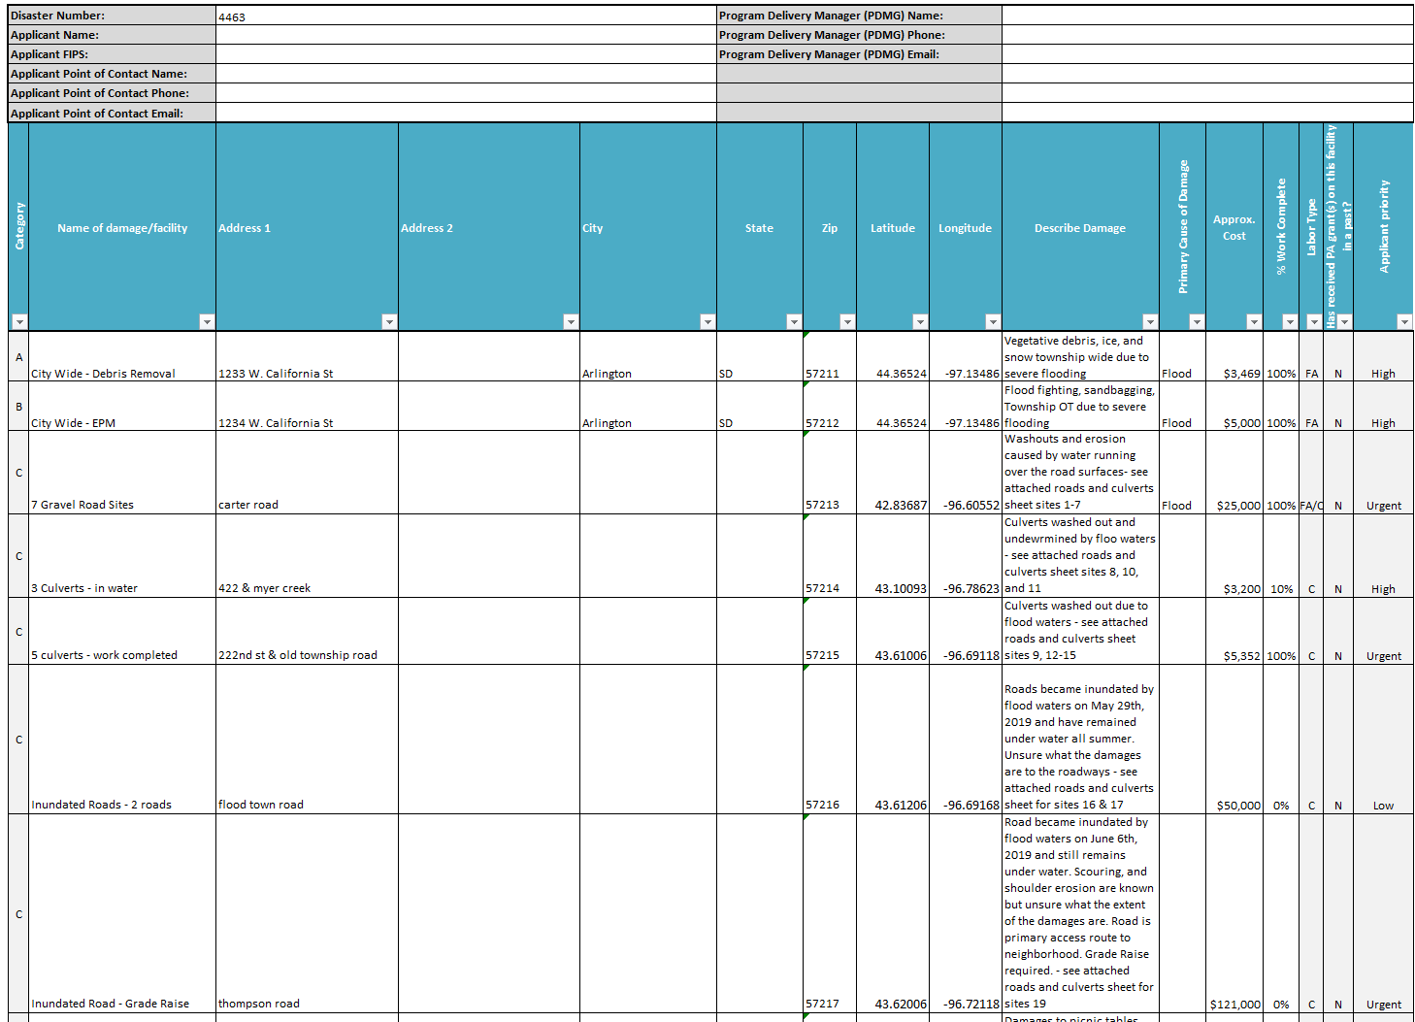
Damage Inventory

Slide 63
Damage Inventory example

Slide 64
Damage Inventory
Be very descriptive about the damage in the spreadsheet. Use a descriptive name like Rockport Road Culvert and not just culvert
Use the information on the Spreadsheets filled out during the PDA as a reference document.
Use one line item per structure/road/bridge/culvert to avoid too many line items
For Coops, please split by transmission, distribution and county
If work is completed break out as a single line item for the completed work

Slide 65
Naming the Damage Inventory Line Item
Ensure the name of the damage line item is clear and distinctive. This is important because the name of the damage auto-populates as the first words of the DDD generated by the Grants Manager.
  “Damaged Road” should be “Mills Road” or “Countywide roads”
  “Building” should be “City Hall” or “Sam Houston Library”
  “Culvert” should be “Old Rockport Road Culvert” or “Smithson Creek Culvert”
  “Category A” should be “Debris removal countywide”

Slide 66
Damage Inventory
Without a complete Damage Inventory:
  Applicant claimed damages are not documented
  Site Inspection Work Orders cannot be processed
  Request for the Essential Elements of Information cannot proceed
  Applicants have 60 days from the recovery scoping meeting to complete their damage inventory.
Complete development of the Damage Inventory prior to the Recovery Scoping Meeting streamlines Public Assistance delivery.

Slide 67

What info is needed?
Damage Inventory, procurement policies, maps, and photos
List of paid staff, regular and OT hours – time cards, fringe benefits info, and pay policy
List of equipment used, hours of operation – dates and times, miles driven, and pertinent records
List of materials and supplies used
Copies of any contracts used for this event
Applicable codes and standards
Hazard Mitigation Proposals
Insurance policies

Slide 68

Documentation
Make sure you have good documentation or your project may be rejected. Start documenting ASAP
Include pictures of damage and any historical photos prior to damage
Verify measurements and location information is correct
Include all permits and correspondence
Include Historical Costs
If structures are included please include building plans or drawings

Slide 69

Funding Breakdown
Federal Share - 75%
State Share - 10%
Applicant Share - 15%
All funding is dispersed by the state. Please do not contact FEMA with funding questions. Contact the SD Office of Emergency Management: 605-773-3231

Slide 70
Payment Process
Project Worksheet is written, approved, and obligated by FEMA
The Federal and State share of funding for each project is calculated
A W9 and signed State Sub-Recipient Agreement are filled out by the applicant and sent to the State
Payment information is sent to applicant via mail
SDOEM requests payment information to SD Auditor’s Office
SD Auditor’s Office sends check to applicant
For additional information please refer to OEM’s payment policy

Slide 71

Payment Notification
Sent to applicant’s agent when FEMA approves or denies a project
Includes payment information, deadlines, and auditing requirements
Includes a copy of the obligated Project Worksheet; please review carefully
Starts time clock for appeal of any FEMA decision (60 days from date of notification)

Slide 72

Appeals
Any determination related to FEMA assistance may be appealed.
Must be filed with the State with in 60 days of the notice of the action being appealed.

Slide 73

Audits
An audit is required if an applicant has received over $750,000 of Federal funds within a calendar year
Common audit findings:
  Not having a debarment and suspension policy
  Lack of internal controls
  Poor contracting practices
  Unsupported costs
  Duplication of benefits
OIG Audit Tips for Managing Disaster-Related Costs

Slide 74
Funds are Lost if Applicants do not:
Ask questions: If something is not clear, ask
Notify the State before a change in scope of work – needs FEMA pre-approval
Obtain required permits per your REC report – USACE, USFWS, SHPO, DANR, THPO
Follow contract procurement procedures
Perform work as described in the approved PW
Keep complete, clear, and accurate records
Remain aware of the PA program deadlines

Slide 75

Record Retention
Applicants are required to retain project documentation for 3 years following the closeout of the DISASTER.
SDOEM recommends retaining documentation longer

Slide 76
What is Next?
Submit completed RPA Package. You are not considered an applicant until all documentation is submitted.
Your PDMG will work with you to schedule the Exploratory Call and your Recovery Scoping Meeting
Projects are identified in preparation for estimating
Damage MUST BE identified within 60 days of Recovery Scoping Meeting, Applicants DO NOT have to wait the full 60 days.

Slide 77
SDOEM Contact Information
South Dakota Office of Emergency Management
221 S Central Ave
Pierre, SD 57501
Phone: (605) 773-3231
Fax: (605) 773-3580
http://oem.sd.gov
Jim Poppen– Recovery and Mitigation Manager
Amanda VanderPlaats – PA Coordinator
Dustin Hight– PA Coordinator

Slide 78

Questions?

