Slide 1
Submitting a Request for Public Assistance

Slide 2
Update Grants Portal
Before you begin your RPA submission, update your Grants Portal account.
The following information will automatically populate on the RPA form from your Grants Portal applicant profile:
UEI & TIN/EIN
Personnel (primary and alternate contacts)
This includes name, e-mail, and phone number
Primary and Mailing address

Slide 3
Submitting Your RPA
When you log in to Grants Portal, you will have a bar across the top of your dashboard that prompts you to submit a request for Public Assistance.

Slide 4
The first screen that pops up will be a standard disclosure. Click the blue Proceed box to advance to the next screen.

Slide 5
The Event, DR4689, should show up in the Event Dropdown. If your Grants Portal account has been updated with your UEI number, and you have participated in a disaster through Grants Portal before, your FEMA PA code, UEI, and DUNS # will automatically populate in the respective fields.

Slide 6
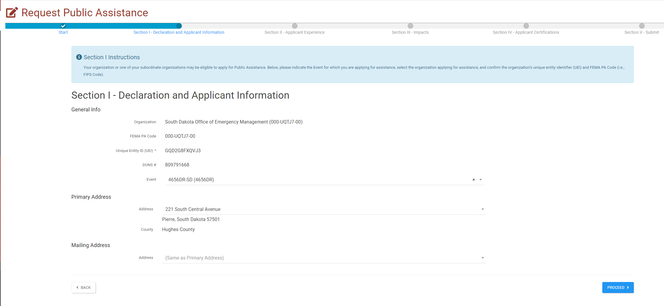
You will be able to select your Primary and Mailing address from these dropdowns. Any address that you have added to your profile in Grants Portal, will show up in these drop downs. Click the blue Proceed box to advance to the next screen.

Slide 7
Select your level of familiarity with Grants Portal and the PA process. Click the blue Proceed box to advance to the next screen.

Slide 8
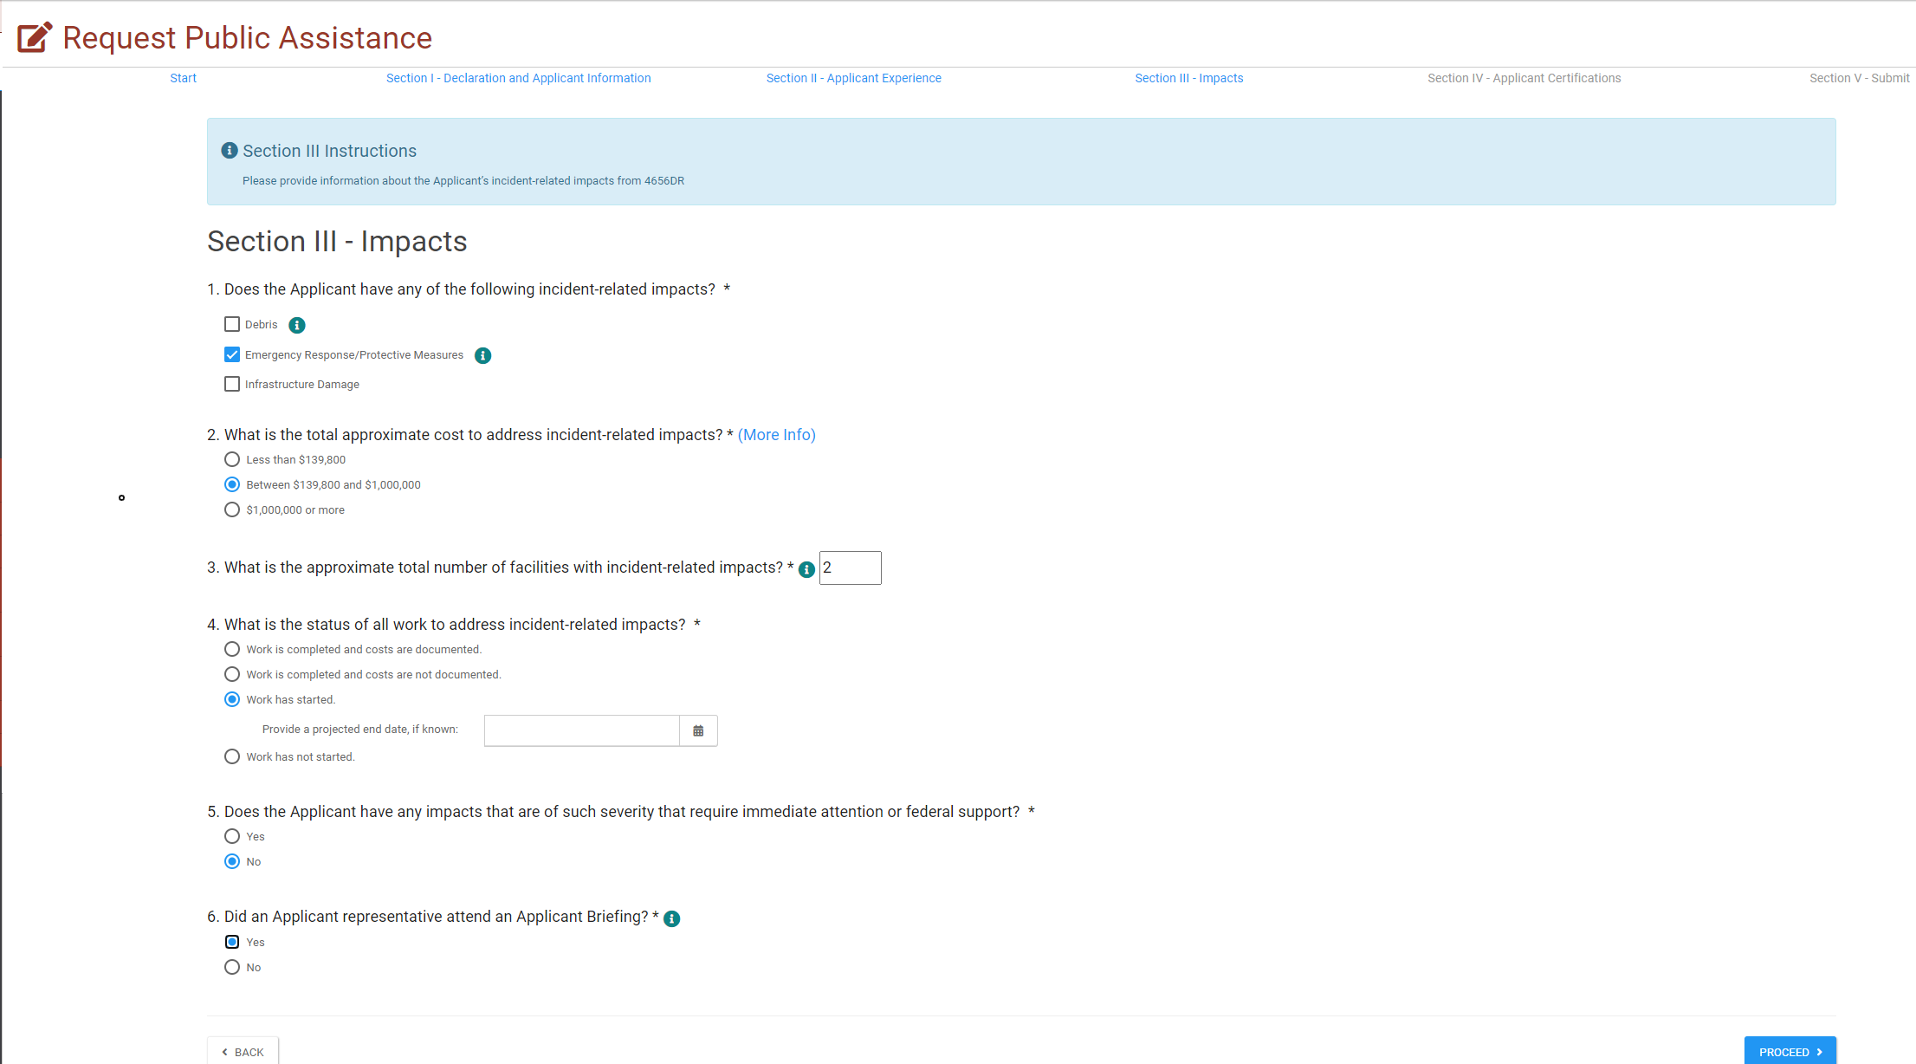
Fill out the questions to the best of your ability. Your answers help provide FEMA with information about the disaster and the types and number of projects they can expect to formulate. Click the blue Proceed box to advance to the next screen.

Slide 9
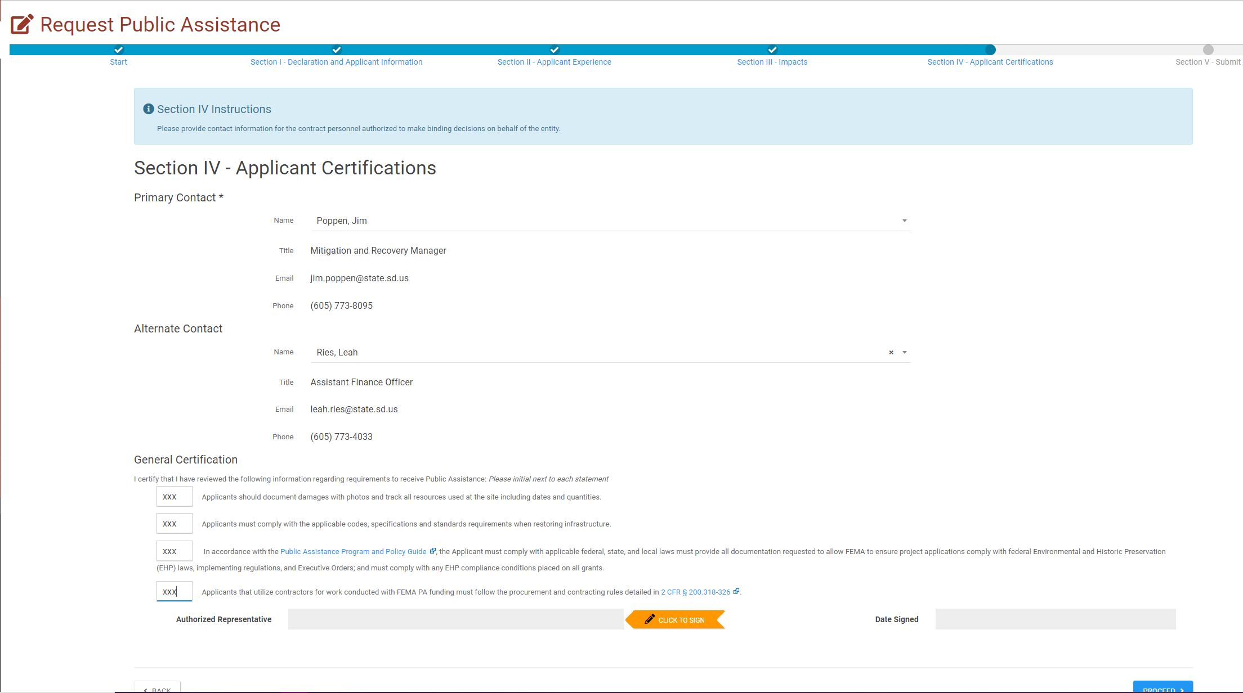
Choose the Primary and Alternate contacts from the drop-down list. Any personnel entered into your Grants Portal account will show up in the drop-down menus. Initial in the box next to each certification. Click the orange Click to Sign box to advance to the signature screen.

Slide 10
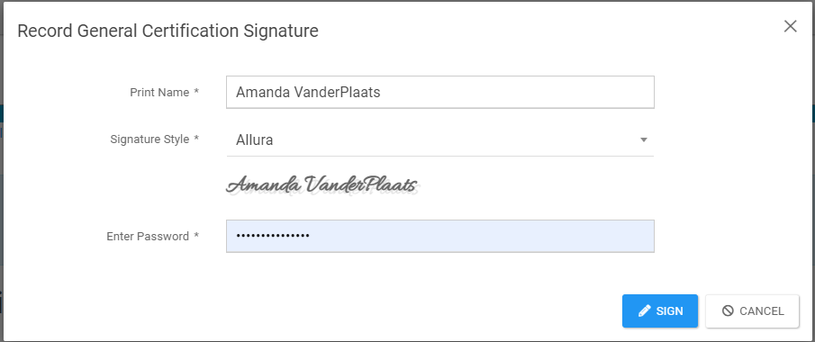
Type your name in the Print Name field. It will automatically show up as a signature in the font style below the box. (You may change the font style) Enter the password for your Grants Portal account. Click the blue Sign box to advance to the next screen.

Slide 11
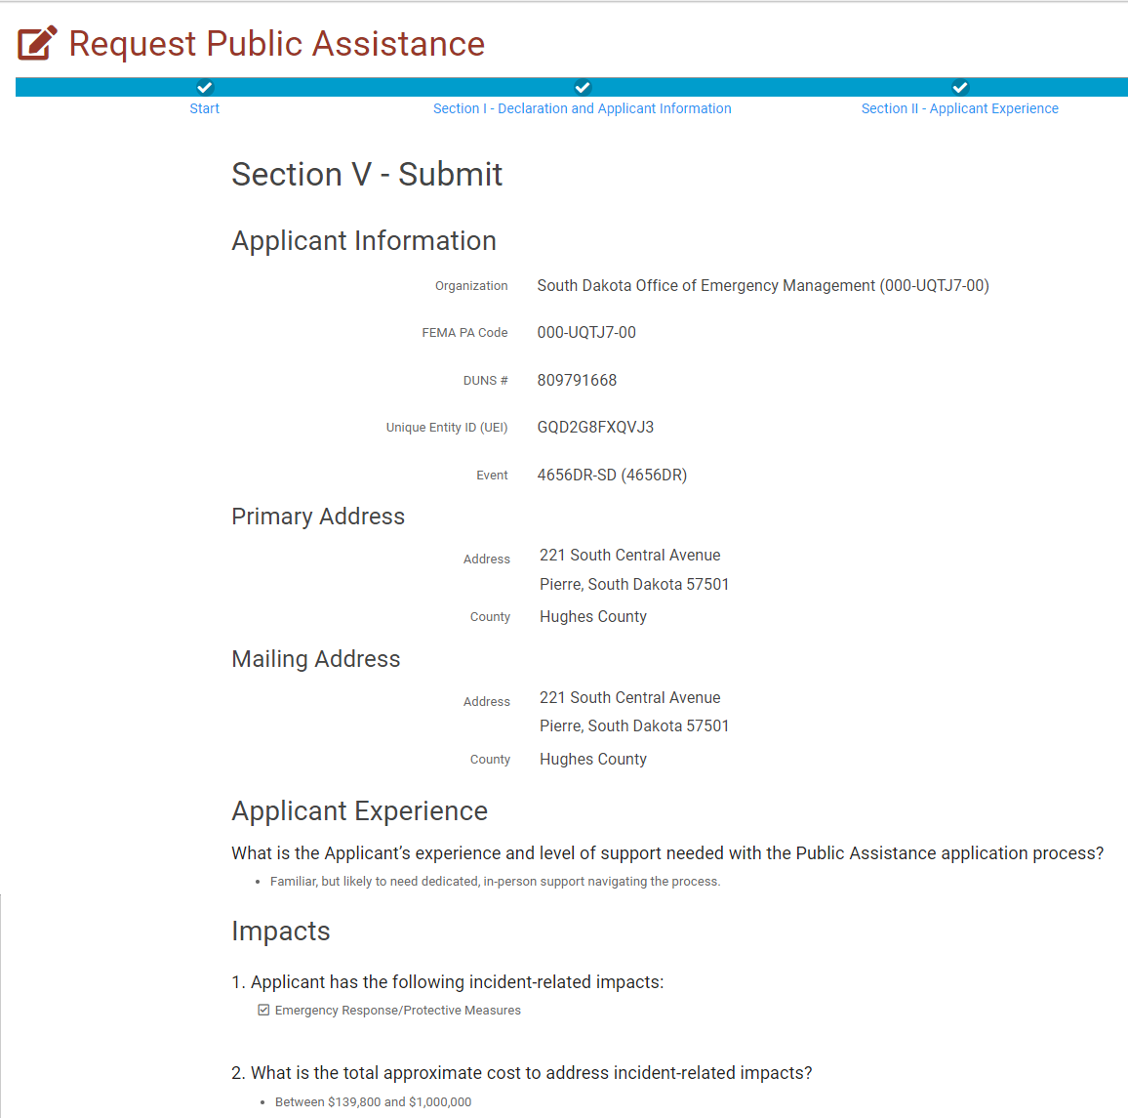
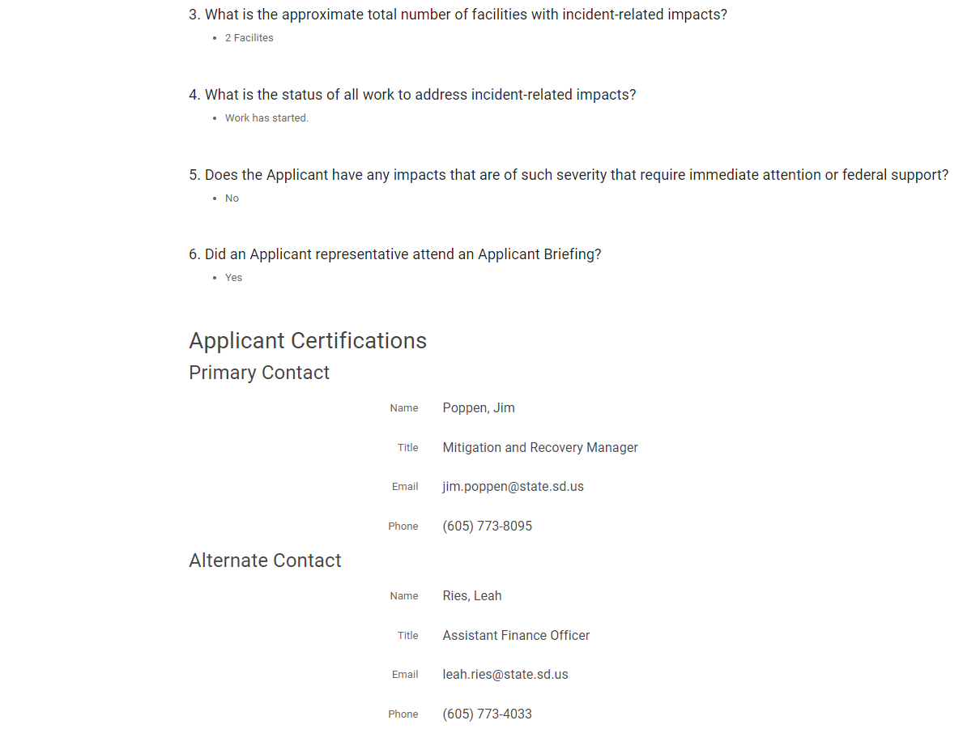
Verify ALL of the information on the RPA form. If any information is incorrect, click the Back button to make corrections. Click the blue Submit box to submit your RPA.

Slide 12
Once your RPA has been submitted, you will be re-directed to your Grants Portal Dashboard and see a box indicating that your RPA has been successfully submitted.

Slide 13
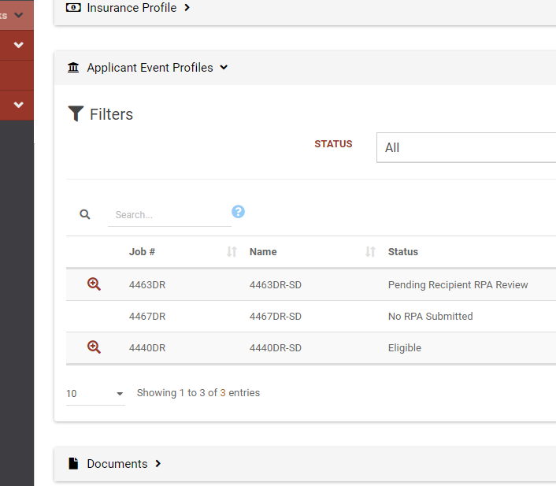
Once your RPA is submitted, the new disaster will show up under your applicant event profiles. Two State POCS and a PDMG will be assigned to you for the duration of the disaster. You can find the contact information for State and FEMA POCs in your applicant event profile.

Slide 14
Any Questions?
South Dakota Office of Emergency Management
Dustin Hight - Recovery Team Lead
Amanda VanderPlaats - Public Assistance Coordinator
Dale Farmen- Public Assistance Coordinator
Colby Jensen - Public Assistance Coordinator
Call (605) 773-3231 with any questions!
Notes:
Amanda

